Slide 1
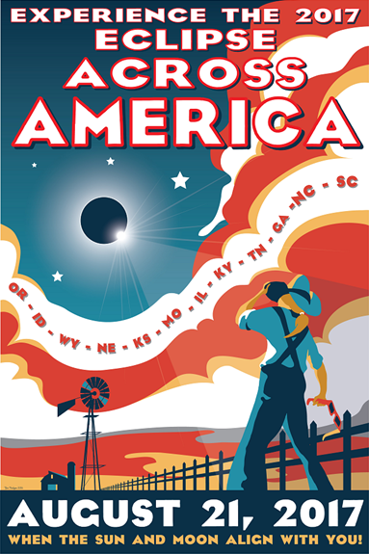
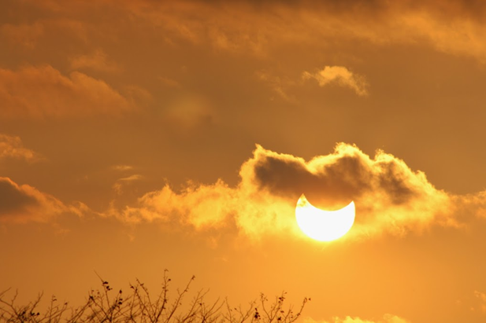
Solar Eclipse 2017 Workshop I
Vayujeet Gokhale Truman State University
http://observatory.truman.edu/eclipse2017/

Slide 2
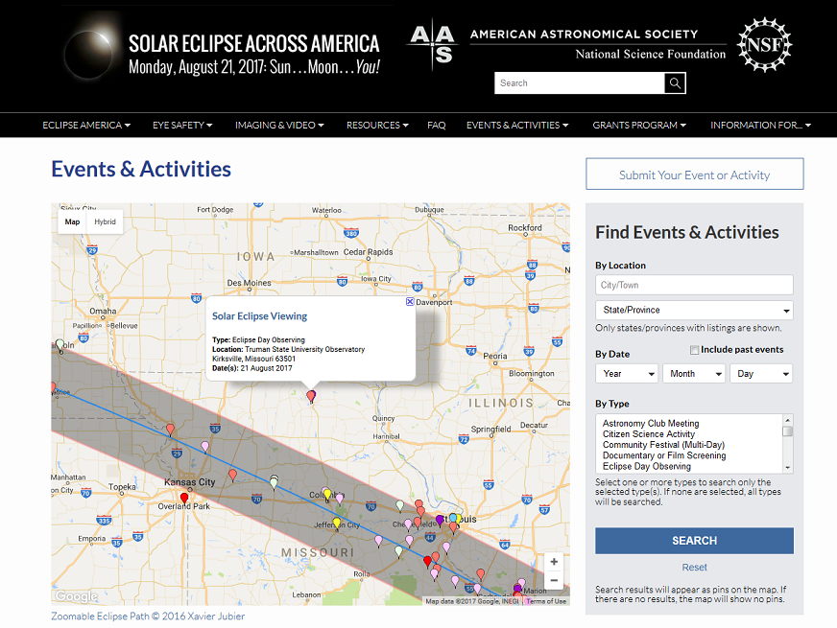

Slide 3
Outline of Talk
Some History
Sun-Earth-Moon Geometry
Tidal Locking & Synchronous Rotation
Phases of the Moon
Lunar Eclipses
Solar Eclipses

Slide 4
History: What have we learnt from Observing Solar Eclipses?
The Sun has a REALLY hot corona!
The surface temperature of the Sun is about 6000 K.
The coronal temperature could be a million to 10 million K.
How can gas so far away form the Sun’s core be this hot!?
Test Einstein’s theory of General Relativity
The Discovery of Helium
Helium lines were first observed in the Sun’s spectra during the 1868 eclipse.
The Solar Radius

Slide 5
The Sun, Earth, Moon System A Few Questions
Why does the same side of the Moon always face the Earth?
Why does the Moon show phases?
Why do we have Eclipses?
What causes a Lunar Eclipse?
What causes a Solar Eclipse?

Slide 6
Sun-Earth-Moon Geometry: Basics
The Earth and Sun go around their common center of mass
It takes one year to complete one orbit
The Earth and Moon go around their common center of mass
It takes about 27 days, 7 hours to complete one orbit but,
It takes about 29 days, 12 hours from one full Moon to the next full Moon
Somewhat incorrectly, we usually refer to these phenomena as: “The Earth goes around the Sun” and “The Moon goes around the Earth”, etc.

Slide 7
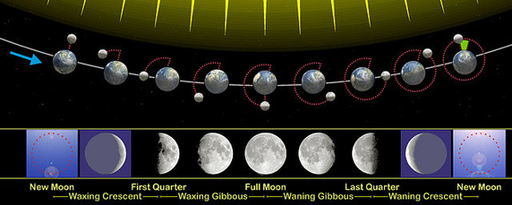
Geometric-Month & Phase-Month
earthsky.org

Slide 8
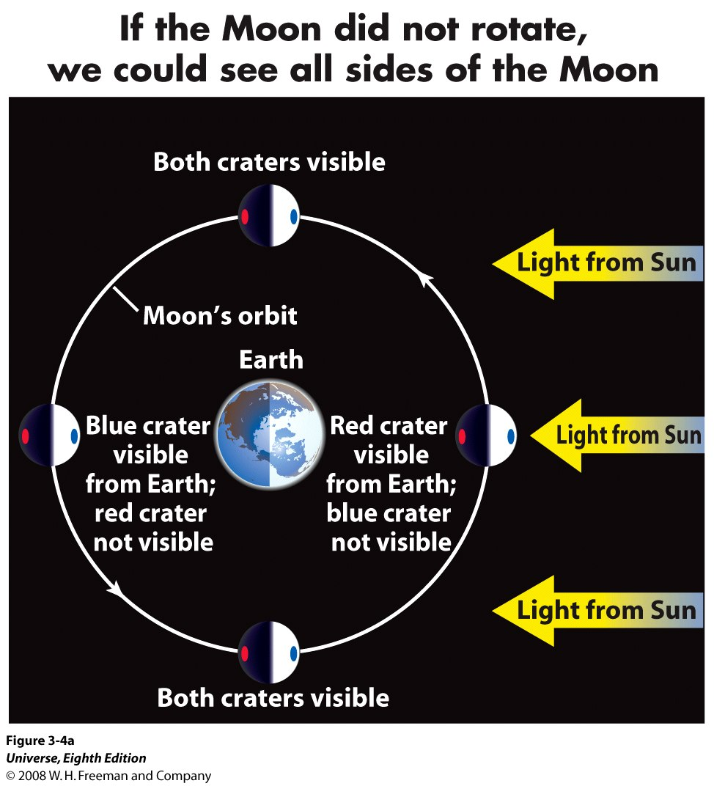
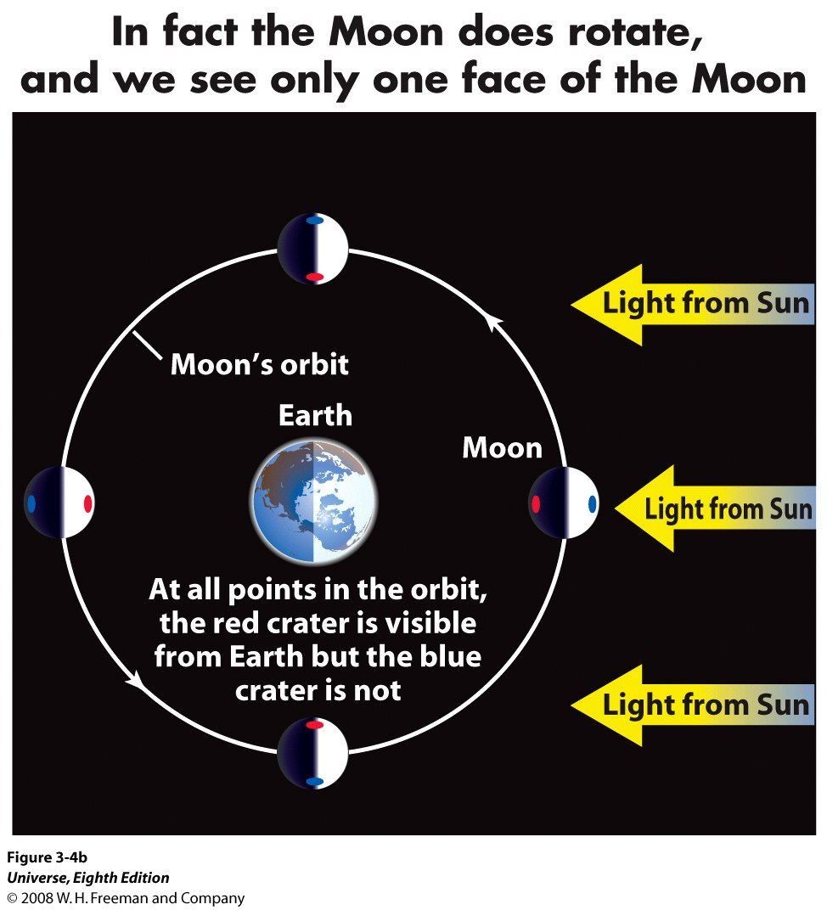
Tidal Locking & Synchronous Rotation
Why does the same Side of Moon Face Earth?

Slide 9
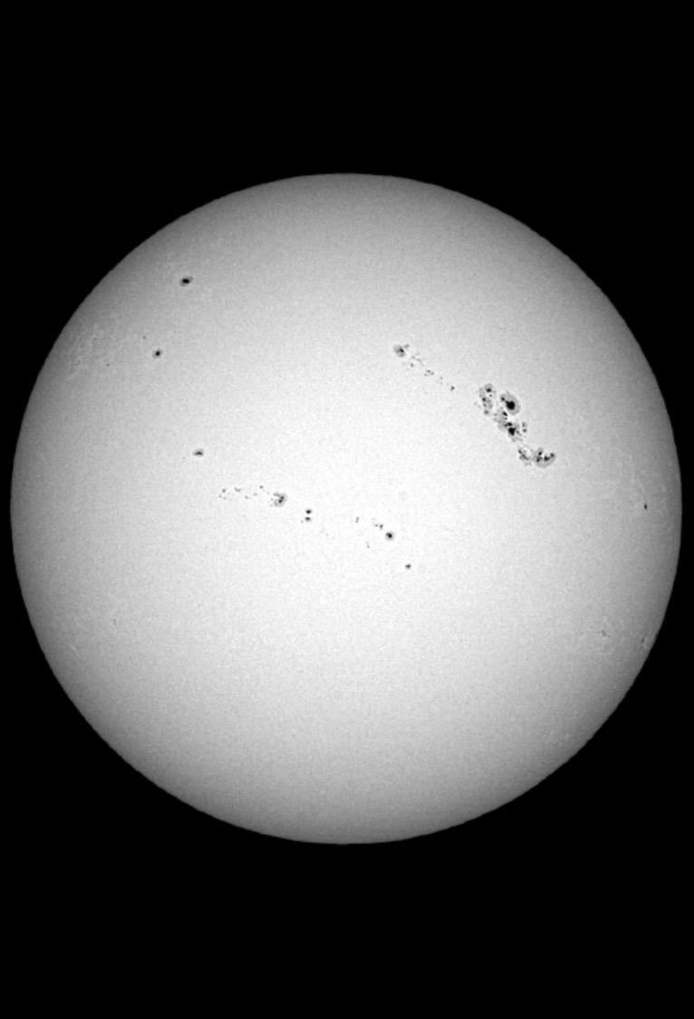
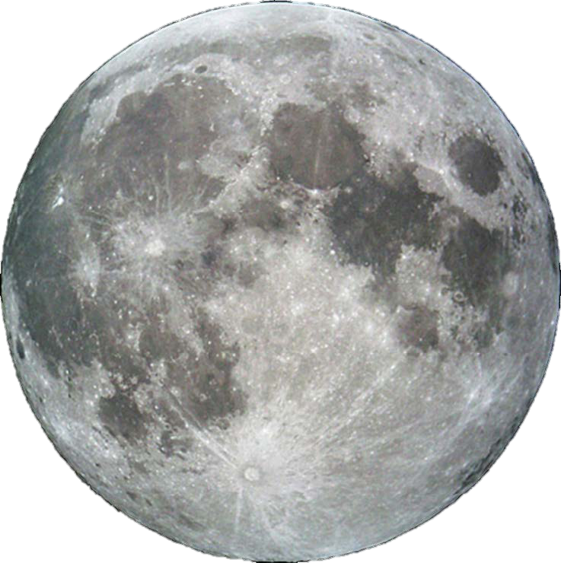
Cosmic Coincidence!?
The Sun’s diameter is ~400x the Moon’s diameter, but the Sun is also ~400x farther away from Earth!

Slide 10
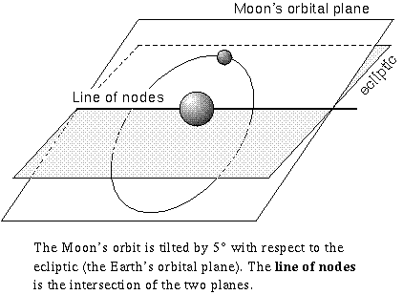
Eclipses
We know that the Moon is orbiting the Earth, the Earth is orbiting the Sun and both the Moon and the Earth are spinning about their own axes.
We ask the question, why doesn’t the Moon block the Sun every month?
Answer: The Moon’s orbital plane is tilted with respect to the ecliptic – the tilt is about 5⁰.
Eclipses can occur only if the Sun, the Moon and the Earth are all along the line of nodes.

Slide 11
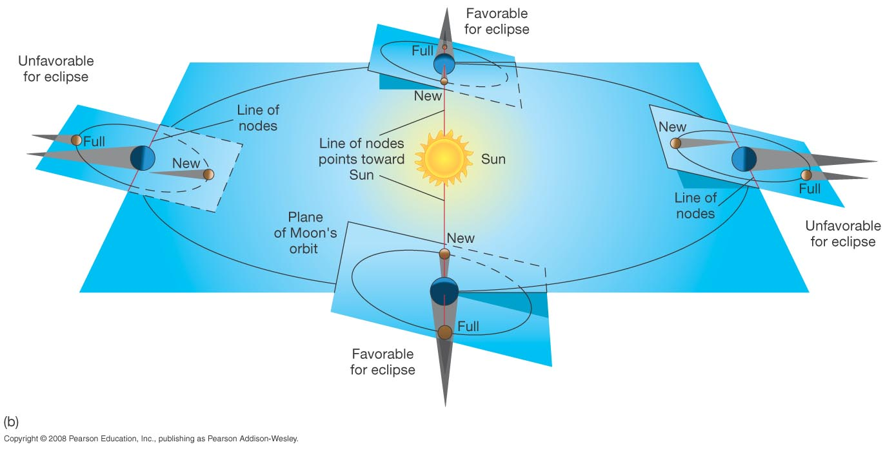
Eclipses
Why do we have Eclipses?
Eclipses can occur only twice a year, since only twice during an year are the Sun, the Moon, and the Earth aligned along the line of nodes.

Slide 12
Eclipses
Situation during most new moons
Situation during an Eclipse – occurs less often

Slide 13
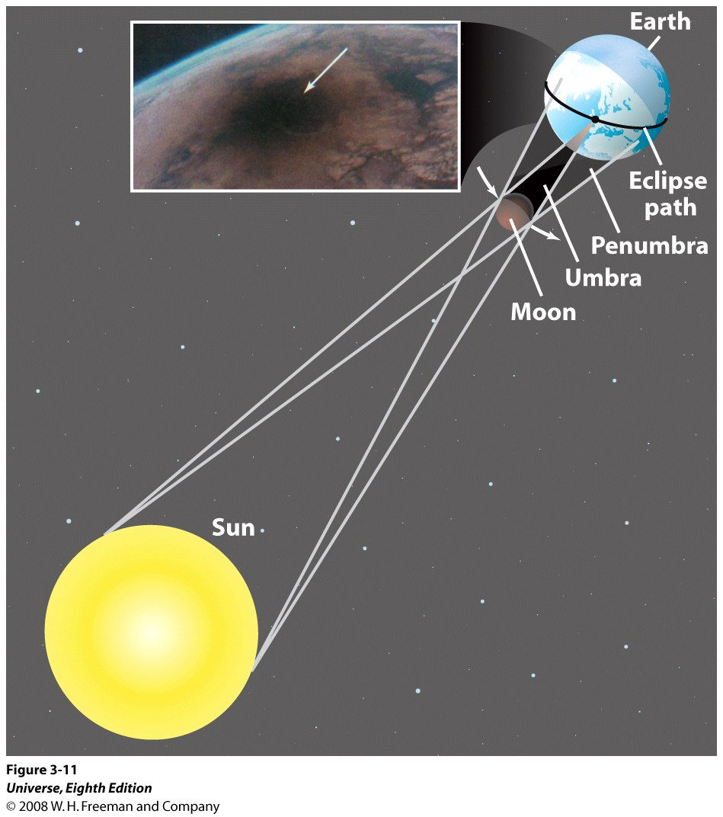
Solar Eclipses

Slide 14
Solar Eclipses
Only the regions over which the umbra falls can experience the total solar eclipse, called “totality”.
The umbra is only a few kilometers in size.
And, since the Earth and the Moon are in motion, the duration of totality is only a few minutes – its never greater than 7.5 minutes!
The umbra traces a path over the surface of the Earth, called the Eclipse path. Only the regions in the eclipse path will observe totality.
"John Beckman (United Kingdom) and other scientists use a Concorde supersonic passenger jet flying at 1,250 miles per hour (2,000 kilometers per hour) over Africa to extend the duration of solar eclipse totality to 74 minutes--10 times longer than can ever be observed from the ground“ (1973)

Slide 15
The Sun, Earth, Moon System
Why don’t eclipses occur on every New Moon day and every Full Moon day?
Why don’t eclipses occur on the same days every year?

Slide 16
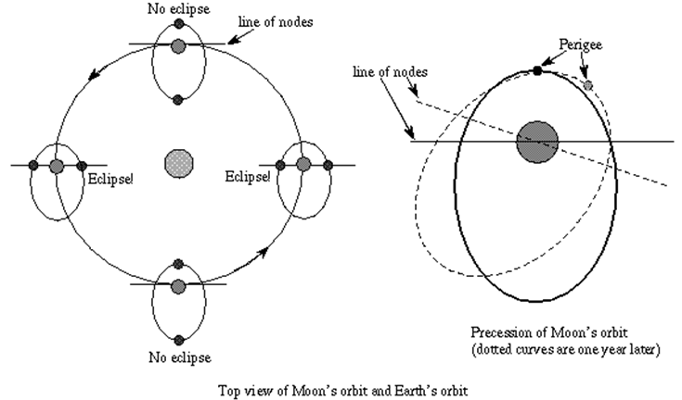
Orbit of the Moon: Eclipses do not occur on the same date and time every year.
astronomynotes.com

Slide 17
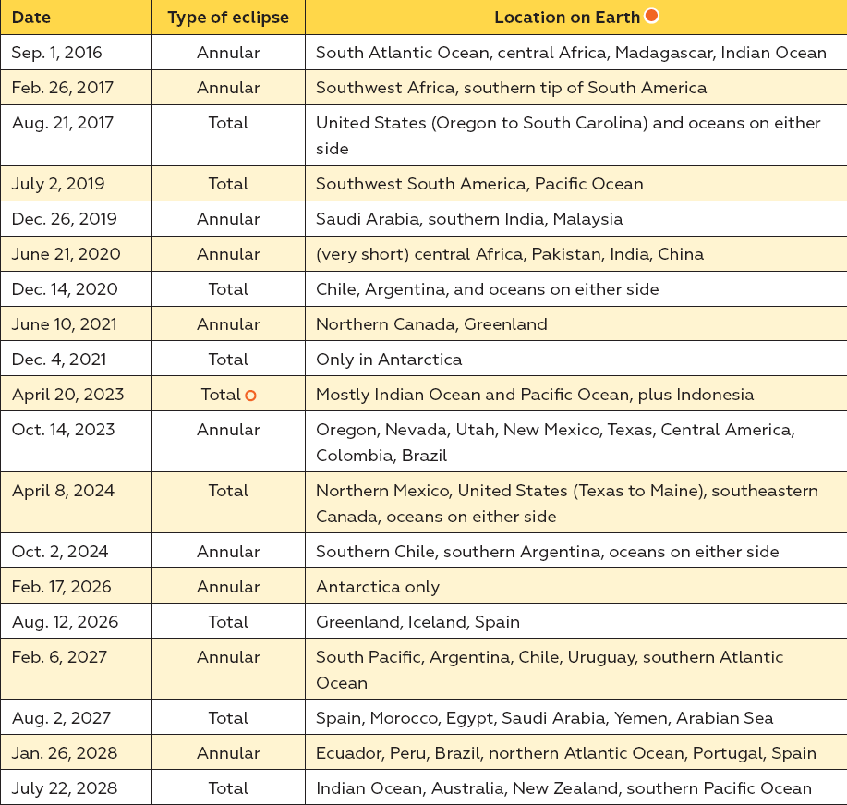
Solar Eclipse 2017

Slide 18
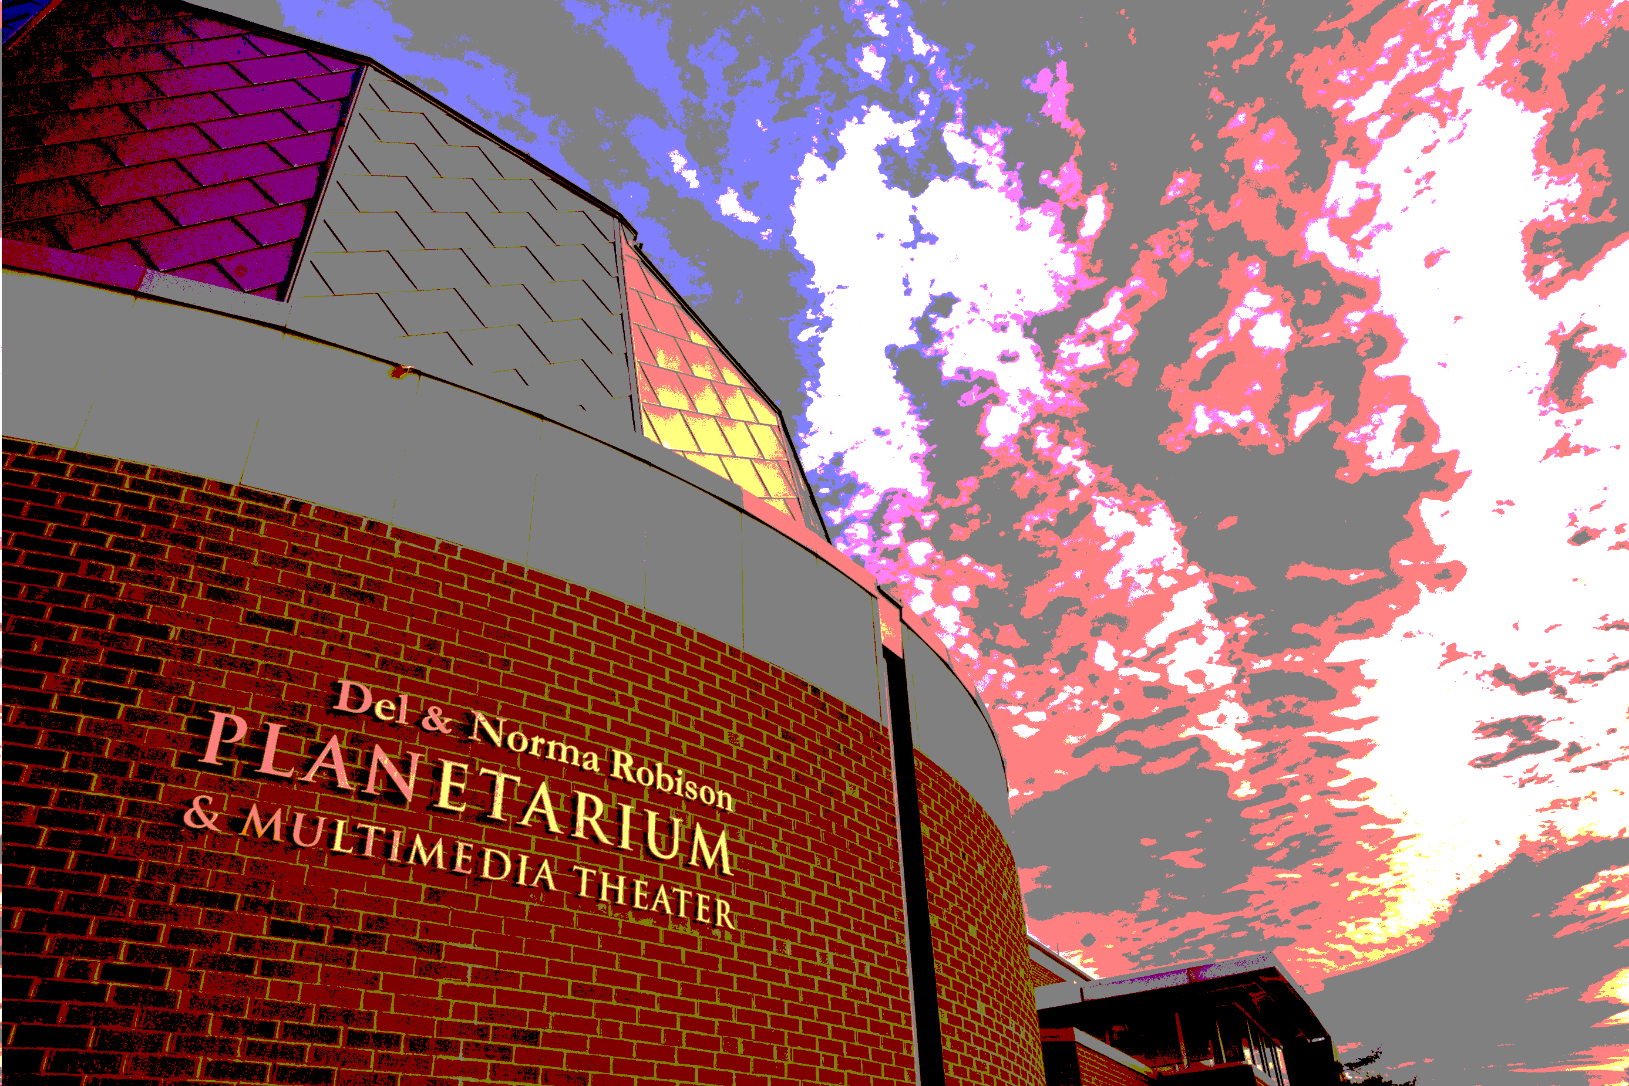
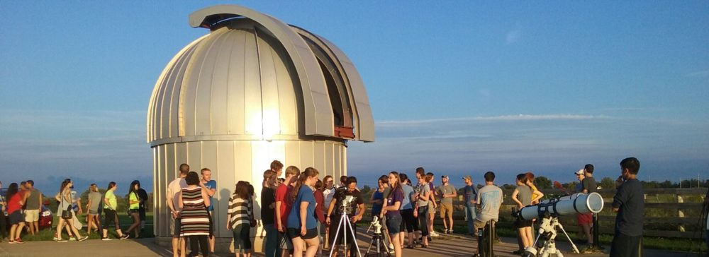
Eclipse 2017 in Kirksville

Slide 19
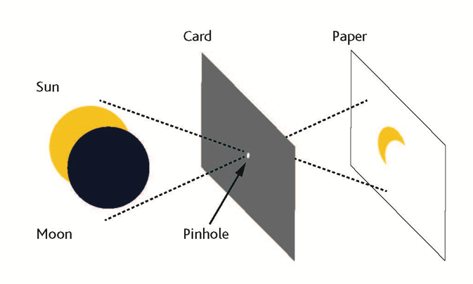
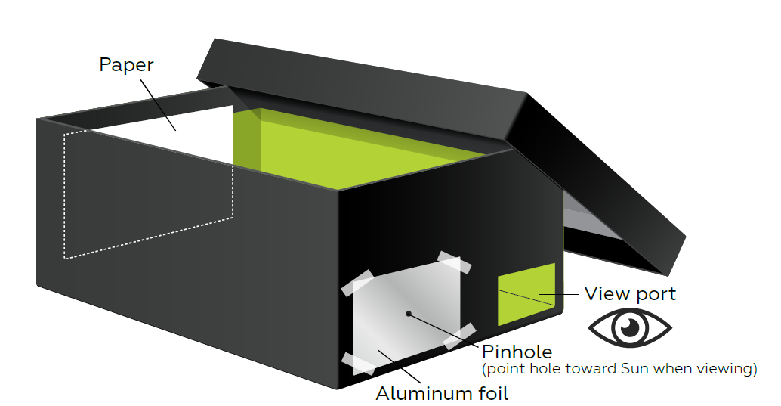
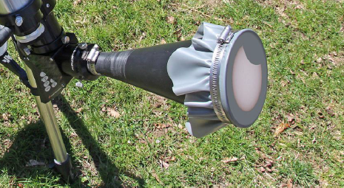
Activities and Information Handouts
How to make a pinhole camera http://www.jpl.nasa.gov/edu/learn/project/how-to-make-a-pinhole-camera/ http://static.nsta.org/extras/solarscience/chapter3/3.10PinholeProjectionInABox.pdf
How to build a sun-funnel: https://eclipse.aas.org/sites/eclipse.aas.org/files/Build-Sun-Funnel-v3.2.pdf

Slide 20
Activities and Information Handouts
American Astronomical Society Eclipse Page: https://eclipse.aas.org/resources/educational-materials
Night Sky Network (NASA-JPL): https://nightsky.jpl.nasa.gov/download-view.cfm?Doc_ID=588
NASA Eclipse 2017 Teacher Resource Page: https://eclipse2017.nasa.gov/k-12-formal-education
NASA Museum Alliance Eclipse Page: https://informal.jpl.nasa.gov/museum/content/eclipse-2017
AAPT Eclipse Page: http://aapt.org/resources/eclipse2017/

Slide 21
Podcasts & Webinars
https://www.nasa.gov/nasa-edge/1005-solar-eclipse-2017-preview-show
https://eclipse.aas.org/resources/podcasts-webcasts
https://www.youtube.com/playlist?list=PLo2YDpGbMTNBYH0jWAMunM4oaMJEpe0qf
http://www.nisenet.org/catalog/online-workshop-tips-planning-your-august-21-2017-solar-eclipse-event-recorded
http://www.nisenet.org/earthspacekit-2017
http://transportationops.org/tools/solar-eclipse-webinar-preparing-august-21-2017-webinar-materials

Slide 22
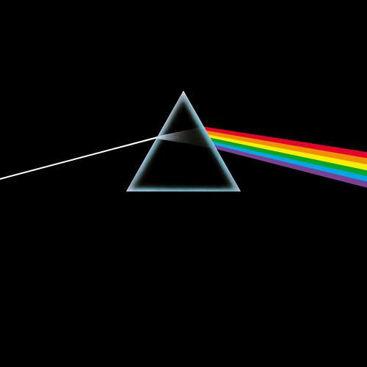
“Eclipse”
All that is now All that is gone All that's to come And everything under the Sun is in tune But the Sun is eclipsed by the moon.
“There is no dark side of the moon really. Matter of fact it's all dark.”

Slide 23
Eclipse 2017 in Kirksville
Extra Slides

Slide 24
History
Eclipses have been the source of much fear, superstition, and also some scientific studies for centuries.
Many cultures have mythological stories associated with eclipses – usually considered a ‘bad omen’ (crucifixion of Christ, wars & famine, etc.)
The earlier reference to a solar eclipse seems to be from two Chinese astronomers in 2137 BCE, though these claims are somewhat dubious.
Mesopotamian records from 1375 BCE mention an eclipse: “On the day of the new moon, in the month of Hiyar, the Sun was put to shame, and went down in the daytime, with Mars in attendance”
https://eclipse.gsfc.nasa.gov/SEhistory/SEhistory.html

Slide 25
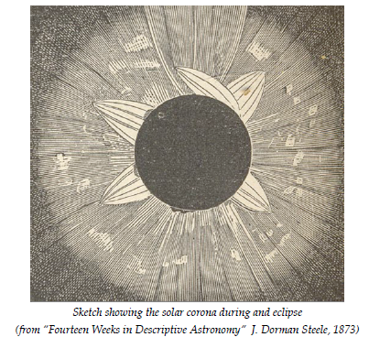
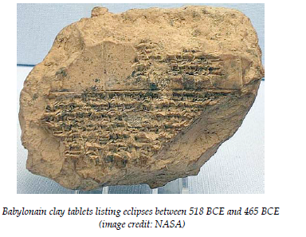
History
http://www.maths.dundee.ac.uk/mhd/Pdfs/wilmotsmith_solar_eclipses.pdf

Slide 26
History
In the ‘modern era’ one of the first scientifically significant comments about an eclipse comes from Kepler: “Johannes Kepler (Germany) is the first to comment scientifically on the solar corona, suggesting that it is light reflected from matter around the Sun (based on reports of eclipses; he never saw a total eclipse)" - Totality - Eclipses of the Sun (3rd ed) - Littmann, Espenak, and Willcox
Edmond Halley also reported witnessing a solar eclipse in 1715.
Soon after, in 1724 and 1733, observers recorded the presence of the Solar Corona and Solar prominences, which were later confirmed to be part of the Sun in 1842.
https://eclipse.gsfc.nasa.gov/SEhistory/SEhistory.html

Slide 27
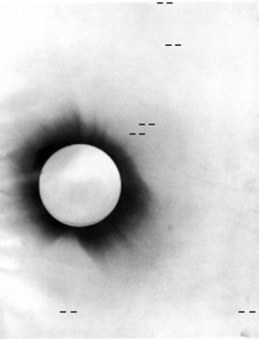
History
The 1919 eclipse was especially important because it presented the first opportunity to definitively test Einstein’s theory of General Relativity.
The proposition was that gravity affected light, space and time itself, and as a result the Sun would deflect starlight passing by it. Changes in the apparent direction of stars in the sky, seen close to the Sun during a total eclipse, could confirm the idea.
Negative photo of the 1919 solar eclipse
http://www.esa.int/Our_Activities/Space_Science/Relativity_and_the_1919_eclipse

Slide 28
The Sun, Earth, Moon System
Why does the same side of the Moon always face the Earth?

Slide 29
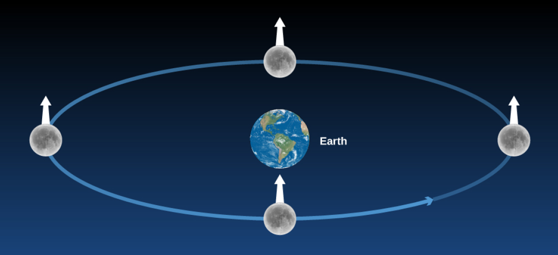
Tidal Locking & Synchronous Rotation
In this figure, we stuck a white arrow into a fixed point on the Moon to keep track of its sides. If the Moon did not rotate as it orbited Earth, it would present all of its sides to our view; hence the white arrow would point directly toward Earth only in the bottom position on the diagram.

Slide 30
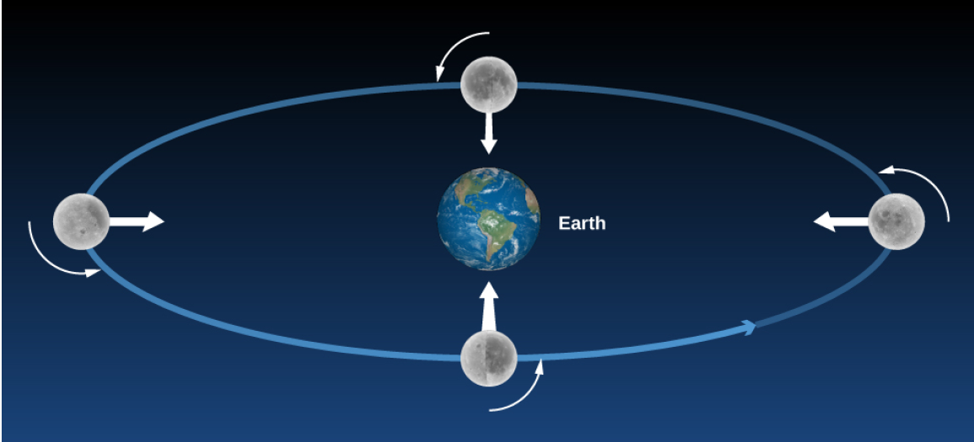
Tidal Locking & Synchronous Rotation
Actually, the Moon rotates in the same period that it revolves, so we always see the same side (the white arrow keeps pointing to Earth).

Slide 31
The Phases of the Moon
The differences in the Moon’s appearance from one night to the next are due to changing illumination by the Sun, not to its own rotation.
Which side is light and which is dark changes as the Moon moves around Earth.
“The back side” is dark just as often as “the front side” (say, on a Full Moon night).
Since the Moon rotates, the Sun rises and sets on all sides of the Moon.
With apologies to Pink Floyd, there is simply no permanent “Dark Side of the Moon.”

Slide 32
The Sun, Earth, Moon System
Why does the Moon show phases?

Slide 33
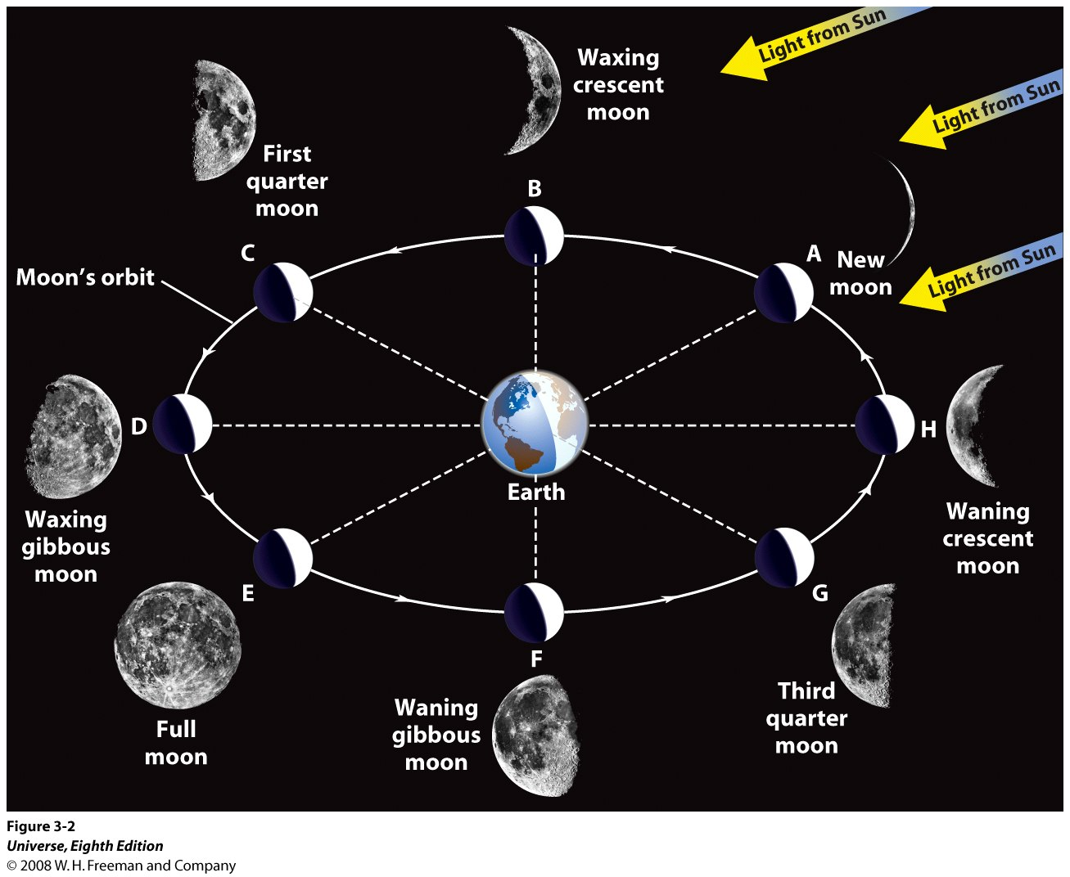
Moon Phase: The Sun, Earth, Moon System

Slide 34
The Sun, Earth, Moon System
Why do we have Eclipses?
What causes a Lunar Eclipse?
What causes a Solar Eclipse?

Slide 35
Lunar Eclipses
A Lunar Eclipse occurs when the Sun, the Earth and the Moon are aligned along the line of nodes, in such a way that the Earth is between the Sun and the Moon, on a Full Moon’s day.
A lunar eclipse may be total, partial or penumbral depending on the exact geometry of the alignment.

Slide 36
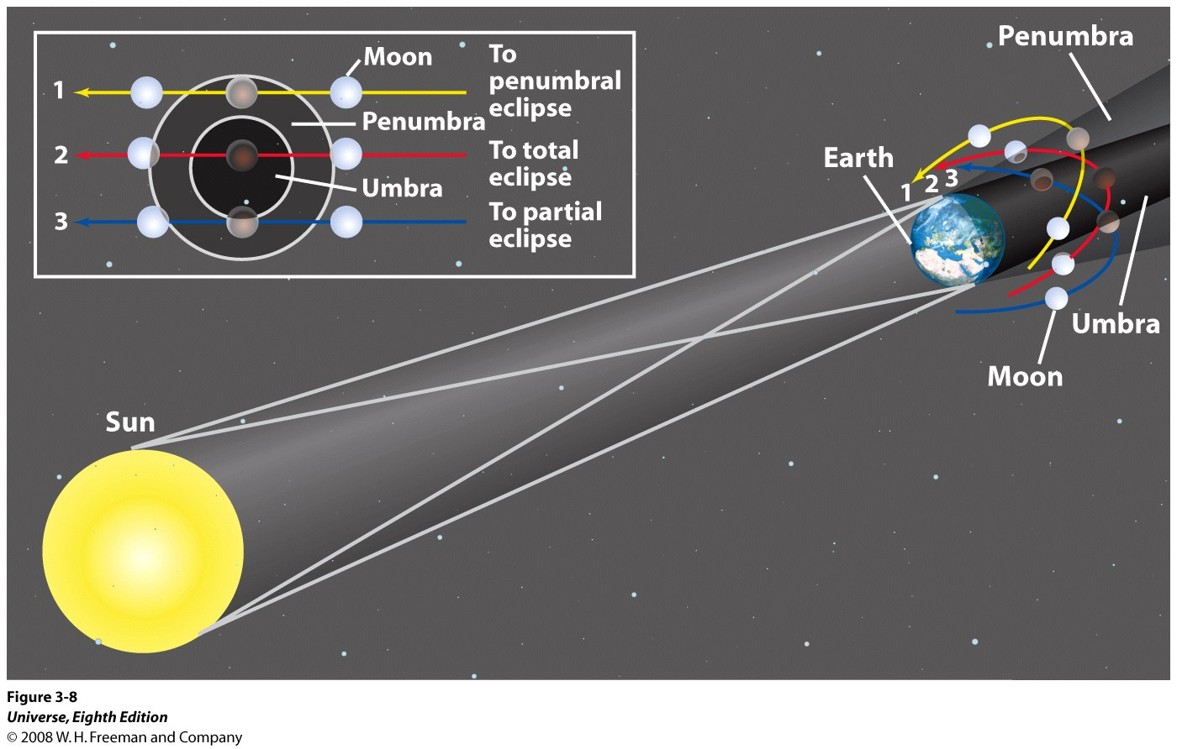
Lunar Eclipses
Situation 1: Penumbral Eclipse
Situation 2: Total Eclipse
Situation 3: Partial Eclipse

Slide 37
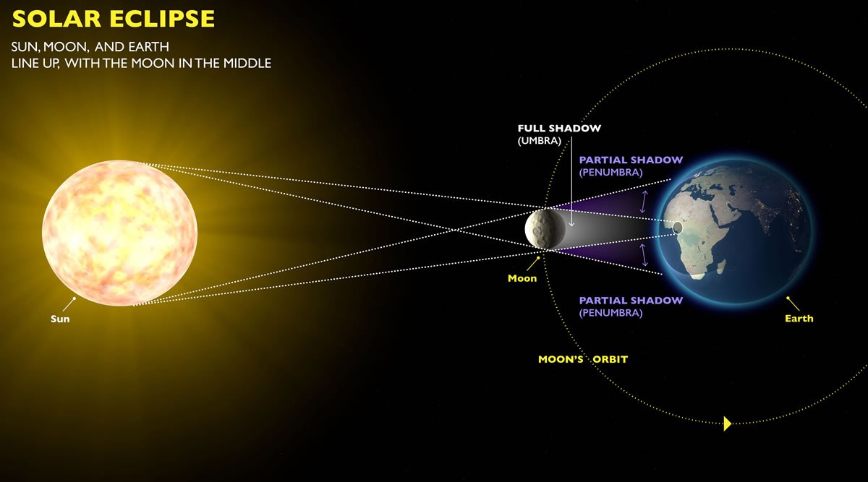
Solar Eclipses
Not to scale © exploratorium.edu

Slide 38
Solar Eclipses
A Solar eclipse occurs when the Sun, the Earth and the Moon are aligned along the line of nodes, and the Moon is between the Sun and the Earth on a New Moon’s day.
A Solar eclipse may be total, partial or annular, depending on the exact geometry of the alignment of the Sun, Moon and Earth.

Slide 39
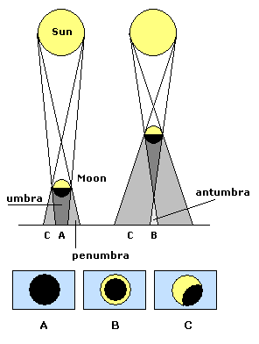
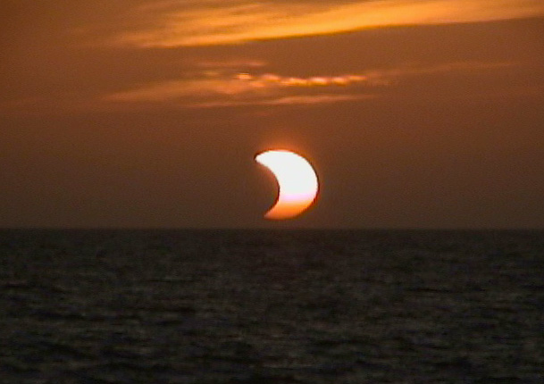
Solar Eclipses
A partial Solar Eclipse
astronomynotes.com

Slide 40
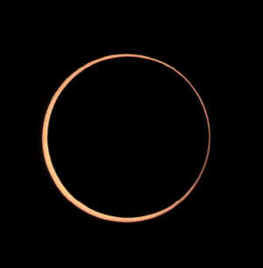
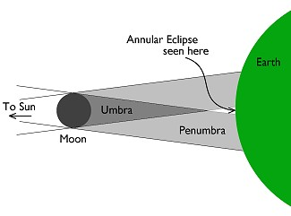
Annular Solar Eclipses
An annular Solar Eclipse
astronomynotes.com

Slide 41
Solar Eclipses
Only the regions over which the umbra falls can experience the total solar eclipse, called “totality”.
The umbra is only a few kilometers in size. Moreover, since the Earth and the Moon are in motion, the duration of totality is only a few minutes – its never greater than 7.5 minutes!
The umbra traces a path over the surface of the Earth, called the Eclipse path. Only the regions in the eclipse path will observe totality.
astronomynotes.com

Slide 42
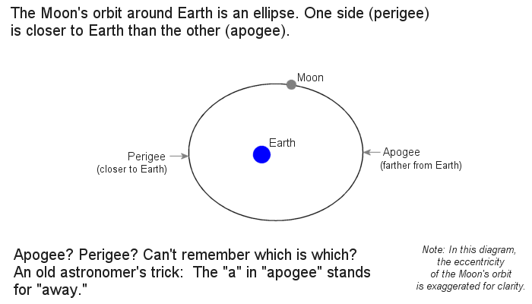
Solar Eclipses
Remember that the Moon’s orbit is an ellipse and not a perfect circle. Thus, the Moon is sometimes closer to the Earth whilst at other times, it moves farther apart and at the opposite side of the orbit, it is at its farthest.

