Slide 1
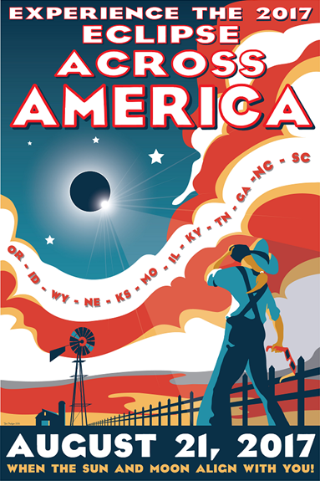
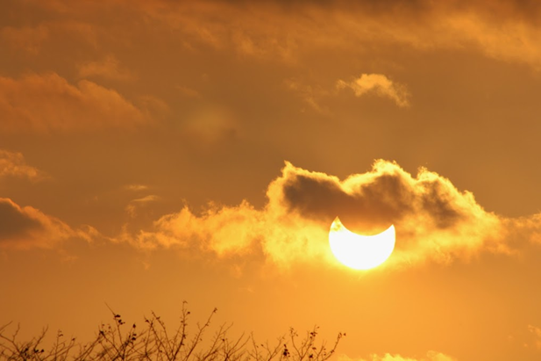







Solar Eclipse 2017
Vayujeet Gokhale
Truman State University
http://observatory.truman.edu/eclipse2017/

Slide 2
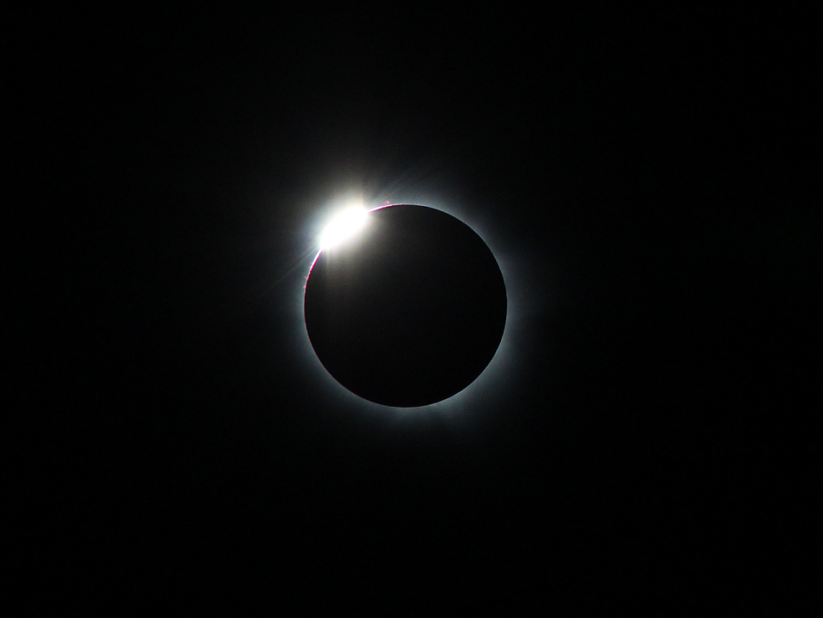
Solar Eclipse 2017
Where will you be on August 21, 2017?

Slide 4
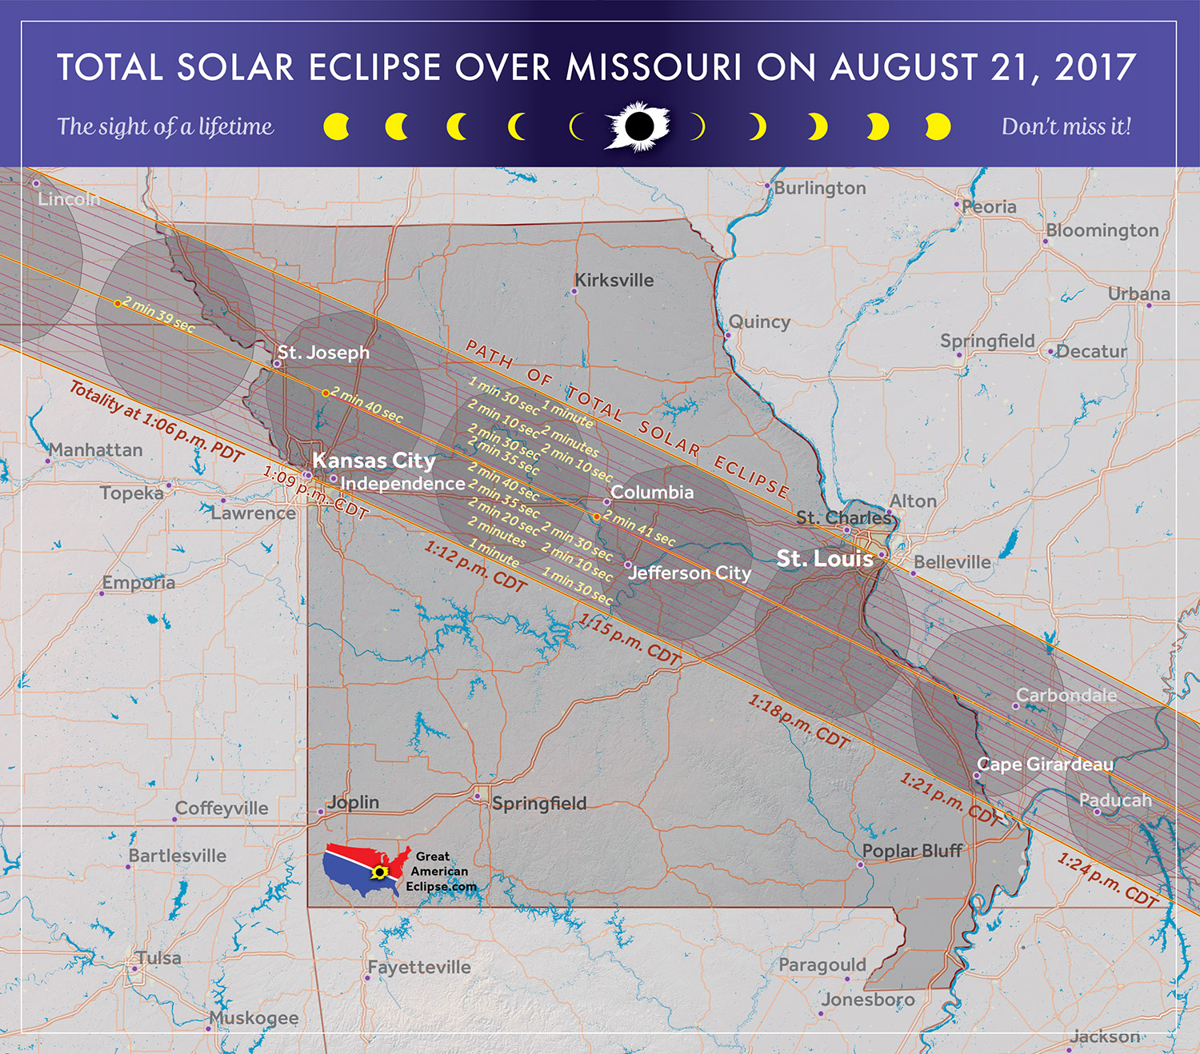

Slide 5
Eclipse Animations
https://svs.gsfc.nasa.gov/vis/a000000/a004300/a004314/eclipse2017usa_1080p30.mp4
https://svs.gsfc.nasa.gov/vis/a000000/a004500/a004515/totpath2017_2160p30.mp4
http://www.eclipse2017.org/2017/2017_anim.HTM

Slide 6

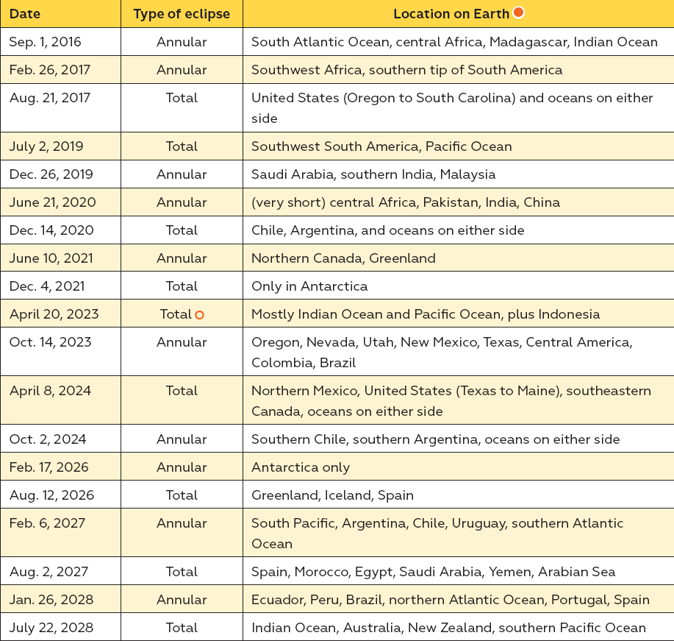
Solar Eclipse 2017

Slide 7
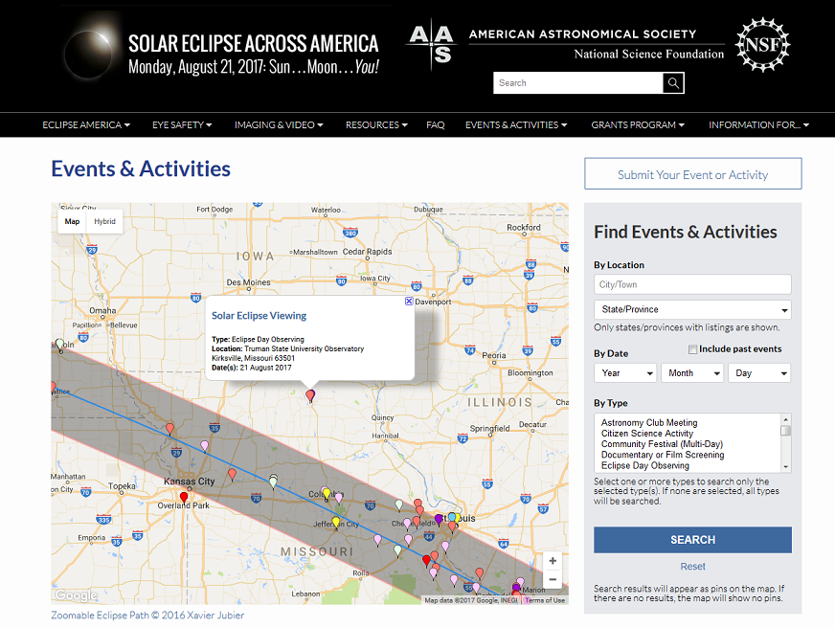

Slide 8
Eclipse 2017 in Kirksville
WE ARE LOOKING FOR
INTERESTED AND MOTIVATED VOLUNTEERS
Sun-Earth-Moon Workshop 1st April 2017 at Truman State University
  1st April (Saturday), Magruder 2005 (computer lab)
  Email gokhale@truman.edu for information and updates (time, schedule, topics to be covered, etc.)

Slide 9
Outline of Talk
Some History
Sun-Earth-Moon Geometry
  Tidal Locking & Synchronous Rotation
  Phases of the Moon
  Lunar Eclipses
  Solar Eclipses
Eclipse 2017 in Kirksville
Safe Ways to witness Solar Eclipses
Useful Websites, Demo’s, Video’s, etc.

Slide 10
History: What have we learnt from Observing Solar Eclipses?
The Sun has a REALLY hot corona!
  The surface temperature of the Sun is about 6000 K.
  The coronal temperature could be a million to 10 million K.
  How can gas so far away form the Sun’s core be this hot!?
Test Einstein’s theory of General Relativity
The Discovery of Helium
  Helium lines were first observed in the Sun’s spectra during the 1868 eclipse.
The Solar Radius

Slide 11
The Sun, Earth, Moon System
A Few Questions
Why does the same side of the Moon always face the Earth?
Why does the Moon show phases?
Why do we have Eclipses?
What causes a Lunar Eclipse?
What causes a Solar Eclipse?

Slide 12
Sun-Earth-Moon Geometry: Basics
The Earth and Sun go around their common center of mass
  It takes one year to complete one orbit
The Earth and Moon go around their common center of mass
  It takes about 27 days, 7 hours to complete one orbit but,
  It takes about 29 days, 12 hours from one full Moon to the next full Moon
Somewhat incorrectly, we usually refer to these phenomena as: “The Earth goes around the Sun” and “The Moon goes around the Earth”, etc.

Slide 13
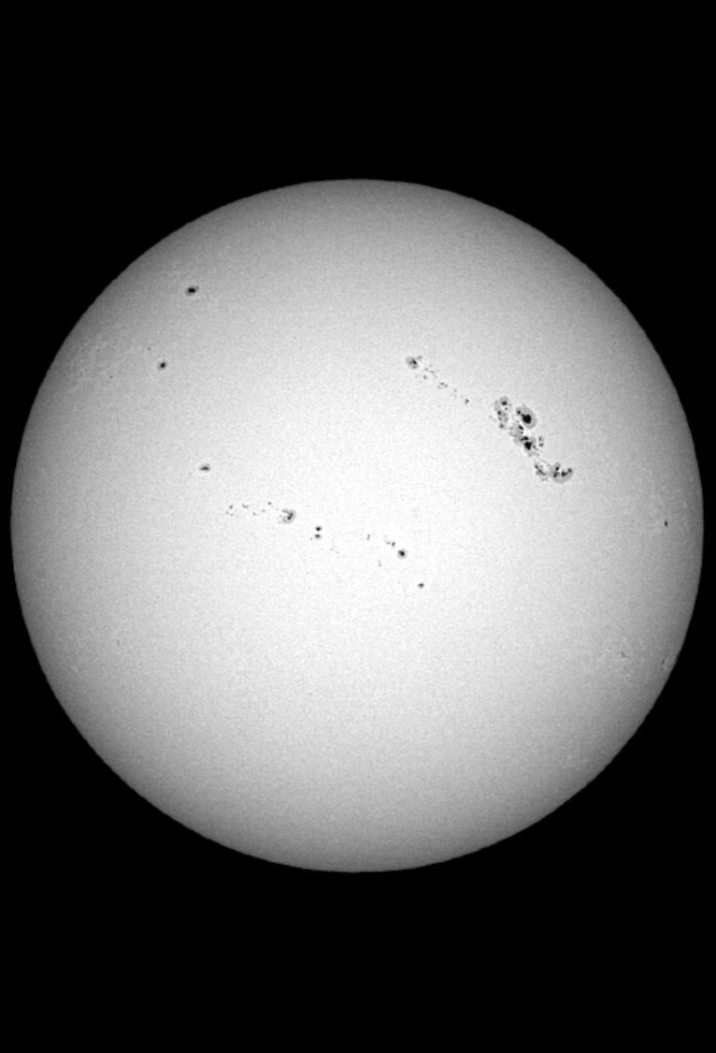
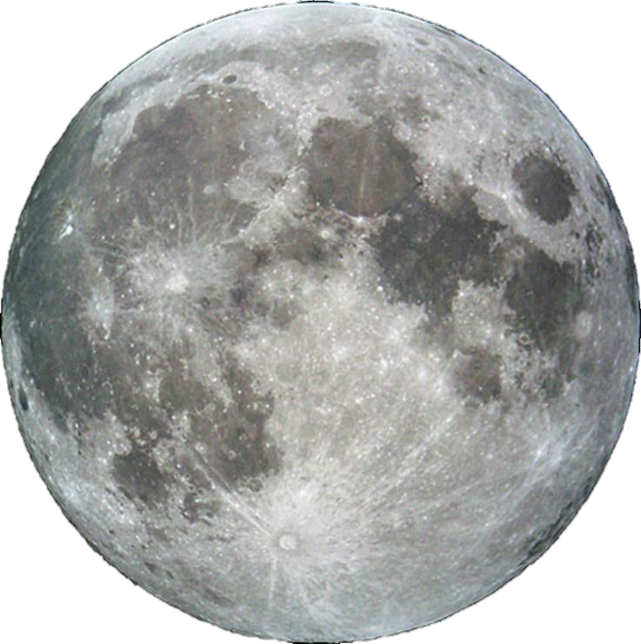
Cosmic Coincidence!?
The Sun’s diameter is ~400x the Moon’s diameter, but the Sun is also ~400x farther away from Earth!

Slide 14
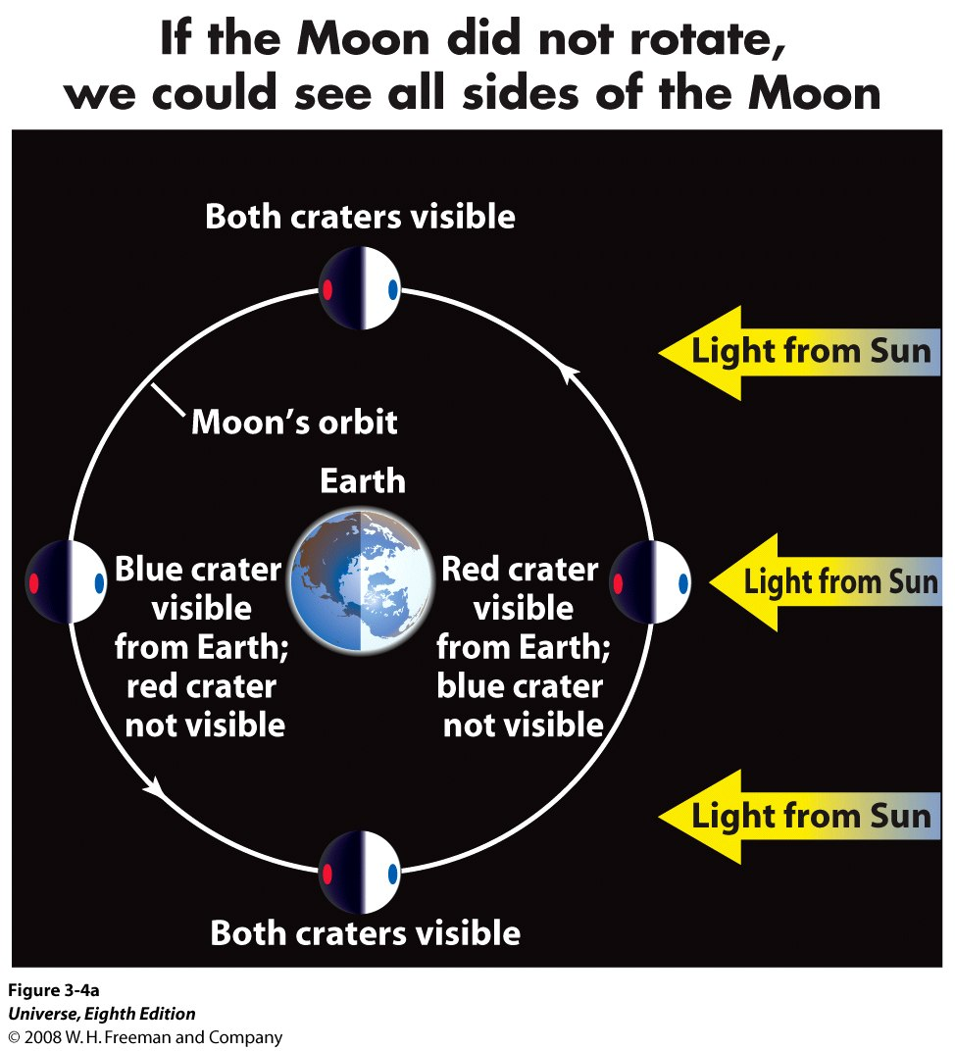
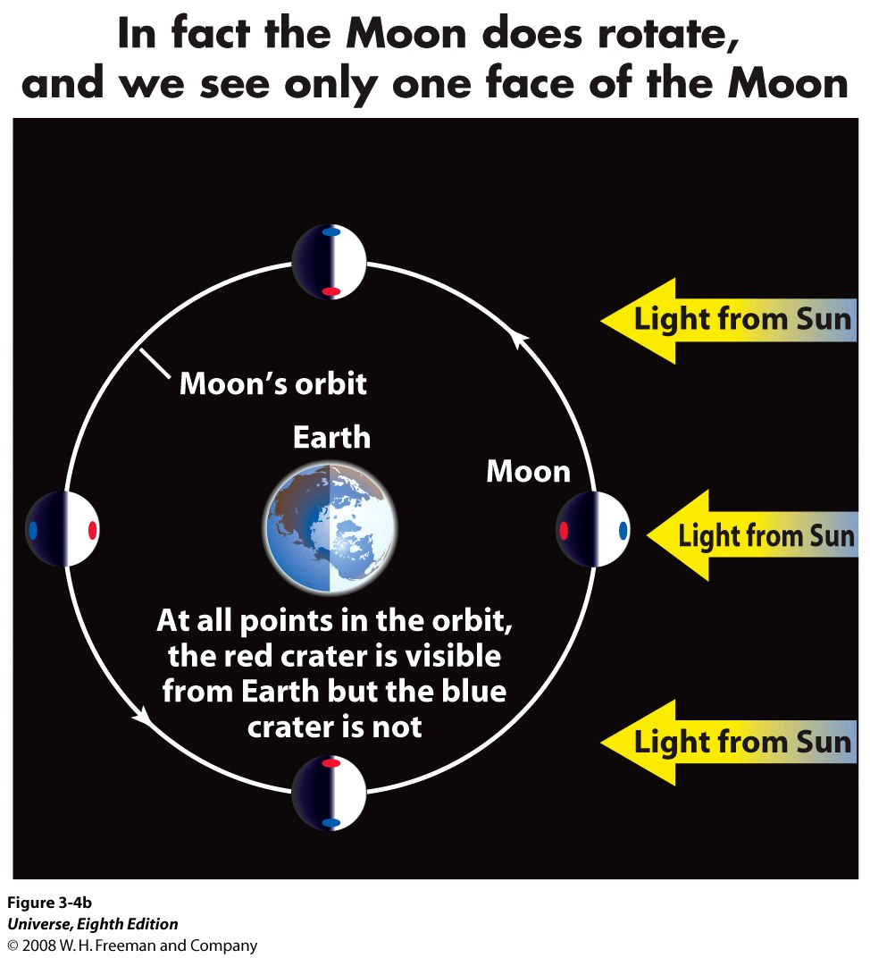
Tidal Locking & Synchronous Rotation
Why does the same Side of Moon Face Earth?

Slide 15
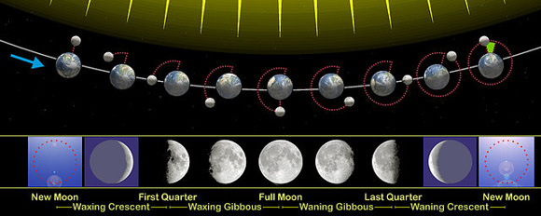
Why does the Moon show Phases?
earthsky.org

Slide 16
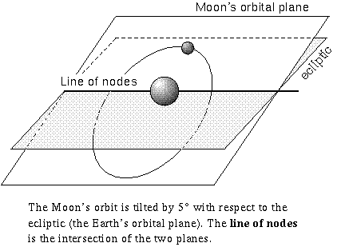
Eclipses
We know that the Moon is orbiting the Earth, the Earth is orbiting the Sun and both the Moon and the Earth are spinning about their own axes.
We ask the question, why doesn’t the Moon block the Sun every month?
Answer: The Moon’s orbital plane is tilted with respect to the ecliptic – the tilt is about 5⁰.
Eclipses can occur only if the Sun, the Moon and the Earth are all along the line of nodes.

Slide 17
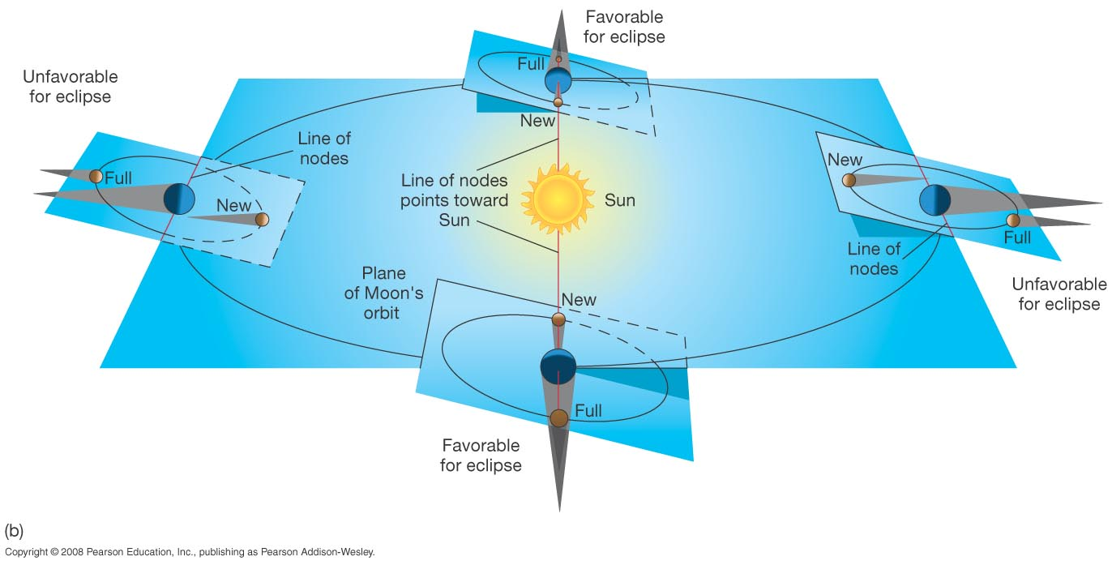
Eclipses
Why do we have Eclipses?
Eclipses can occur only twice a year, since only twice during an year are the Sun, the Moon, and the Earth aligned along the line of nodes.

Slide 18
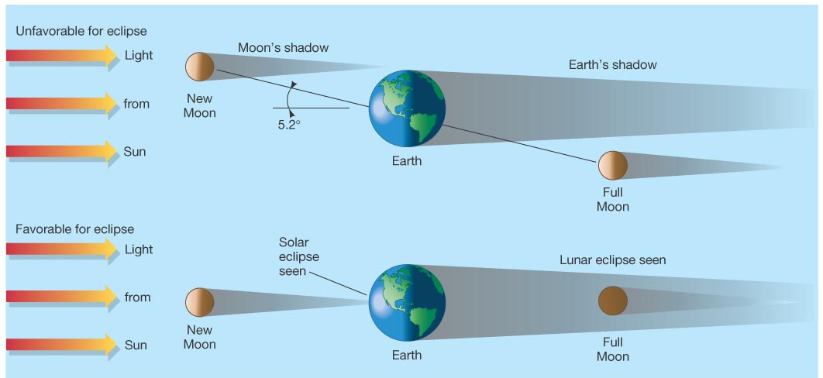
Eclipses
Situation during most new moons
Situation during an Eclipse – occurs less often

Slide 19
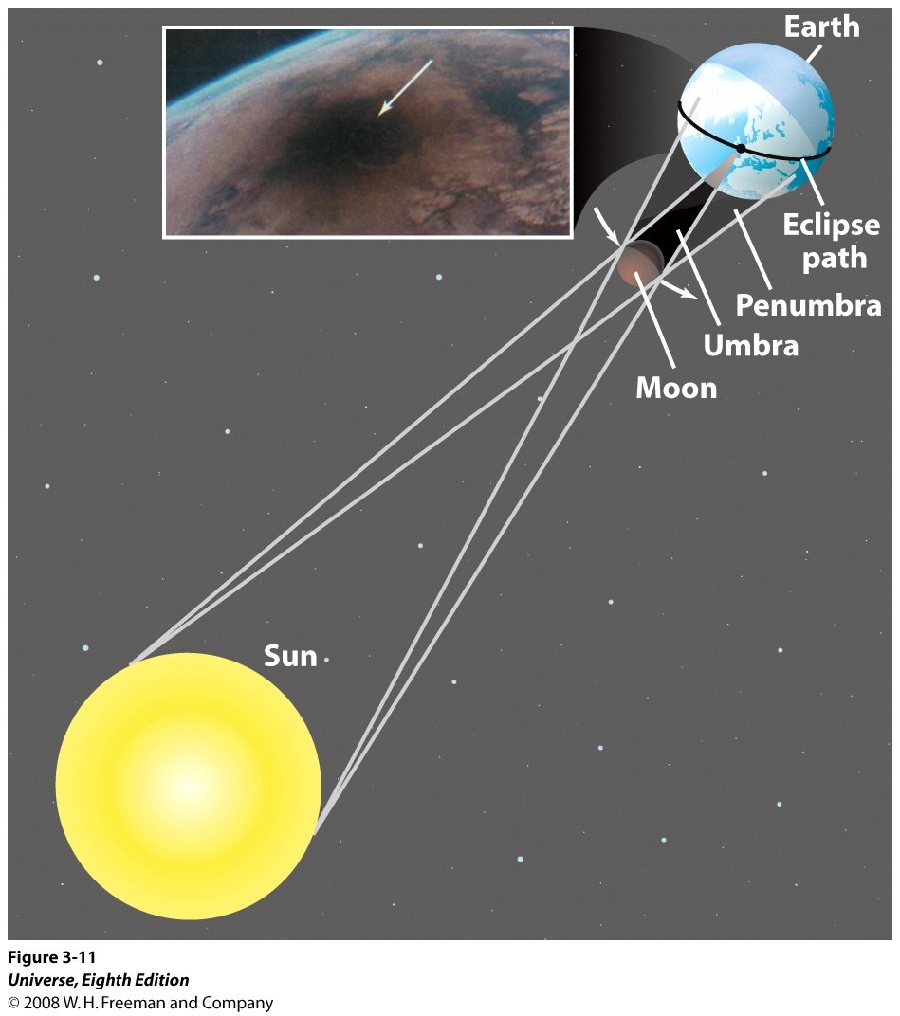
Solar Eclipses

Slide 20

Solar Eclipses
Only the regions over which the umbra falls can experience the total solar eclipse, called “totality”.
The umbra is only a few kilometers in size.
And, since the Earth and the Moon are in motion, the duration of totality is only a few minutes – its never greater than 7.5 minutes!
The umbra traces a path over the surface of the Earth, called the Eclipse path. Only the regions in the eclipse path will observe totality.
"John Beckman (United Kingdom) and other scientists use a Concorde supersonic passenger jet flying at 1,250 miles per hour (2,000 kilometers per hour) over Africa to extend the duration of solar eclipse totality to 74 minutes--10 times longer than can ever be observed from the ground“ (1973)

Slide 21
The Sun, Earth, Moon System
Why don’t eclipses occur on every New Moon day and every Full Moon day?
Why don’t eclipses occur on the same days every year?

Slide 22
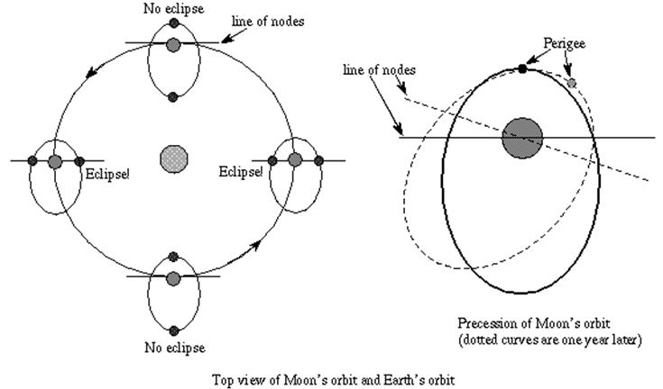
Orbit of the Moon: Eclipses do not occur on the same date and time every year.
astronomynotes.com

Slide 23
Solar Eclipse 2017

Slide 24

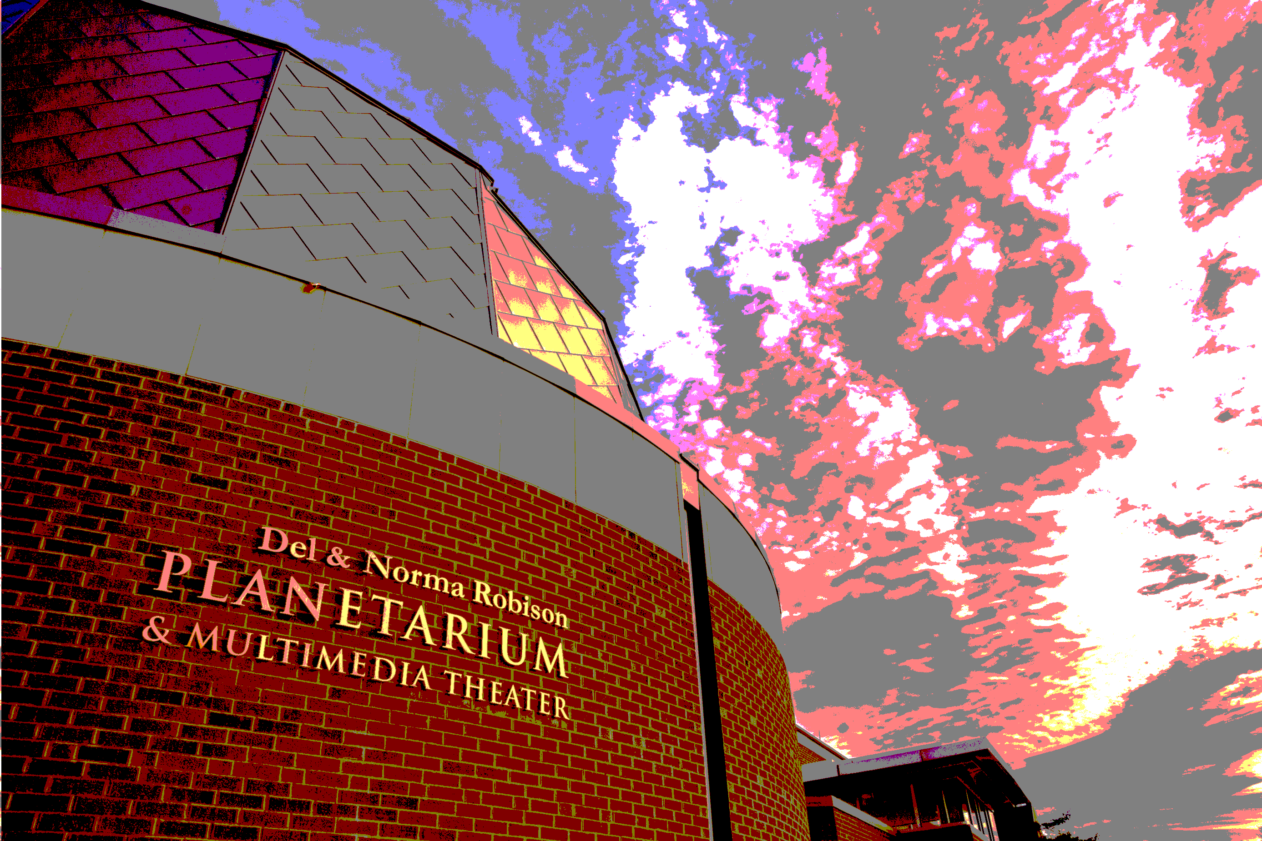
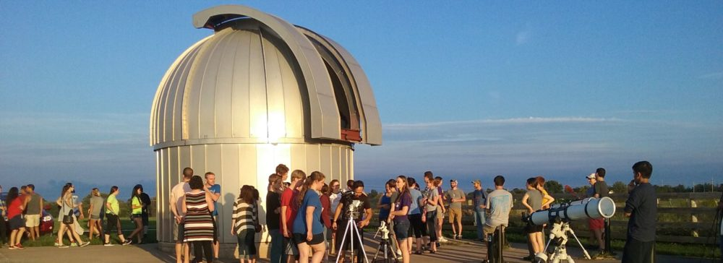
Eclipse 2017 in Kirksville

Slide 25
Eclipse 2017 in Kirksville
Event | Time (EST) | Alt | Azi
Start of partial eclipse | 11:44:53 AM | 55.6° | 139.2°
Maximum eclipse | 1:11:57 PM | 61.7° | 179.2°
End of partial eclipse | 2:37:52 PM | 56.1° | 219.2°
http://observatory.truman.edu/eclipse2017/

Slide 26
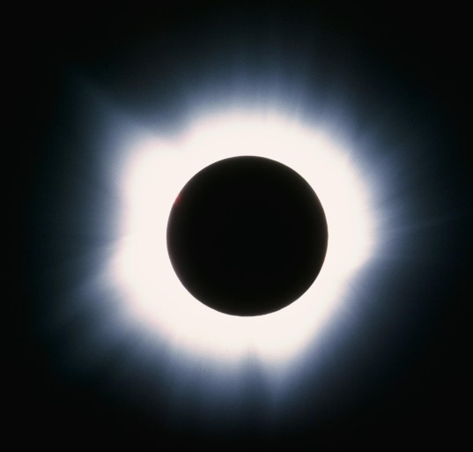
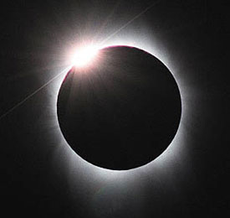
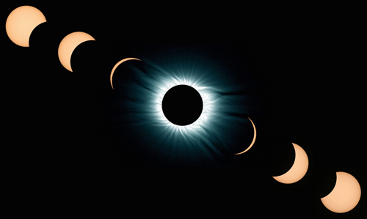
Eclipse 2017 in K’ville
The diamond ring
“Totality”
The solar corona

Slide 27
Viewing the Partial Eclipse
Safe ways to Observe Solar Eclipses
!! Do Not Look Directly
at the Sun!!
!! REFER TO HANDOUT !!
Projection of image
  Pinhole or using tools
Directly with filter
Live streaming the event
Notes:
During a partial eclipse, Do Not Look Directly At The Sun.
There are many ways to view a partial eclipse. Even those on the path of totality will observe a partial eclipse for all but a few minutes, so this applies to everyone.
We’re going to talk about 3 different ways to view a solar eclipse here.
Let’s start with the simplest way – Projection.

Slide 28
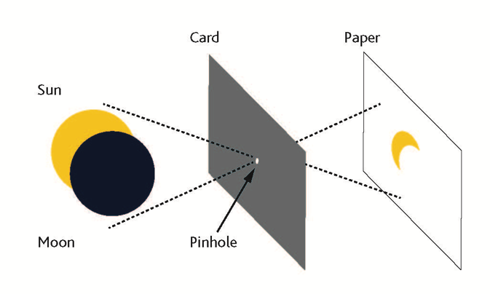
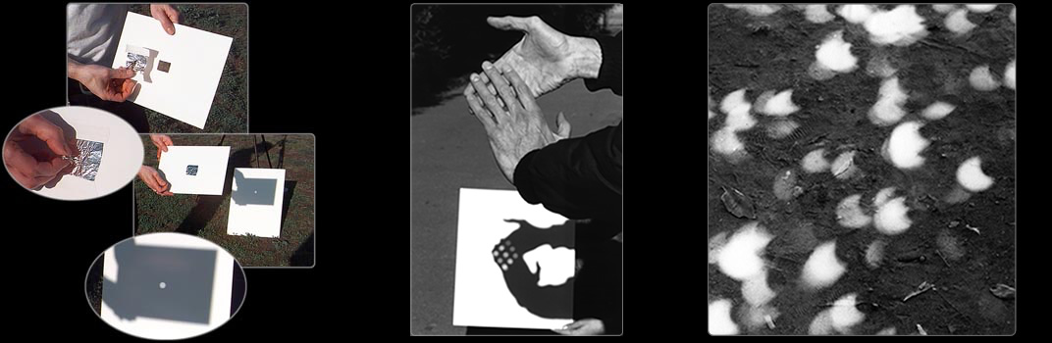
Watch the Show Safely!
Pinhole Projection
Safe ways to Observe Solar Eclipses
!! Potential Art Projects !!
Photo Credit: exploratorium.edu
Notes:
Pinhole projection can be done anywhere by making a small hole in a piece of cardboard or tinfoil and looking at the light that shines through it to a flat place a few feet away.
You might not know this, but the round lights you see everyday on the ground, between the leaves of trees are actually projections of the Sun!
You can use any number of small holes like the spaces between leaves, a colander, or even your hands.
Get creative and try it out before the eclipse. You can try different shaped holes, different sizes. See what works best.
Activity suggestion:
As you walk in the evening, you can try this at night with street lights through the leaves. Some lights are actually made up of many smaller LEDs and you will see those in the projections.

Slide 29
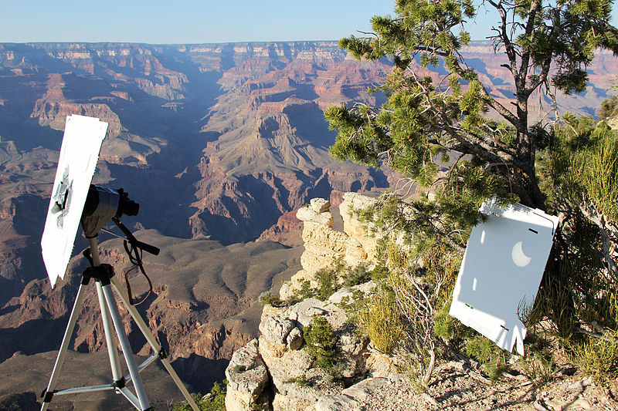
Project the Sun with Tools – and Care
Safe ways to Observe Solar Eclipses
Notes:
Another method of projection involves binoculars or a small telescope.
Emphasize : This is not viewing the Sun directly! You never want to look through binoculars at the Sun. *
By carefully covering all but one lens, you can project an image of the Sun onto a flat surface.
This set-up needs careful monitoring so that no one accidentally looks through the eyepiece.
You will go blind.
Possible addition:
It can be useful to take an old pair of binoculars (or a magnifying glass) and shine them on a piece of thin plastic like old negatives or a plastic garbage bag. These will melt and give your visitors a visceral reminder not to look through binoculars at the Sun. Be careful – this projection can get very hot and you’ll need to give your instrument a break as it heats up.

Slide 30
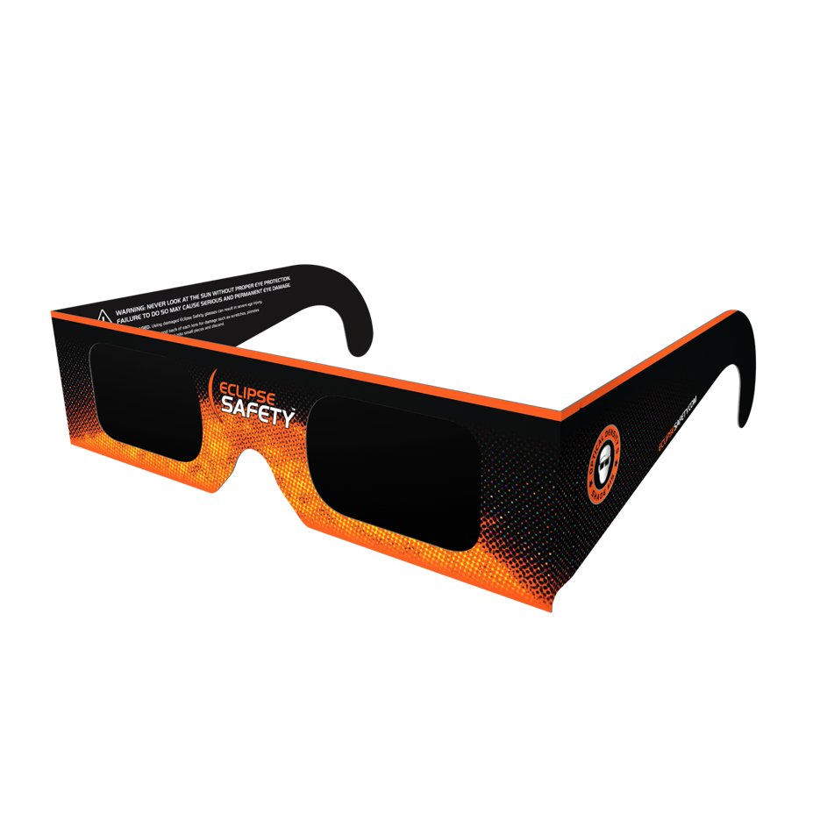
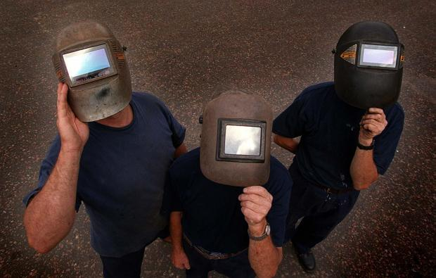
Observing Directly with Filters
Safe ways to Observe Solar Eclipses
There are ways to observe the eclipse directly, but it requires special filters.
Use approved eclipse glasses – not sunglasses!
Also welders glass #14 is safe for viewing. Don’t combine two #7 glasses. That is not safe.
#14 Welders Glasses
Notes:
There are ways to observe the eclipse directly, but it requires special filters
Use approved eclipse glasses – not sunglasses!
Also welders glass #14 is safe for viewing. Don’t combine two #7 glasses. That is not safe.

Slide 31
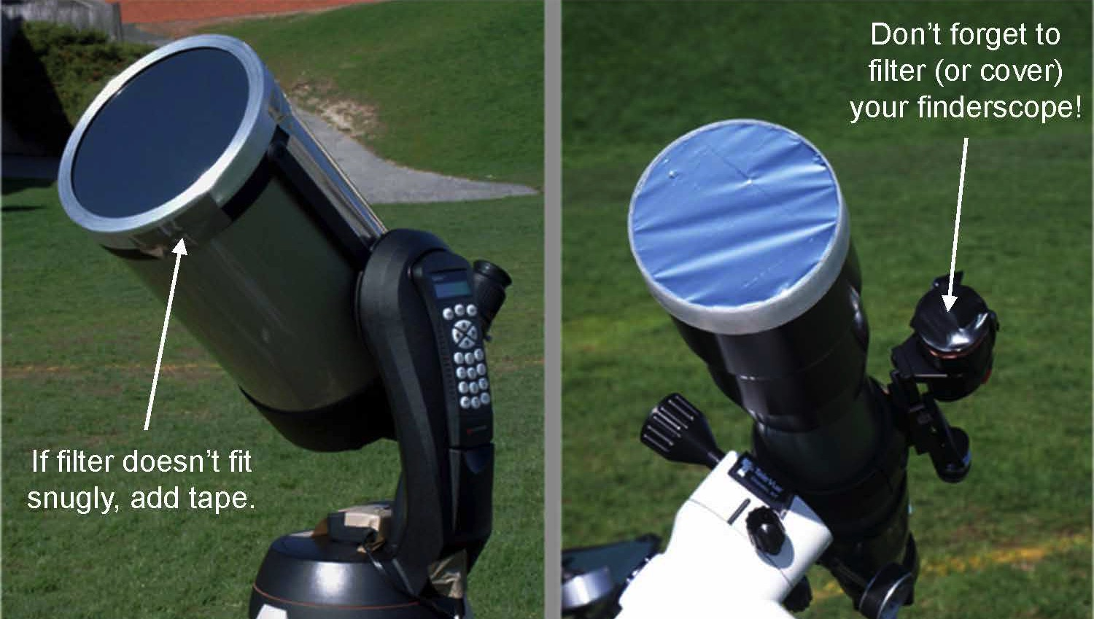
Use Special Care with Filtered Optics
Safe ways to Observe Solar Eclipses
Notes:
Telescopes and binoculars equipped with special solar filters are also useful if you have access.
Use only special-purpose solar filters on your precious optics!
These are usually made of metalized glass or special Mylar, not from a balloon.
Get these filters as far in advance as possible. See more information in the Resources page.
-----
Image credit: Rick Feinberg

Slide 32
Safe ways to Observe Solar Eclipses
The only safe way to look directly at the uneclipsed or partially eclipsed sun is through special-purpose solar filters, such as “eclipse glasses” or handheld solar viewers, and telescopes and binoculars specially fitted with appropriate solar filters.
Homemade filters or ordinary sunglasses, even very dark ones, are not safe for looking at the sun.
To date three manufacturers have certified that their eclipse glasses and hand-held solar viewers meet the ISO 12312-2 international standard for such products: Rainbow Symphony, American Paper Optics, and Thousand Oaks Optical.

Slide 33
Eclipse 2017 in Kirksville: Funding
$2300 from the Missouri Space Grant Consortium
(MACC + Truman)
$2300 from the ‘AAS Small Eclipse Grant’ (Truman)
$1000 from SAM & Physics (Truman)
$600 from Kirksville Tourism

Slide 34
Eclipse 2017 in Kirksville
12 solar telescopes (optical telescopes fitted with appropriate solar filters)
10 Solar binoculars
7500 solar glasses
  3000 R-III schools
  2500 Truman State
  1000 Del and Norma Robison Planetarium
  1000 Kirksville Tourism
In addition, 300 solar glasses have been ordered by the Adair County Public Library.
2 Sunspotters
Several pinhole cameras of different kinds

Slide 35
Eclipse 2017 in Kirksville
Staff/Faculty Committee
  Janet Gooch (SAM Dean)
  Tom Nothdurft (R-III Schools)
  Zac Burden (Mo-hall Director)
  Carolina-Sempertegui-Sosa (Biology)
  Bill Miller (Chemistry)
  David Caples (MACC)
  Vayujeet Gokhale (Physics)
Student Volunteers
  Samantha Carroll
  Pujita Ravichandar
  Haley Parker
  Rebecca Niemeier
  Patrick Morgan
  Jonathan Marple
  Garrett Money
  Mridul Bhattarai
  Charlyn Ortmann
  Faith Parrish (MACC)

Slide 36
Events leading up to Eclipse 2017 in Kirksville
Solar scopes will be set up across Kirksville (the county library, grocery stores, TSU campus, farmers market, etc.) twice a month
Trained volunteers will educate students and members of the community about solar activity such as sunspots, solar flares, plages, prominences, and filaments.
Students will explain the science and geometry of eclipses to members of the general public.

Slide 37
Events leading up to Eclipse 2017 in Kirksville
On the day of the eclipse, several solar telescopes will be set up at various locations on or near the Truman campus, the Truman Observatory, the Adair County Library, and the Kirksville R-III school district campus.
In addition, solar glasses will be distributed for safe viewing of the eclipse. Sunspotters, solar binoculars, and handheld spectroscopes will be available at selected sites.
The Adair County Library will establish a ‘Library-Telescope program’ using some of the solar telescopes and binoculars for patrons to check out.
  Appropriate user-friendly modifications will be made,
  Appropriate instructions will be printed,
  Library staff will be trained in safety and operation of these instruments.

Slide 38
Eclipse 2017 in Kirksville
Locations
Near Water Fountain on Truman Campus
Truman State Observatory
MACC/R-III School Area
Adair County Public Library/Rotary Park
Other Potential Locations
Downtown Kirksville (lunch traffic)
North Park
1000 Hills State Park
Walmart/Hyvee/Aldi Parking Lot (?)
Other ideas?

Slide 39
Eclipse 2017 in Kirksville: Faculty & Students
First day of classes at Truman State University & MACC.
  Cancel/shorten classes, if possible. Meet outside if it is nice.
  Eclipse related assignments for classes (in spring & fall)
  Encourage participation in eclipse-related activities – use eclipse as an opportunity to engage students/public in astronomy & science.
  Art projects – paintings, photography, etc.
  Citizen science projects on NASA/JPL websites.
  ‘Truman Transformation’ and incoming Freshman
  Summer activities – JBA, Zombies, etc.
Schools is session for a week before the eclipse.

Slide 40
Eclipse 2017 in Kirksville
WE ARE LOOKING FOR
INTERESTED AND MOTIVATED VOLUNTEERS
Sun-Earth-Moon Workshop 1st April 2017 at Truman State University
  1st April 2017, Magruder 2005 (computer lab)
  Email gokhale@truman.edu for information and updates (time, schedule, topics to be covered, etc.)

Slide 41
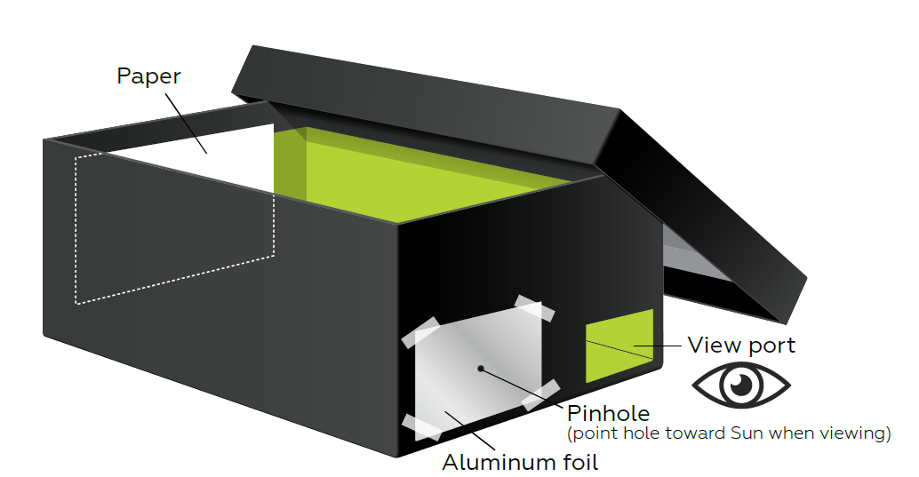
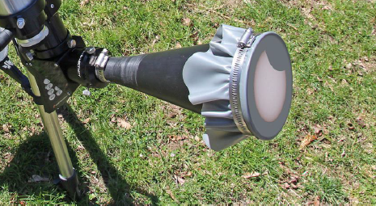
Activities and Information Handouts
How to make a pinhole camera
http://www.jpl.nasa.gov/edu/learn/project/how-to-make-a-pinhole-camera/
http://static.nsta.org/extras/solarscience/chapter3/3.10PinholeProjectionInABox.pdf
How to build a sun-funnel:
https://eclipse.aas.org/sites/eclipse.aas.org/files/Build-Sun-Funnel-v3.2.pdf

Slide 42
Activities and Information Handouts
American Astronomical Society Eclipse Page:
https://eclipse.aas.org/resources/educational-materials
Night Sky Network (NASA-JPL):
https://nightsky.jpl.nasa.gov/download-view.cfm?Doc_ID=588
NASA Eclipse 2017 Teacher Resource Page:
https://eclipse2017.nasa.gov/k-12-formal-education
NASA Museum Alliance Eclipse Page:
https://informal.jpl.nasa.gov/museum/content/eclipse-2017
AAPT Eclipse Page:
http://aapt.org/resources/eclipse2017/

Slide 43
Podcasts & Webinars
https://www.nasa.gov/nasa-edge/1005-solar-eclipse-2017-preview-show
https://eclipse.aas.org/resources/podcasts-webcasts
https://www.youtube.com/playlist?list=PLo2YDpGbMTNBYH0jWAMunM4oaMJEpe0qf
http://www.nisenet.org/catalog/online-workshop-tips-planning-your-august-21-2017-solar-eclipse-event-recorded
http://www.nisenet.org/earthspacekit-2017
http://transportationops.org/tools/solar-eclipse-webinar-preparing-august-21-2017-webinar-materials

Slide 44
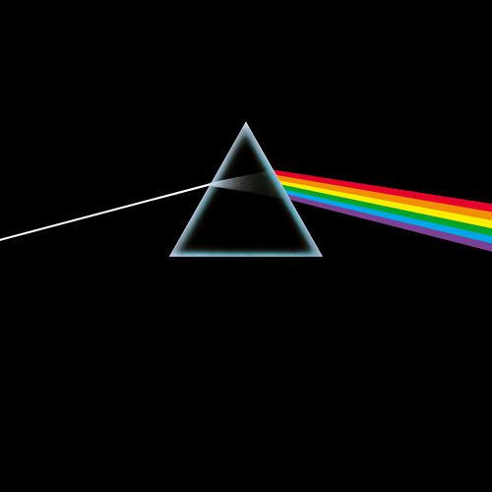
“Eclipse”
All that is now
All that is gone
All that's to come
And everything under the Sun is in tune
But the Sun is eclipsed by the moon.
“There is no dark side of the moon really.
Matter of fact it's all dark.”

Slide 45
Eclipse 2017 in Kirksville
Extra Slides

Slide 46
History
Eclipses have been the source of much fear, superstition, and also some scientific studies for centuries.
Many cultures have mythological stories associated with eclipses – usually considered a ‘bad omen’ (crucifixion of Christ, wars & famine, etc.)
The earlier reference to a solar eclipse seems to be from two Chinese astronomers in 2137 BCE, though these claims are somewhat dubious.
Mesopotamian records from 1375 BCE mention an eclipse:
“On the day of the new moon, in the month of Hiyar, the Sun was put to shame, and went down in the daytime, with Mars in attendance”
https://eclipse.gsfc.nasa.gov/SEhistory/SEhistory.html

Slide 47
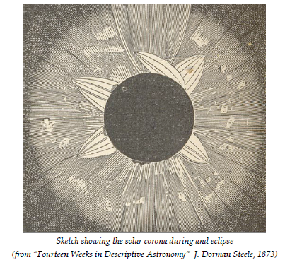
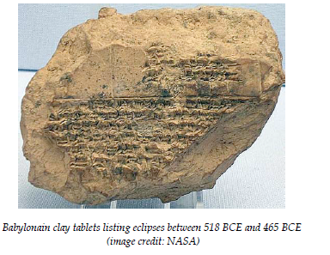
History
http://www.maths.dundee.ac.uk/mhd/Pdfs/wilmotsmith_solar_eclipses.pdf

Slide 48
History
In the ‘modern era’ one of the first scientifically significant comments about an eclipse comes from Kepler:
“Johannes Kepler (Germany) is the first to comment scientifically on the solar corona, suggesting that it is light reflected from matter around the Sun (based on reports of eclipses; he never saw a total eclipse)"
- Totality - Eclipses of the Sun (3rd ed) - Littmann, Espenak, and Willcox
Edmond Halley also reported witnessing a solar eclipse in 1715.
Soon after, in 1724 and 1733, observers recorded the presence of the Solar Corona and Solar prominences, which were later confirmed to be part of the Sun in 1842.
https://eclipse.gsfc.nasa.gov/SEhistory/SEhistory.html

Slide 49
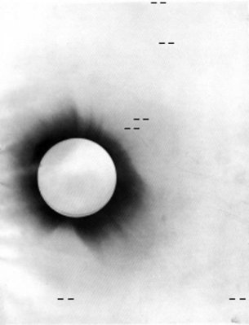
History
The 1919 eclipse was especially important because it presented the first opportunity to definitively test Einstein’s theory of General Relativity.
  The proposition was that gravity affected light, space and time itself, and as a result the Sun would deflect starlight passing by it. Changes in the apparent direction of stars in the sky, seen close to the Sun during a total eclipse, could confirm the idea.
Negative photo of the 1919 solar eclipse
http://www.esa.int/Our_Activities/Space_Science/Relativity_and_the_1919_eclipse

Slide 50
The Sun, Earth, Moon System
Why does the same side of the Moon always face the Earth?

Slide 51
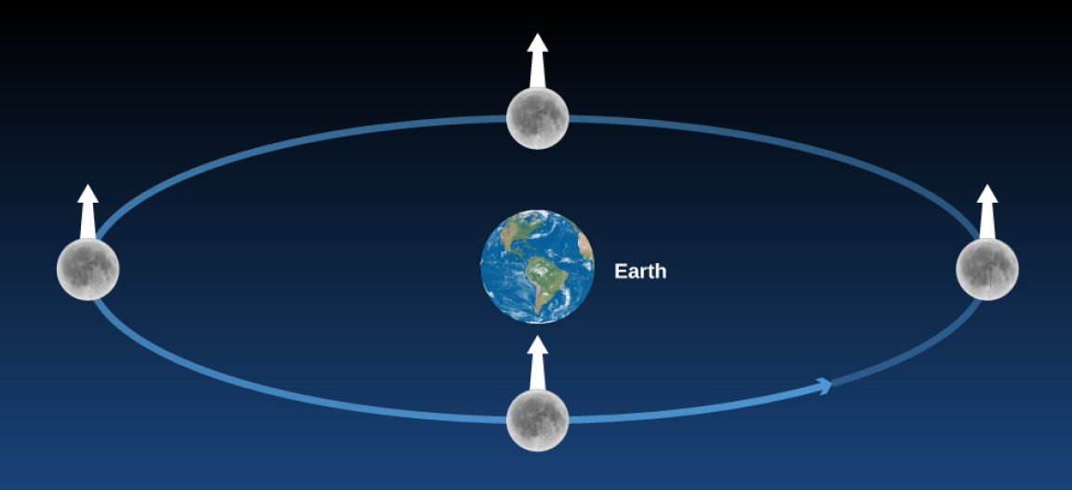
Tidal Locking & Synchronous Rotation
In this figure, we stuck a white arrow into a fixed point on the Moon to keep track of its sides. If the Moon did not rotate as it orbited Earth, it would present all of its sides to our view; hence the white arrow would point directly toward Earth only in the bottom position on the diagram.

Slide 52
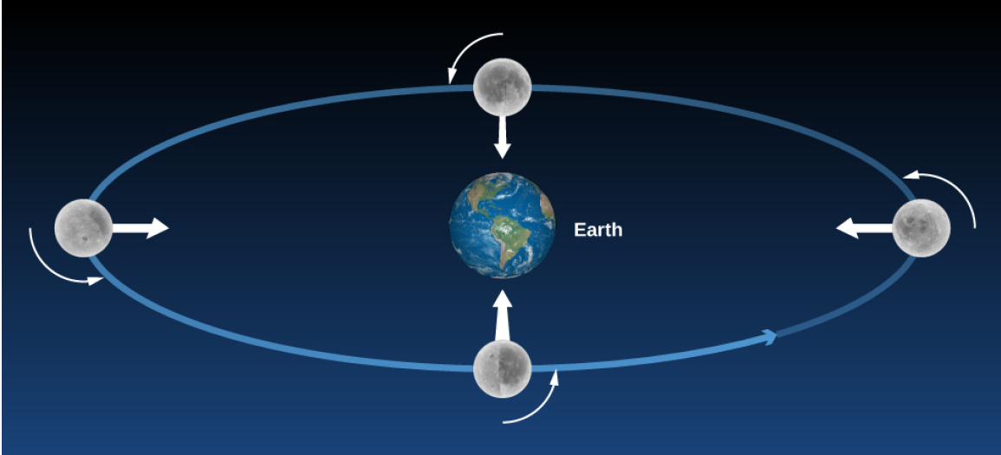
Tidal Locking & Synchronous Rotation
Actually, the Moon rotates in the same period that it revolves, so we always see the same side (the white arrow keeps pointing to Earth).

Slide 53
The Phases of the Moon
The differences in the Moon’s appearance from one night to the next are due to changing illumination by the Sun, not to its own rotation.
Which side is light and which is dark changes as the Moon moves around Earth.
“The back side” is dark just as often as “the front side” (say, on a Full Moon night).
Since the Moon rotates, the Sun rises and sets on all sides of the Moon.
With apologies to Pink Floyd, there is simply no permanent “Dark Side of the Moon.”

Slide 54
The Sun, Earth, Moon System
Why does the Moon show phases?

Slide 55
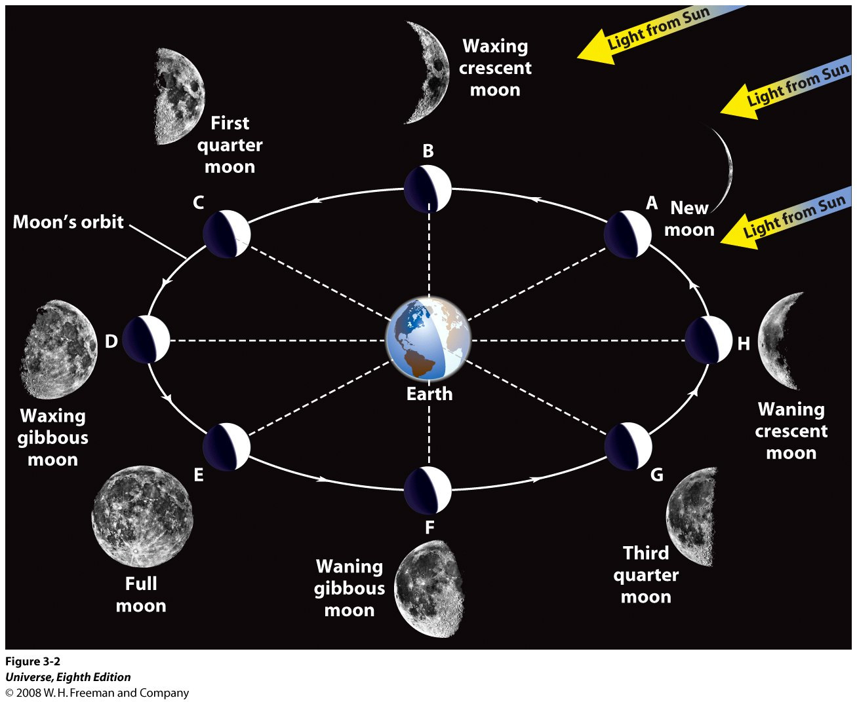
Moon Phase: The Sun, Earth, Moon System

Slide 56
The Sun, Earth, Moon System
Why do we have Eclipses?
What causes a Lunar Eclipse?
What causes a Solar Eclipse?

Slide 57
Lunar Eclipses
A Lunar Eclipse occurs when the Sun, the Earth and the Moon are aligned along the line of nodes, in such a way that the Earth is between the Sun and the Moon, on a Full Moon’s day.
A lunar eclipse may be total, partial or penumbral depending on the exact geometry of the alignment.

Slide 58
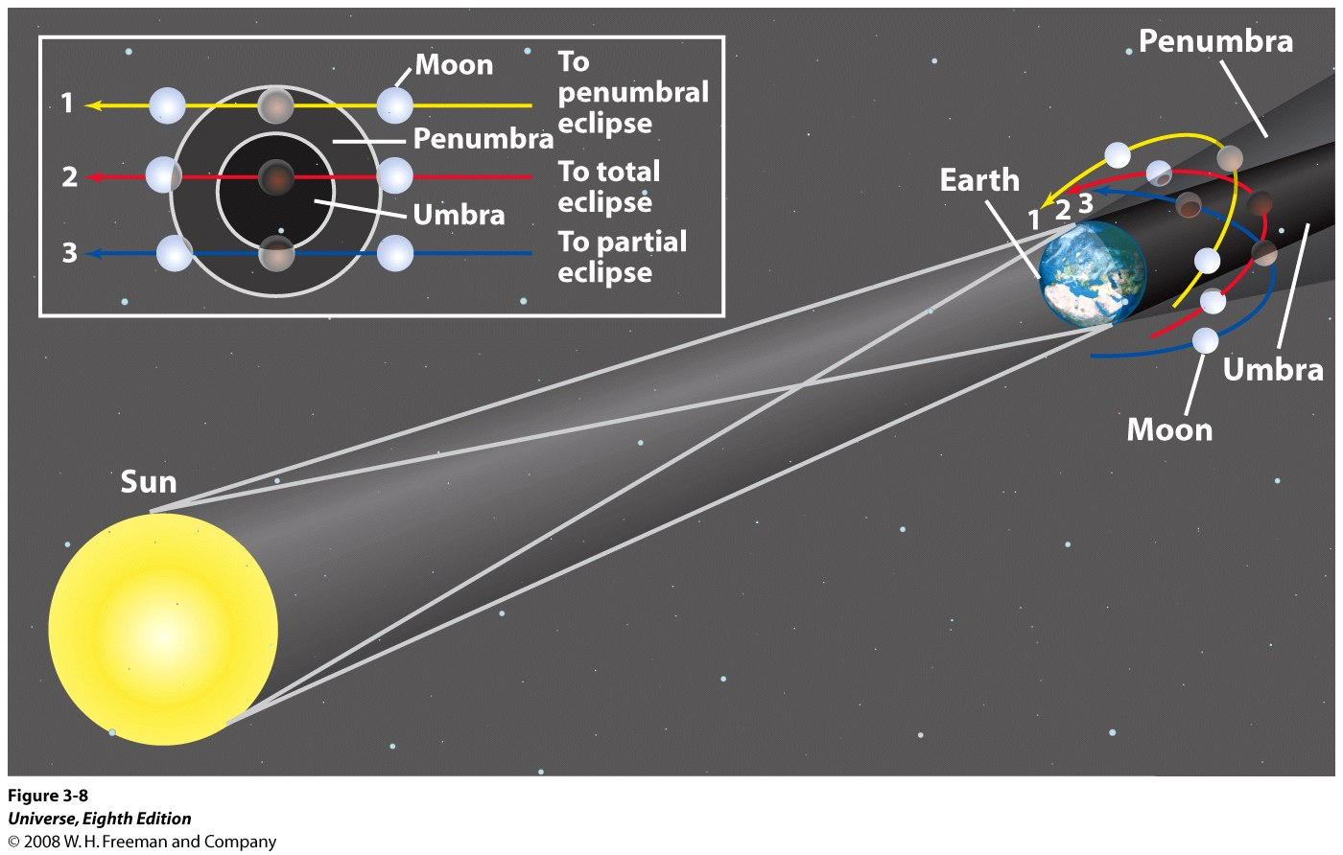
Lunar Eclipses
Situation 1: Penumbral Eclipse
Situation 2: Total Eclipse
Situation 3: Partial Eclipse

Slide 59
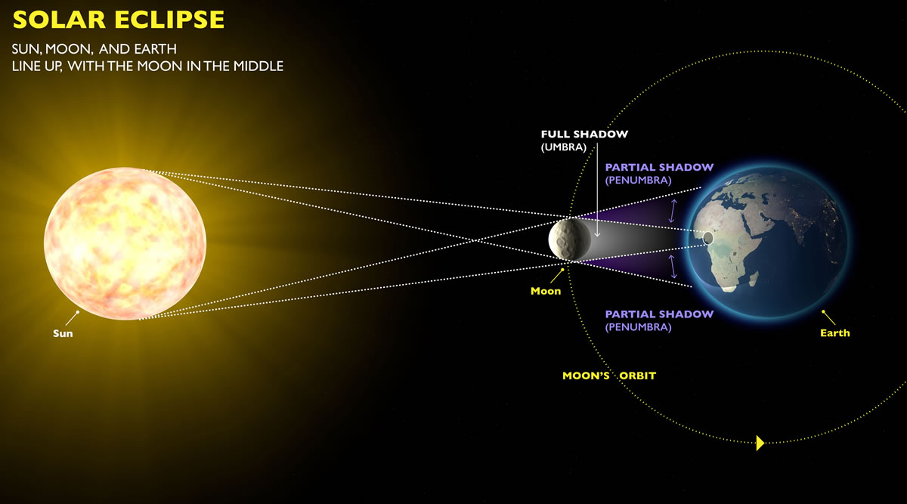
Solar Eclipses
Not to scale © exploratorium.edu

Slide 60
Solar Eclipses
A Solar eclipse occurs when the Sun, the Earth and the Moon are aligned along the line of nodes, and the Moon is between the Sun and the Earth on a New Moon’s day.
A Solar eclipse may be total, partial or annular, depending on the exact geometry of the alignment of the Sun, Moon and Earth.

Slide 61
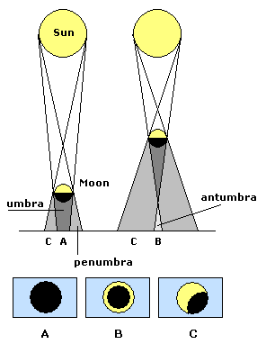
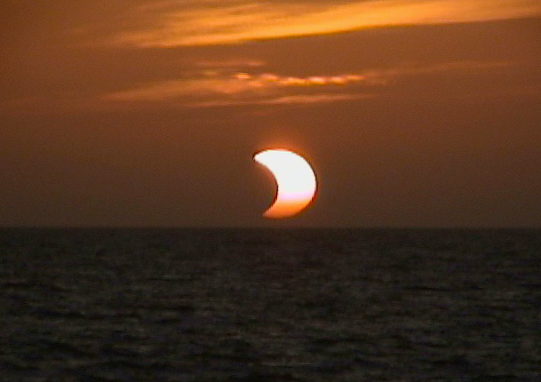
Solar Eclipses
A partial Solar Eclipse
astronomynotes.com

Slide 62
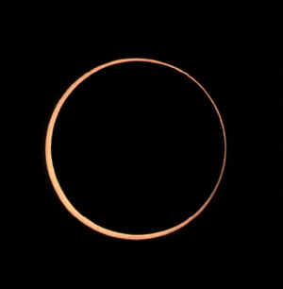
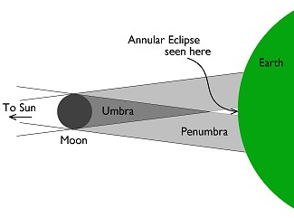
Annular Solar Eclipses
An annular Solar Eclipse
astronomynotes.com

Slide 63
Solar Eclipses
Only the regions over which the umbra falls can experience the total solar eclipse, called “totality”.
The umbra is only a few kilometers in size. Moreover, since the Earth and the Moon are in motion, the duration of totality is only a few minutes – its never greater than 7.5 minutes!
The umbra traces a path over the surface of the Earth, called the Eclipse path. Only the regions in the eclipse path will observe totality.
astronomynotes.com

Slide 64
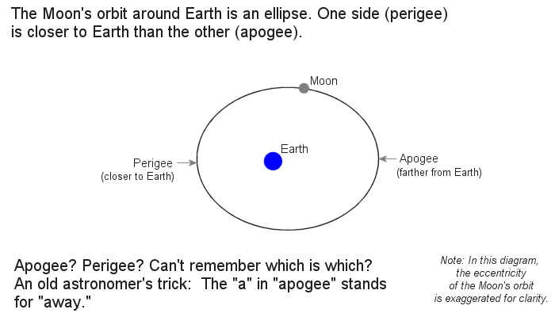
Solar Eclipses
Remember that the Moon’s orbit is an ellipse and not a perfect circle. Thus, the Moon is sometimes closer to the Earth whilst at other times, it moves farther apart and at the opposite side of the orbit, it is at its farthest.

