Slide 1
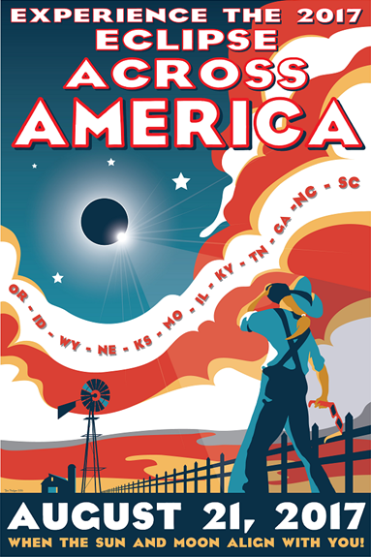
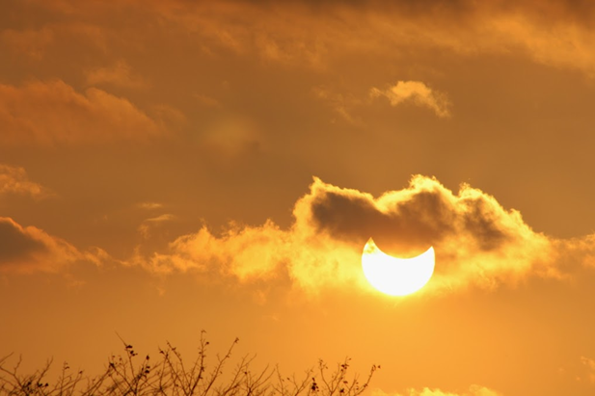







Solar Eclipse 2017
Vayujeet Gokhale
Truman State University

Slide 2
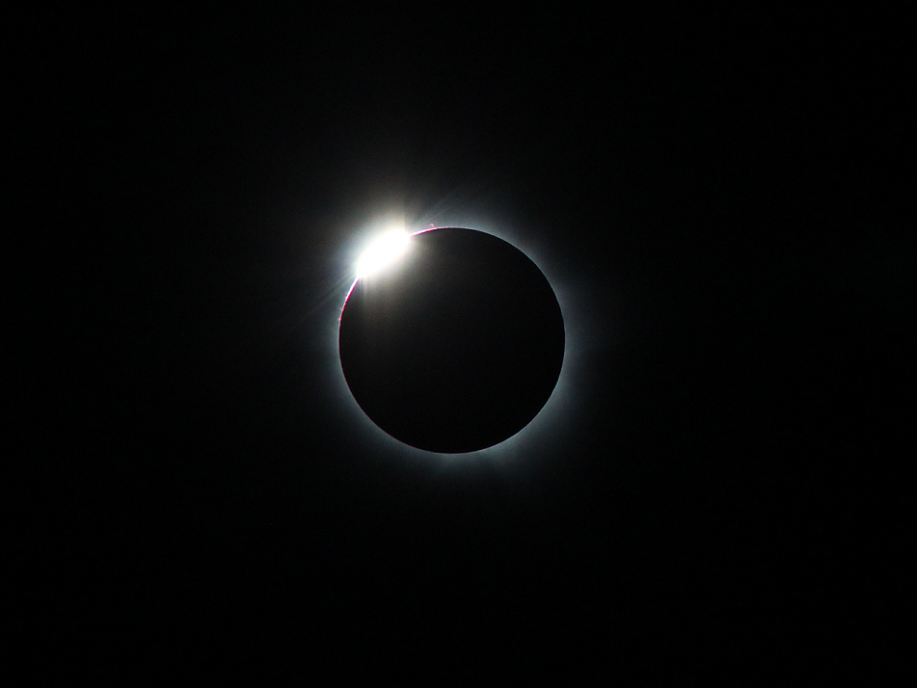
Solar Eclipse 2017
Where will you be on August 21, 2017?

Slide 4
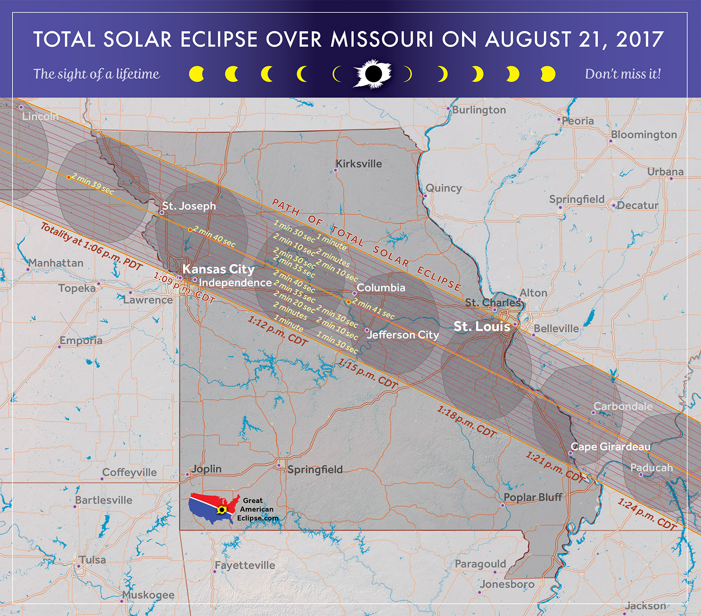

Slide 5

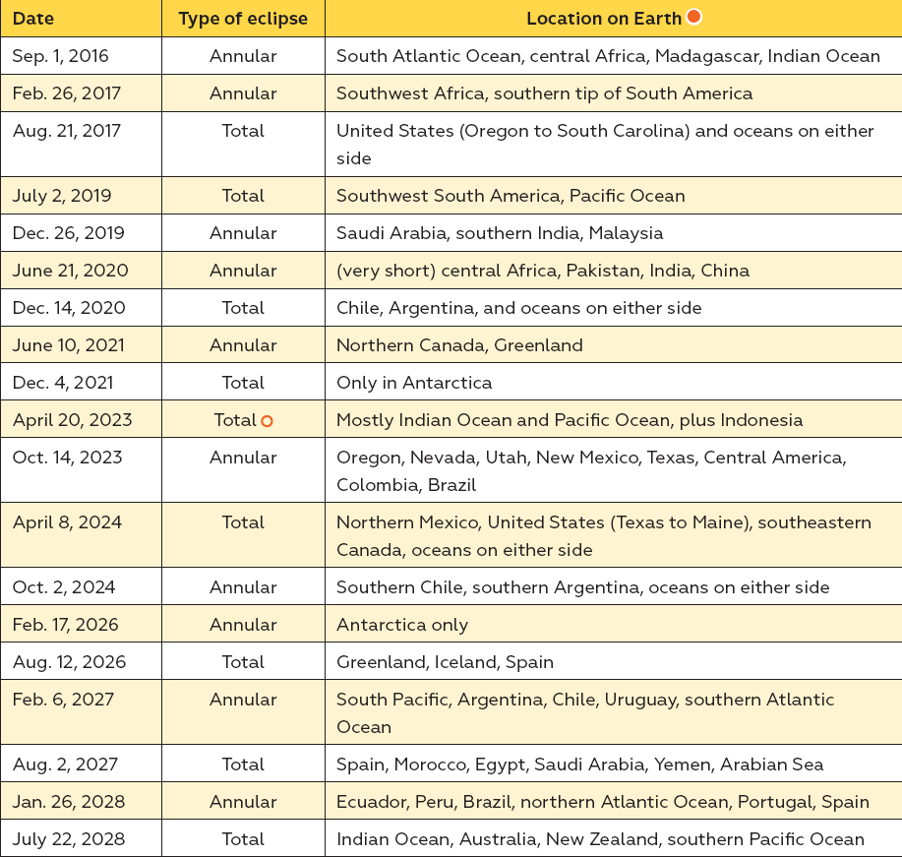
Solar Eclipse 2017

Slide 6
Eclipse 2017 in Kirksville
WE ARE LOOKING FOR
INTERESTED AND MOTIVATED VOLUNTEERS
Sun-Earth-Moon Workshop in Late March at Truman State University
  Exact date, time and room numbers TBD
  Email gokhale@truman.edu for information and updates

Slide 7
Outline of Talk
Sun-Earth-Moon Geometry
  Phases of the Moon
  Lunar Eclipses
  Solar Eclipses
Safe Ways to witness Solar Eclipses
Eclipse 2017 in Kirksville
Useful Websites, Demo’s, Video’s, etc.

Slide 8
The Sun, Earth, Moon System
Why does the Moon show phases?

Slide 9
The Sun, Earth, Moon System
The Earth and Sun go around their common center of mass
  It takes one year to complete one orbit
The Earth and Moon go around their common center of mass
  It takes about 27 days, 7 hours to complete one orbit but,
  It takes about 29 days, 12 hours from one full Moon to the next full Moon

Slide 10
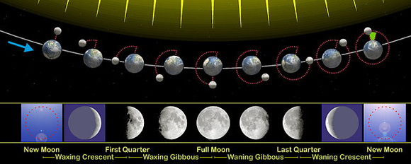
The Sun, Earth, Moon System
The Earth and Sun go around their common center of mass
  It takes one year to complete one orbit
The Earth and Moon go around their common center of mass
  It takes about 27 days, 7 hours to complete one orbit but,
  It takes about 29 days, 12 hours from one full Moon to the next full Moon
earthsky.org

Slide 11
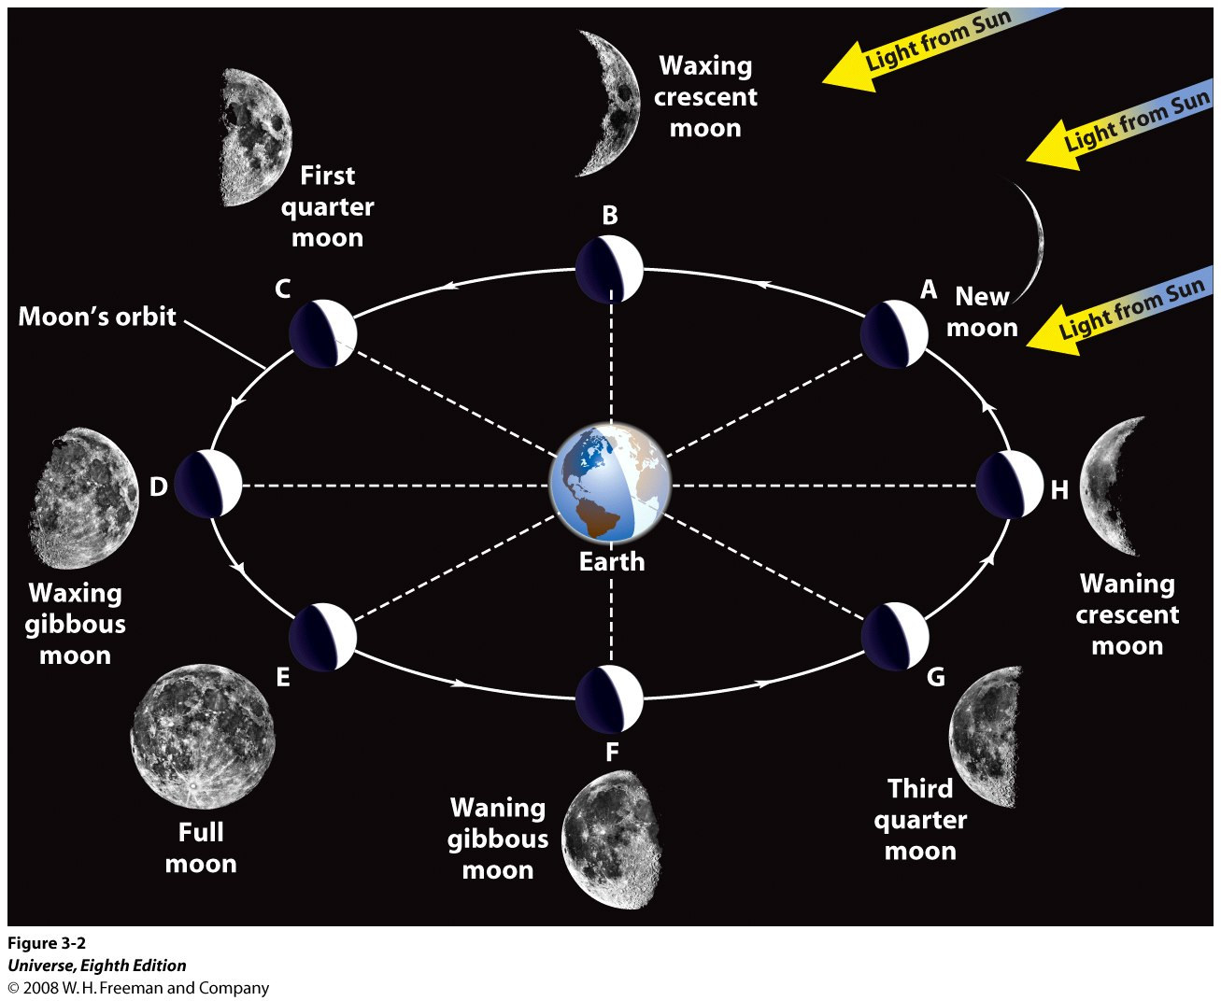
Moon Phase: The Sun, Earth, Moon System

Slide 12
The Sun, Earth, Moon System
Why do we have Eclipses?
What causes a Lunar Eclipse?
What causes a Solar Eclipse?

Slide 13
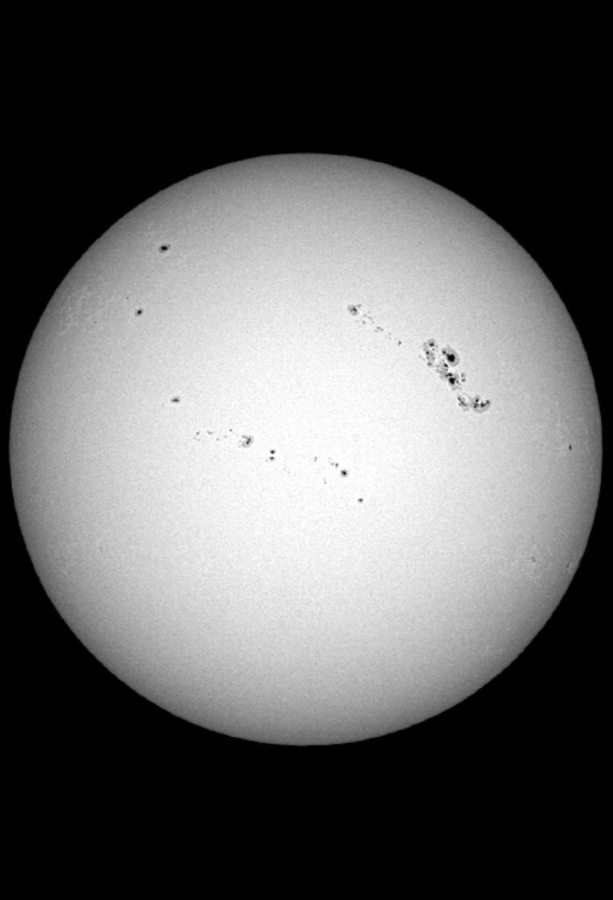
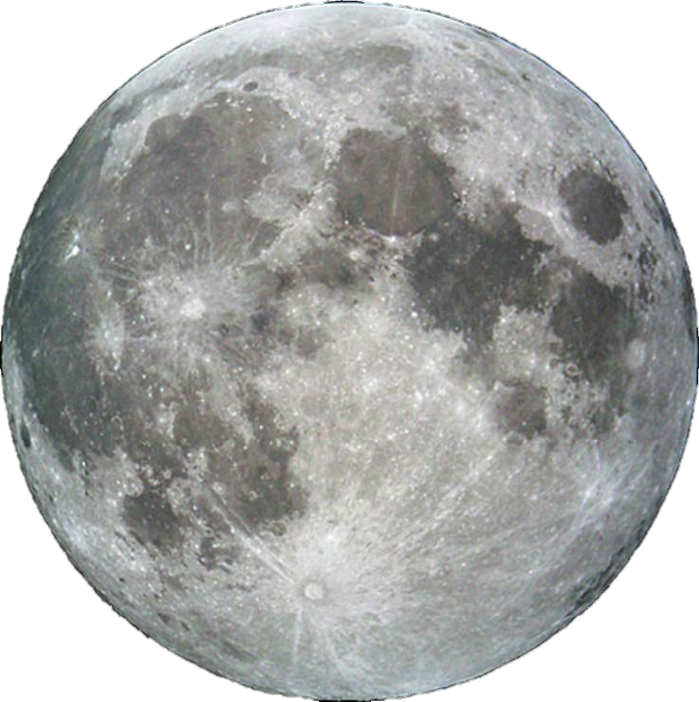
Cosmic Coincidence!
The Sun’s diameter is 400x the Moon’s diameter, but the Sun is also 400x farther away from Earth!

Slide 14
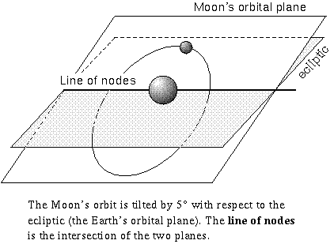
Eclipses
We know that the Moon is orbiting the Earth, the Earth is orbiting the Sun and both the Moon and the Earth are spinning about their own axes.
We ask the question, why doesn’t the Moon block the Sun every month?
Answer: The Moon’s orbital plane is tilted with respect to the ecliptic – the tilt is about 5⁰.
Eclipses can occur only if the Sun, the Moon and the Earth are all along the line of nodes.

Slide 15
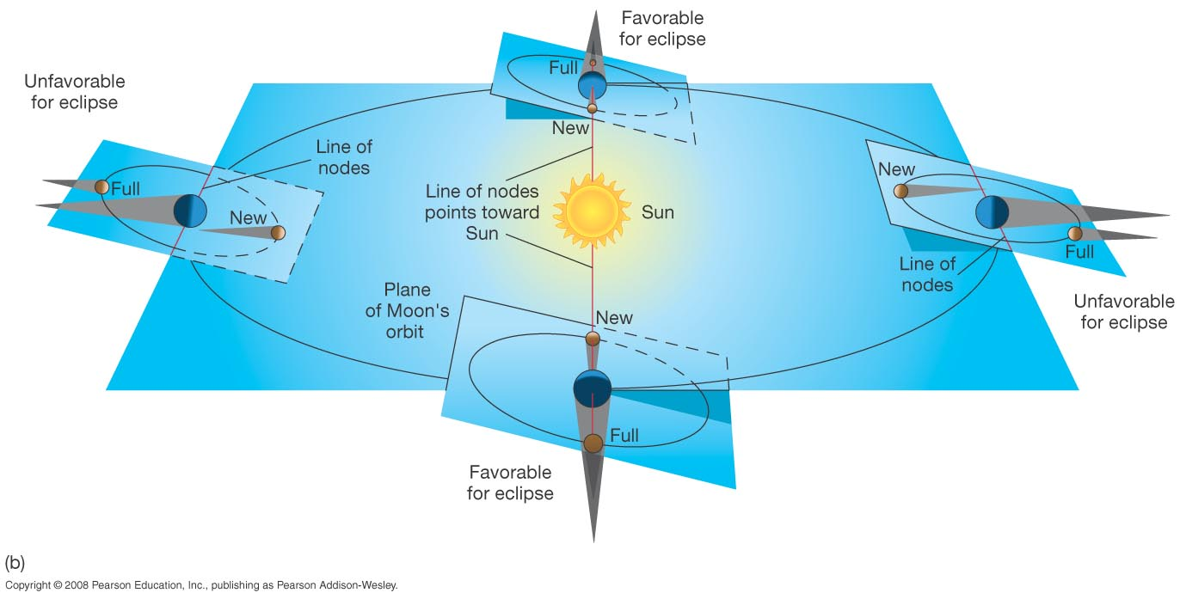
Eclipses
Eclipses can occur only twice a year, since only twice during an year
the Sun, the Moon and the Earth are along the line of nodes.

Slide 16
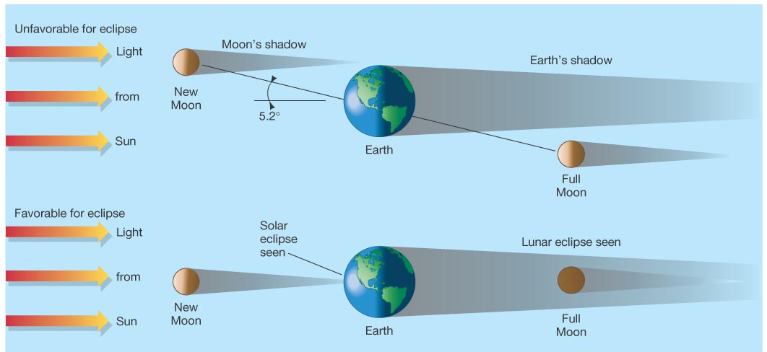
Eclipses
Situation during most new moons
Situation during an Eclipse – occurs less often

Slide 17
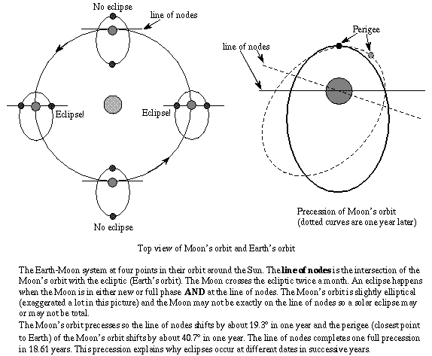
Orbit of the Moon: Eclipses do not occur on the same date and time every year.

Slide 18
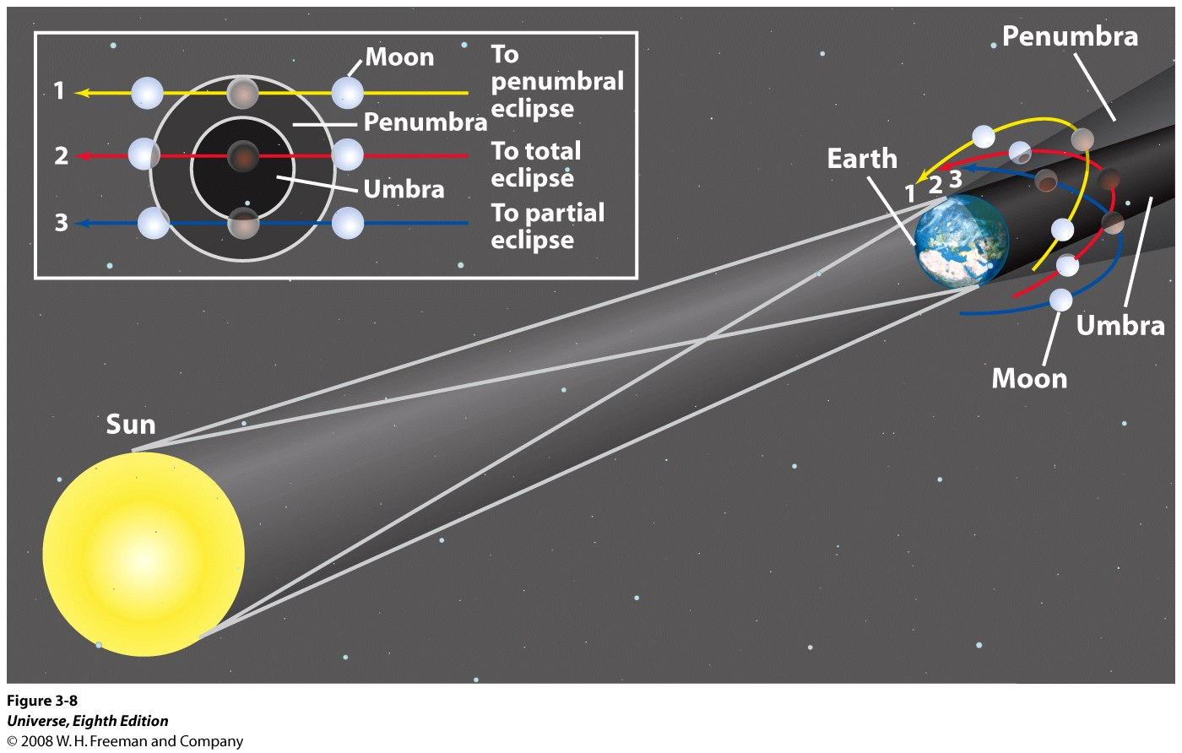
The Lunar Eclipse
Situation 1: Penumbral Eclipse
Situation 2: Total Eclipse
Situation 3: Partial Eclipse

Slide 19
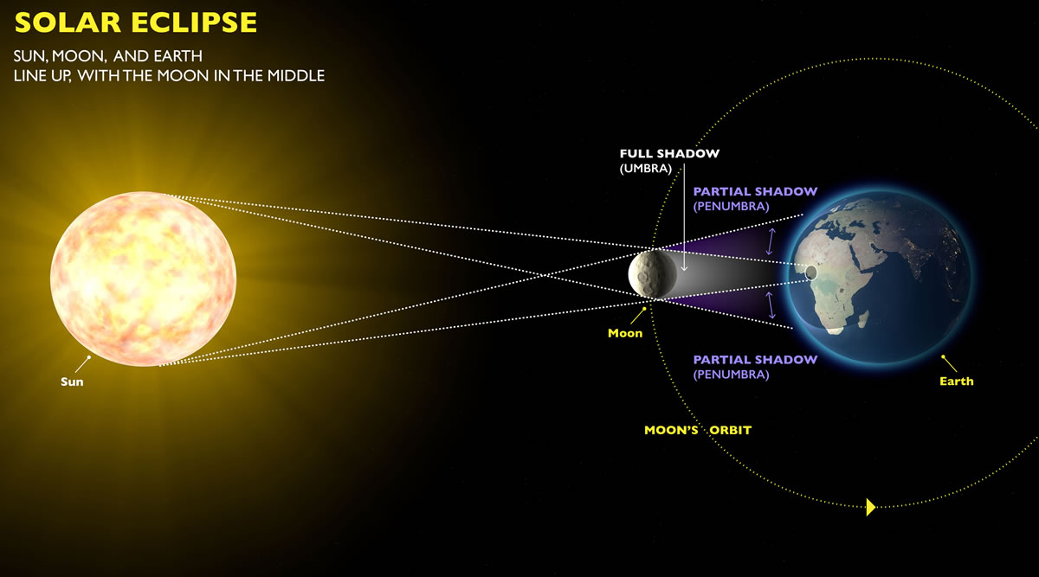
Solar Eclipses
Not to scale © exploratorium.edu

Slide 20
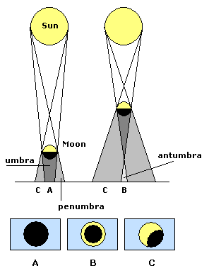
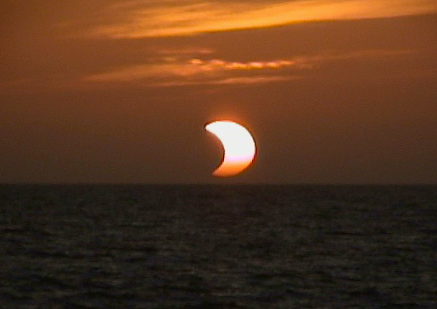
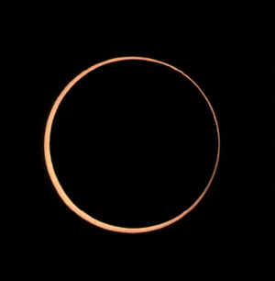
The Solar Eclipse
A partial Solar Eclipse
An annular Solar Eclipse

Slide 21
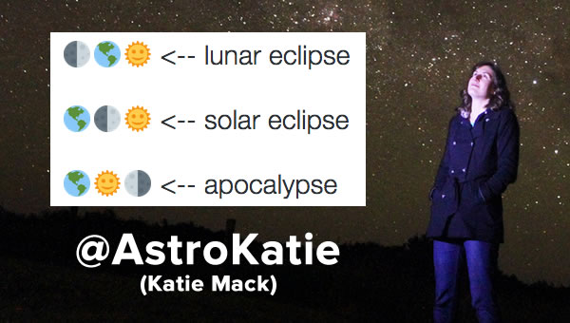
Bottom Line: Eclipses

Slide 22
Viewing the Partial Eclipse
Safe ways to Observe Solar Eclipses
!! Do Not Look Directly
at the Sun!!
!! REFER TO HANDOUT !!
Projection of image
  Pinhole or using tools
Directly with filter
Live streaming the event
Notes:
During a partial eclipse, Do Not Look Directly At The Sun.
There are many ways to view a partial eclipse. Even those on the path of totality will observe a partial eclipse for all but a few minutes, so this applies to everyone.
We’re going to talk about 3 different ways to view a solar eclipse here.
Let’s start with the simplest way – Projection.

Slide 23
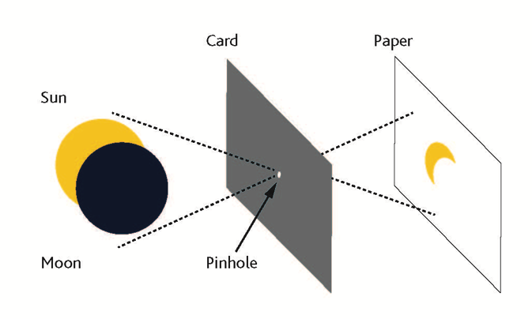
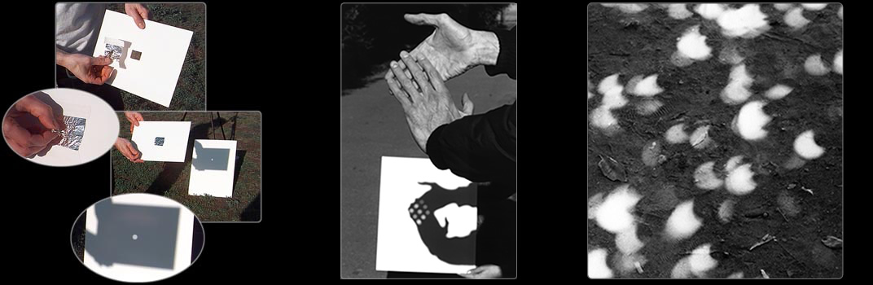
Safe ways to Observe Solar Eclipses
Pinhole Cameras
!! Potential Art Projects !!
Photo Credit: exploratorium.edu
Notes:
Pinhole projection can be done anywhere by making a small hole in a piece of cardboard or tinfoil and looking at the light that shines through it to a flat place a few feet away.
You might not know this, but the round lights you see everyday on the ground, between the leaves of trees are actually projections of the Sun!
You can use any number of small holes like the spaces between leaves, a colander, or even your hands.
Get creative and try it out before the eclipse. You can try different shaped holes, different sizes. See what works best.
Activity suggestion:
As you walk in the evening, you can try this at night with street lights through the leaves. Some lights are actually made up of many smaller LEDs and you will see those in the projections.

Slide 24
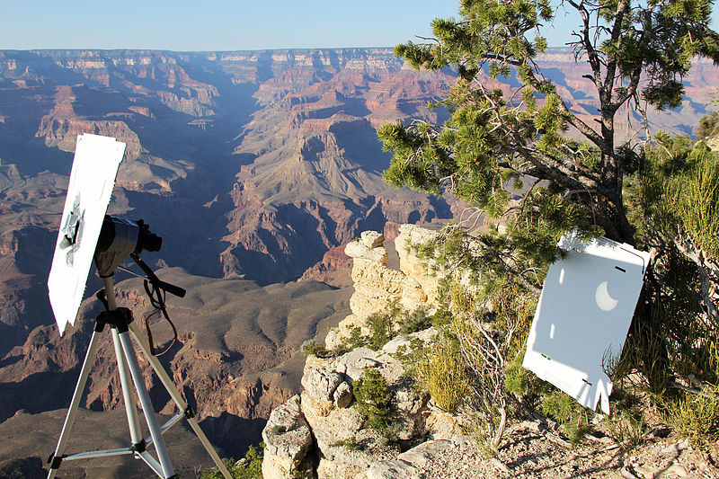
Project the Sun with Tools – and Care
Safe ways to Observe Solar Eclipses
Notes:
Another method of projection involves binoculars or a small telescope.
Emphasize : This is not viewing the Sun directly! You never want to look through binoculars at the Sun. *
By carefully covering all but one lens, you can project an image of the Sun onto a flat surface.
This set-up needs careful monitoring so that no one accidentally looks through the eyepiece.
You will go blind.
Possible addition:
It can be useful to take an old pair of binoculars (or a magnifying glass) and shine them on a piece of thin plastic like old negatives or a plastic garbage bag. These will melt and give your visitors a visceral reminder not to look through binoculars at the Sun. Be careful – this projection can get very hot and you’ll need to give your instrument a break as it heats up.

Slide 25
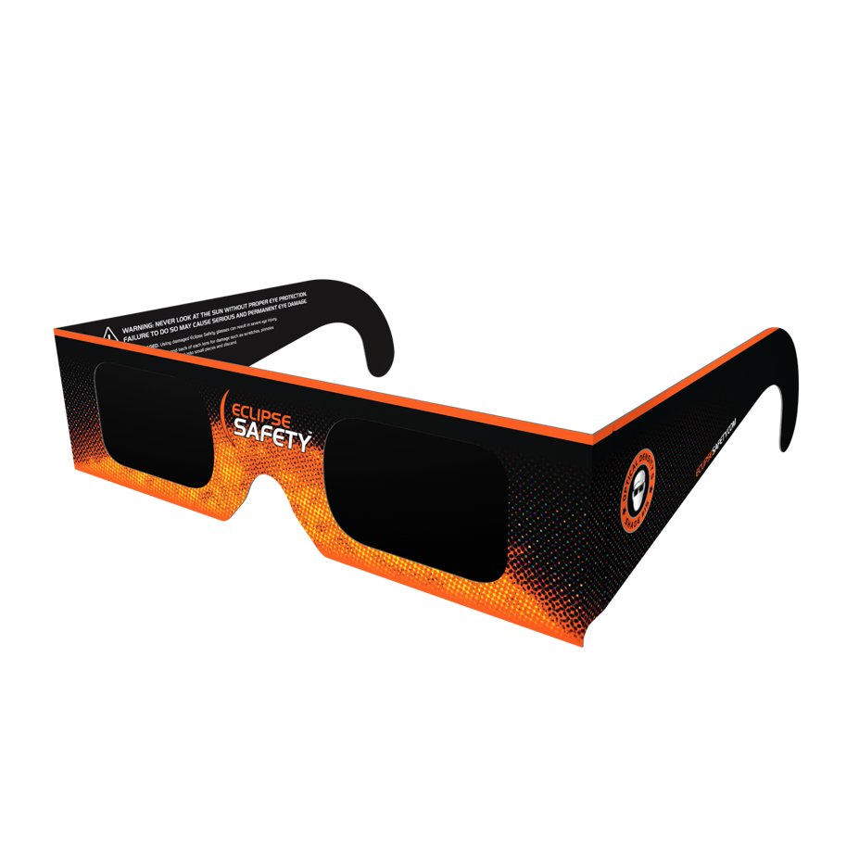
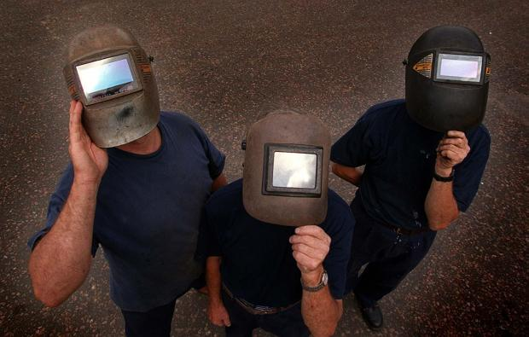
Observing Directly with Filters
Safe ways to Observe Solar Eclipses
There are ways to observe the eclipse directly, but it requires special filters.
Use approved eclipse glasses – not sunglasses!
Also welders glass #14 is safe for viewing. Don’t combine two #7 glasses. That is not safe.
#14 Welders Glasses
Notes:
There are ways to observe the eclipse directly, but it requires special filters
Use approved eclipse glasses – not sunglasses!
Also welders glass #14 is safe for viewing. Don’t combine two #7 glasses. That is not safe.

Slide 26
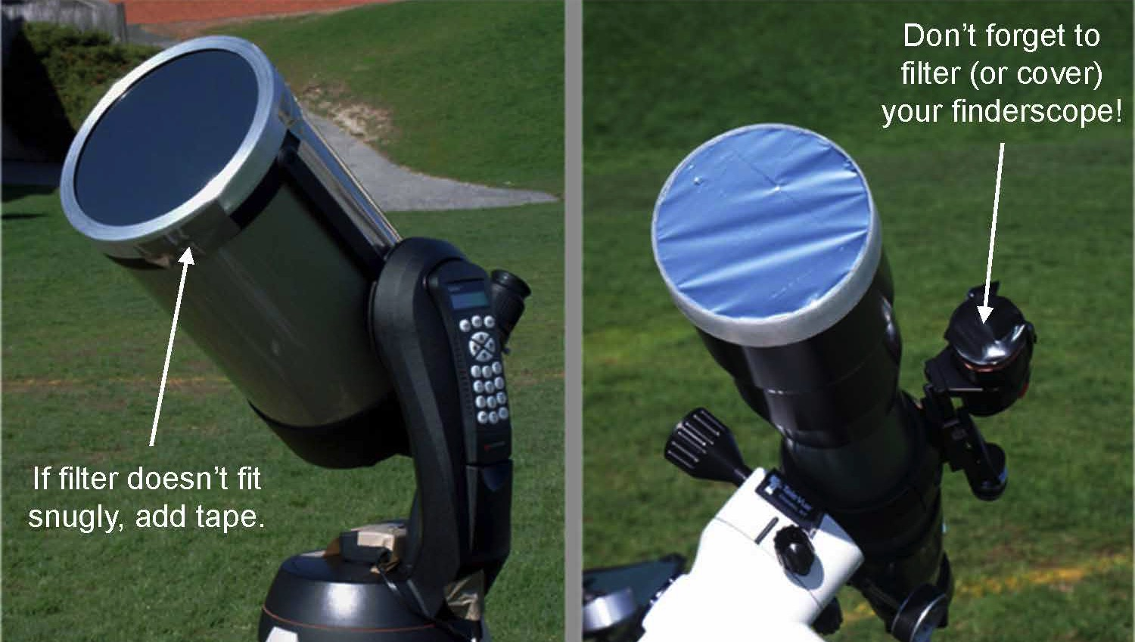
Use Special Care with Filtered Optics
Safe ways to Observe Solar Eclipses
Notes:
Telescopes and binoculars equipped with special solar filters are also useful if you have access.
Use only special-purpose solar filters on your precious optics!
These are usually made of metalized glass or special Mylar, not from a balloon.
Get these filters as far in advance as possible. See more information in the Resources page.
-----
Image credit: Rick Feinberg

Slide 27

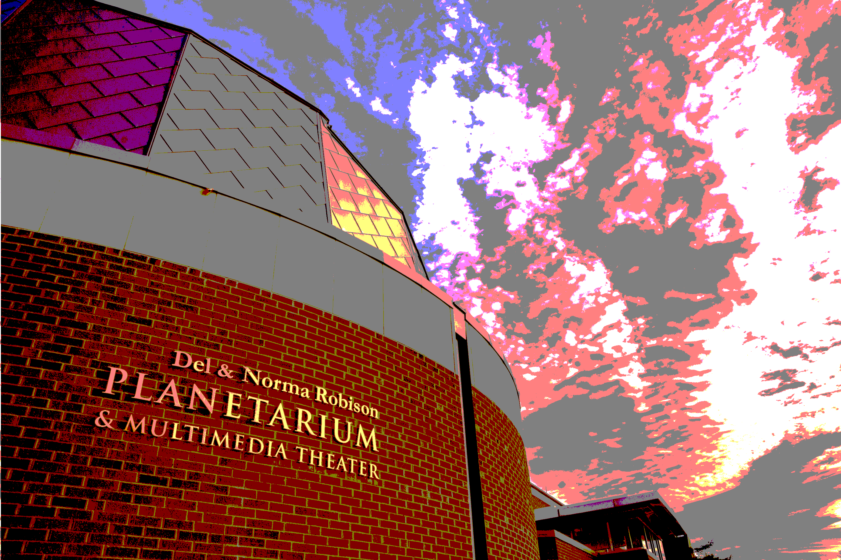
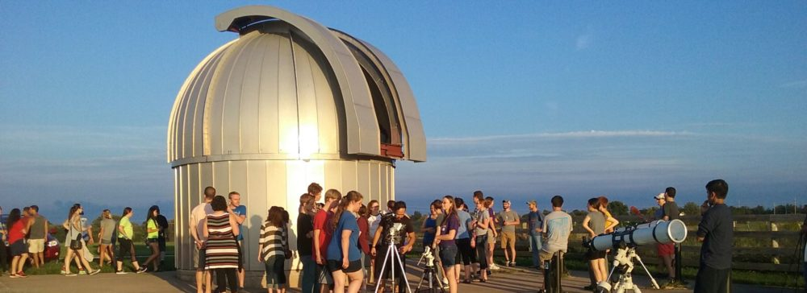
Eclipse 2017 in Kirksville

Slide 28
Eclipse 2017 in Kirksville
Event | Time (EST) | Alt | Azi
Start of partial eclipse | 11:44:53 AM | 55.6° | 139.2°
Maximum eclipse | 1:11:57 PM | 61.7° | 179.2°
End of partial eclipse | 2:37:52 PM | 56.1° | 219.2°
http://observatory.truman.edu/eclipse2017/

Slide 29
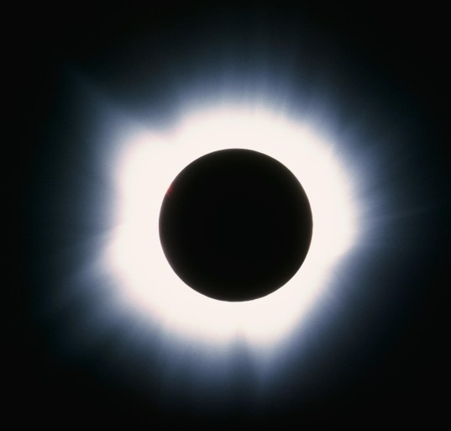
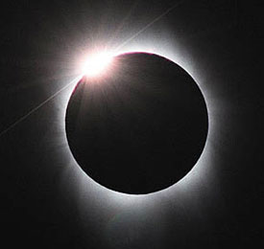
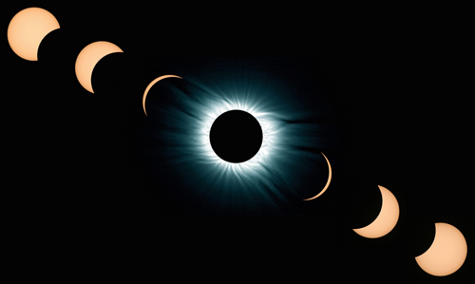
Eclipse 2017
The diamond ring
“Totality”
The solar corona

Slide 30
Eclipse 2017 in Kirksville: Funding
$2800 from the Missouri Space Grant Consortium
(MACC + Truman)
$2800 from the ‘AAS Small Eclipse Grant’ (Truman)
$1000 from SAM & Physics (Truman)
$600 from Kirksville Tourism

Slide 31
Eclipse 2017 in Kirksville
12 solar telescopes (optical telescopes fitted with appropriate solar filters)
10 Solar binoculars
7500 solar glasses
  3000 R-III schools
  2500 Truman State
  1000 Del and Norma Robison Planetarium
  1000 Kirksville Tourism
In addition, 300 solar glasses have been ordered by the Adair County Public Library.
2 Sunspotters
Several pinhole camera’s of different kinds (as mentioned earlier)

Slide 32
Eclipse 2017 in Kirksville
Staff/Faculty Committee
  Janet Gooch (SAM Dean)
  Tom Nothdurft (R-III Schools)
  Zac Burden (Mo-hall Director)
  Carolina-Sempertegui-Sosa (Biology)
  Bill Miller (Chemistry)
  David Caples (MACC)
  Vayujeet Gokhale (Physics)
Student Volunteers
  Samantha Carroll
  Pujita Ravichandar
  Haley Parker
  Rebecca Niemeier
  Patrick Morgan
  Jonathan Marple
  Garrett Money
  Mridul Bhattarai
  Charlyn Ortmann
  Faith Parrish (MACC)

Slide 33
Eclipse 2017 in Kirksville
WE ARE LOOKING FOR
INTERESTED AND MOTIVATED VOLUNTEERS
Sun-Earth-Moon Workshop in Late March at Truman State University
  Exact date, time and room numbers TBD
  Email gokhale@truman.edu for information and updates

Slide 34
Events leading up to Eclipse 2017 in Kirksville
Solar scopes will be set up across Kirksville (the county library, grocery stores, TSU campus, farmers market, etc.) twice a month
Trained volunteers will educate students and members of the community about solar activity such as sunspots, solar flares, plages, prominences, and filaments.
Students will explain the science and geometry of eclipses to members of the general public.

Slide 35
Events leading up to Eclipse 2017 in Kirksville
On the day of the eclipse, several solar telescopes will be set up at various locations on or near the Truman campus, the Adair County Library, and the Kirksville R-III school district campus.
In addition, solar glasses will be distributed for safe viewing of the eclipse. Sunspotters, solar binoculars, and handheld spectroscopes will be available at selected sites.
The Adair County Library will establish a ‘Library-Telescope program’ using some of the solar telescopes and binoculars for patrons to check out.
  Appropriate user-friendly modifications will be made.
  Library staff will be trained in safety and operation of these instruments.

Slide 36
Eclipse 2017 in Kirksville
Locations
Water Fountain on Truman Campus
Truman State Observatory
MACC/R-III School Area
Adair County Public Library/Rotary Park
Other Potential Locations
Downtown Kirksville (lunch traffic)
North Park
Walmart/Hyvee/Aldi Parking Lot (?)
Other ideas?

Slide 37
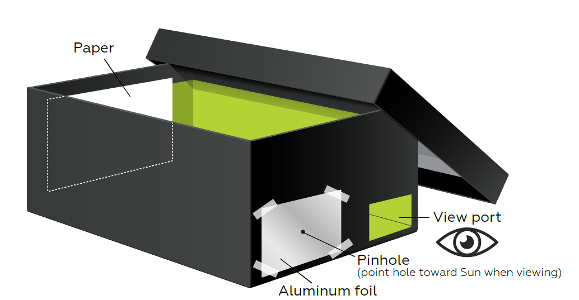
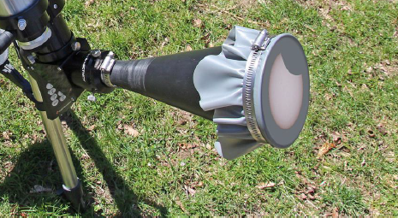
Activities and Information Handouts
How to make a pinhole camera
http://www.jpl.nasa.gov/edu/learn/project/how-to-make-a-pinhole-camera/
http://static.nsta.org/extras/solarscience/chapter3/3.10PinholeProjectionInABox.pdf
How to build a sun-funnel:
https://eclipse.aas.org/sites/eclipse.aas.org/files/Build-Sun-Funnel-v3.2.pdf

Slide 38
Activities and Information Handouts
American Astronomical Society Eclipse Page:
https://eclipse.aas.org/resources/educational-materials
Night Sky Network (NASA-JPL):
https://nightsky.jpl.nasa.gov/download-view.cfm?Doc_ID=588
NASA Eclipse 2017 Teacher Resource Page:
https://eclipse2017.nasa.gov/k-12-formal-education
NASA Museum Alliance Eclipse Page:
https://informal.jpl.nasa.gov/museum/content/eclipse-2017
AAPT Eclipse Page:
http://aapt.org/resources/eclipse2017/

Slide 39
Eclipse 2017 in Kirksville
WE ARE LOOKING FOR
INTERESTED AND MOTIVATED VOLUNTEERS
Sun-Earth-Moon Workshop in Late March at Truman State University
  Exact date, time and room numbers TBD
  Email gokhale@truman.edu for information and updates

