Slide 1
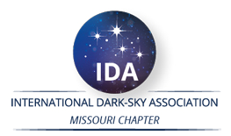
The International Dark Sky Places Program
Vayujeet Gokhale & Stephanie Todd
@Vayujeet, @darkskyTSU

Slide 2
Purpose of Outdoor Lighting
Enhance safety for people,
Improve security for property,
Aesthetic value,
Economic development.
Common Applications
Roadway and street lights,
Parking lots,
Sports fields,
Housing complexes,
Residential,
Downtown areas,
Malls and shops,
Gas stations & car dealerships,
Parks,
Electronic Billboards, etc.

Slide 3
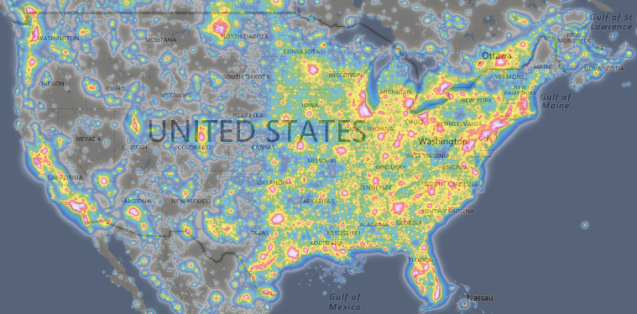
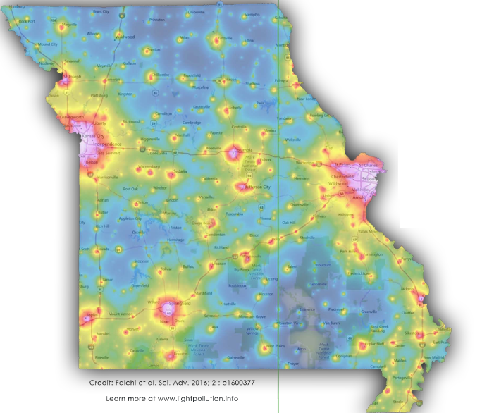
The Challenge
https://lightpollutionmap.info/
“The loss of the night sky is placed in the broader context of society’s difficulty in fully articulating non-consumptive values such as natural beauty.”
Terrel Gallaway (Missouri State University; IDA-Mo Board Member)
How to bridge this gap!?

Slide 4
Three Aspects of Combating LP
Quantifying Light Pollution
Measurements to quantify light pollution
Insects, animals, plants etc. that are harmed by bad lighting
Economic and health incentives to reduce night time lighting
Education & Outreach
Harm caused by Light Pollution to living beings
Aesthetic considerations and financial savings
Develop a dark sky group of motivated and knowledgeable individuals
Actions: Fixing the Problem
Remedies for ‘bad’ light fixtures and bulbs
Communicate with administrators (schools, city, county, parks..)
Funding Sources

Slide 5
Mission Statements
The IDA's mission is to preserve and protect the nighttime environment and our heritage of dark skies through environmentally responsible outdoor lighting.
The mission of DarkSkyMissouri is to raise awareness about light pollution issues in Missouri, promote quality outdoor lighting, protect our natural environment and our beautiful night sky, and educate the public how reducing light pollution can lower energy costs.
The International Dark Sky Places conservation program recognizes and promotes excellent stewardship of the night sky.

Slide 6
Approach to Problem and Solutions
What is Light Pollution?
Quantity and Quality (Intensity and color)
Why fight light pollution?
Human health and safety
Ecology and Environment
Addressing Light Pollution
Technical solutions
Color, Shielding, Timers
Public Outreach & Awareness
Laws and Ordinances
The International Dark Sky Places program can be thought of as a way to engage individuals and institutions to implement best outdoor lighting practices based on sound science to build healthier communities and ecosystems.

Slide 7
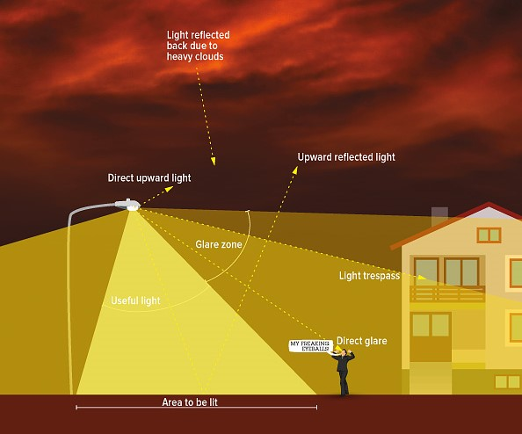
What is Light Pollution?
Photo Credit: IDA

Slide 8
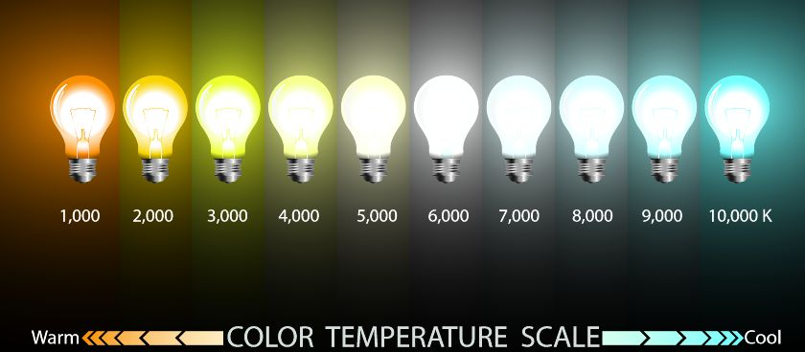
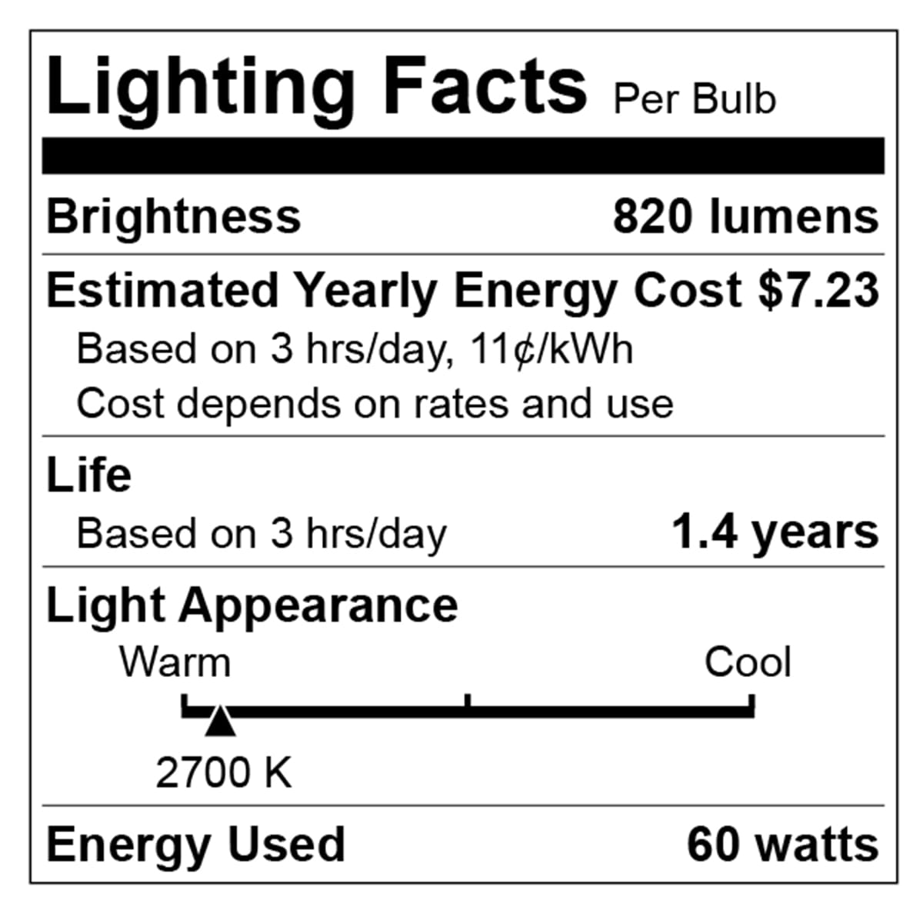
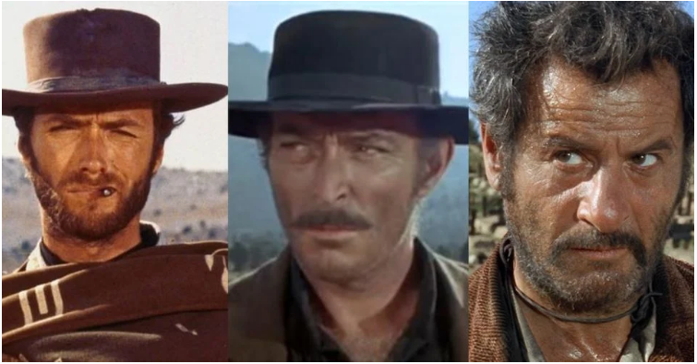
Light Intensity and Color are both important
For outdoor lighting, aim for 3000 K and below, preferably about 2000 K.
Orange/Red good, yellow bad, blue light ugly

Slide 9
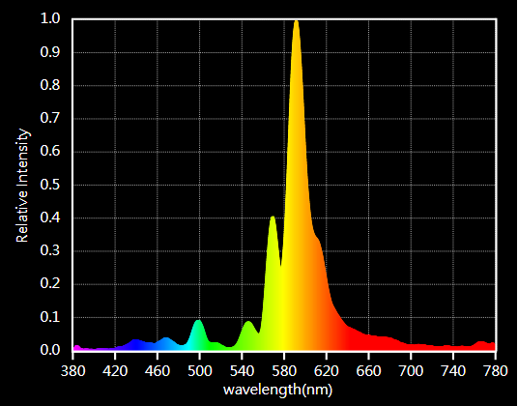
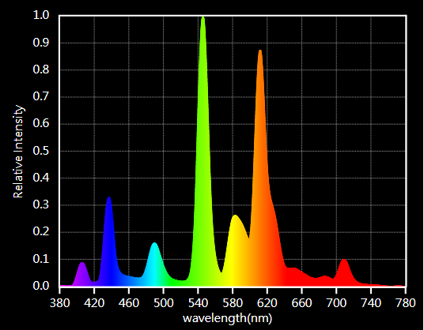
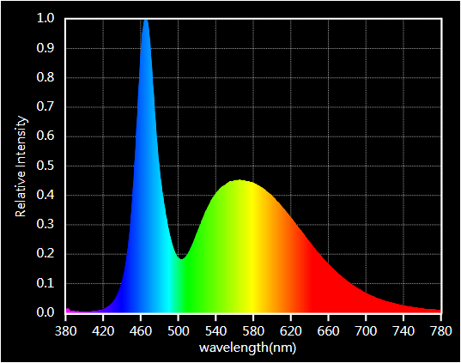
Color is important but check spectrum!

Slide 10
Technical Solutions to Light Pollution
Use “warmer” (low CCT temperature) lights -- that is, use amber or red colored outdoor lights.
These cause less glare, and are soothing to the eye,
Orange/Red light scatters less in the atmosphere than blue/white light – hence contributes less to sky glow, and
the least harmful to plants, insects, birds, and animals.
Secondly, turn off the lights when they are not in use -- whether indoors or outdoors.
If at all lights are necessary outdoors:
Use well shielded light fixtures (“dark sky friendly”)
put lights on a timer so that they can turn “on” only when needed.
(This also is good for safety).

Slide 11
Reducing Light Pollution
The technical solutions to light pollution are rather straight-forward: minimize use of outdoor light, direct it where it is needed, and use amber/red light instead of blue-white light.
The bigger challenge is to overcome individual and institutional inertia and make people change their habits.
This requires dark sky advocates to take the initiative and engage the public to create awareness about the issues involved, and to move people to act and demand change [bottom-up approach].
Additionally, dark sky advocates need to talk to administrators and lawmakers to help them pass laws and ordinances that prohibit the unnecessary and indiscriminate use of outdoor lights [top-down approach].

Slide 12
Protecting the Night
How to bring about change?
One of the most difficult things to do is to get people to change their behavior
INDIVIDUALS WILL HAVE TO BEAR THE BURDEN OF CHANGE TILL INSTITUTIONS CATCH UP
Consider starting a Dark Sky Group: Involve individuals from diverse backgrounds – administrators, artists, birders, farmers, health experts, hunters, power companies, scientists, teachers, and so on.

Slide 13
Dark Sky Group
Develop a core group that enjoys the work.
Reach out to potential partners in the community (parks, businesses science-teachers, etc.)
Start spreading the word: write a letter to the local newspaper; set up booth at the farmers market, get students involved, etc.
Establish personal contacts with local businesses, city administrators, park officials, and so on.
Goal should be to develop awareness about the problems and the solutions to light pollution.
Be patient, develop a thick skin, arm yourself with knowledge, and develop “polite courage”.
https://www.darksky.org/how-to-start-a-local-dark-skies-group/

Slide 14
Overall Approach
Resources (freely available, no need to re-invent every wheel)
Handouts, Powerpoint presentations, brochures, expertise [IDA-Mo]
Basics of Light Pollution (IDA, IDA-Mo, local experts)
What is LP?
Why work to reduce LP? [harmful effects of LP, how LP affects *everything*]
How to measure LP?
How to solve LP?
Develop a “Dark Sky Awareness” program
Outreach [variety of target audience: general public, younglings, admins, etc.]
Actions and Expectations
International Dark Sky Places (IDSPlaces) Programs
Categories
Criteria
Process of Certification

Slide 15
https://www.darksky.org/our-work/conservation/idsp/
Use the IDSPlaces guidelines document as your “north star”
What needs to be done to get certified = improvement in outdoor lighting

Slide 16
Benefits of IDSPlaces
Healthier community and ecosystem
Financial benefits of tourism
Chance to be a world-leading community
Financial savings owing to reduced energy usage
Maintaining top-tier sky quality
Light Pollution is a well defined problem, with reasonably straight-forward and available solution.
If we cannot solve such problems, what hope do we have to solve more intractable problems!?

Slide 17
Benefits of IDSPlaces
IDSPlaces serve as a real-life example of this mission in action:
Meaningful Change Backed By Policy
Community Involvement/Support
Public Access
Dark Sky Lighting Practices
Continued Commitments to Conservation

Slide 18
International Dark Sky Places (IDSP) Designation Types
International Dark Sky Places (IDSP) Designation Types
International Dark Sky Parks
International Dark Sky Sanctuaries
International Dark Sky Reserves
International Dark Sky Communities
Urban Night Sky Places
Each Place has its own set of guidelines, available at darksky.org/idsp
Current total: 177 Countries: 21

Slide 19
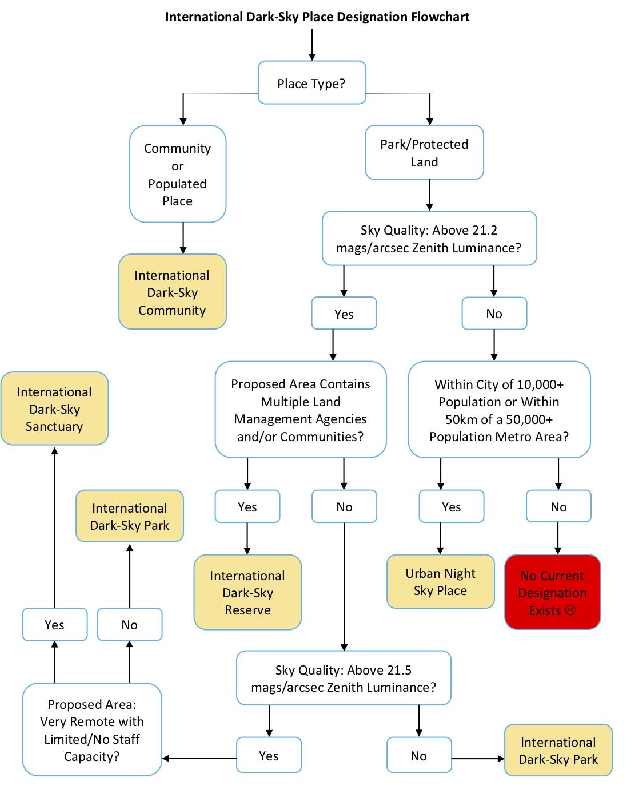
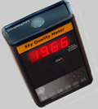
SQM
Most of Missouri parks are likely to be in these categories

Slide 20
International Dark Sky Places (IDSP) Designation Types
International Dark Sky Places (IDSP) Designation Types
International Dark Sky Parks
Either public or private
Legally protected for scientific, natural, cultural or public enjoyment purposes
Should be accessible, at least in part, at night
Night sky equal or darker than 21.2 mag/arcsec²

Slide 21
International Dark Sky Places (IDSP) Designation Types
Example: Urban Night Sky Places
An IDA Urban Night Sky Place is a municipal park, open space, observing site, or other similar property near or surrounded by large urban environs whose planning and design actively promote an authentic nighttime experience in the midst of significant artificial light.
https://www.darksky.org/wp-content/uploads/bsk-pdf-manager/2021/05/UNSP-Final-May-2021.pdf

Slide 22
International Dark Sky Places (IDSP) Designation Types
Urban Night Sky Places: Eligibility
Within 50-km (~32 miles) of municipality with population greater than 10,000 or 50,000+ people if defined as a metro area of two or more adjoining municipalities.
Sufficient mitigation of light trespass and glare.
(At least partial) Regular night time access.
Engage visitors with direct interpretation of the value of natural nighttime darkness and good outdoor lighting practices.
Managing agency easily identifiable to visitors.

Slide 23
International Dark Sky Places (IDSP) Designation Types
UNSP: Minimum Requirements
Evidence of Eligibility
Lighting Management Plan
Lighting Inventory
Evidence of commitment to quality outdoor lighting
Education and public outreach
Signage
Annual Reports

Slide 24
International Dark Sky Places (IDSP) Designation Types
UNSP: Light Management Plan
Written policy adopted by managing agency
Sets forth conditions of which areas are or not to be lighted.
Identify different use situations and locations and prescribe maximum illumination levels, lamp-type, and shielding.
The LMP must embrace basic good outdoor lighting ethics:
Only use light when and where needed, and in the appropriate amount, given use needs and ambient lighting conditions.
Outdoor lighting fixtures must be fully shielded and make appropriate use of timers and/or motion sensors.
Lighting of less than 500 lumens may be unshielded for special purposes, such as historical preservation. Such approved special uses must be clearly stated in the LMP

Slide 25
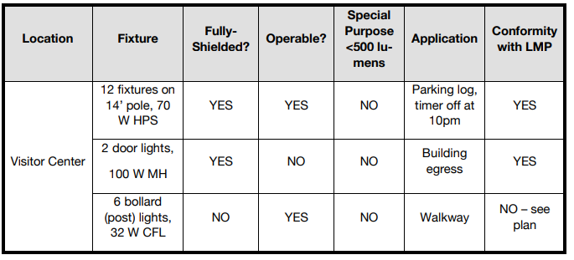
International Dark Sky Places (IDSP) Designation Types
UNSP: Light Management Plan
These can be met by abiding by about 9 “minimum standards” prescribed in the UNSP guidelines document.
The LMP is most likely the most onerous of the criteria for the UDSP program: design a good LMP and the rest is not-as-difficult!
Inventory Example:

Slide 26
IDS Places Program
How to Apply for Dark Sky Place Designation

Slide 27
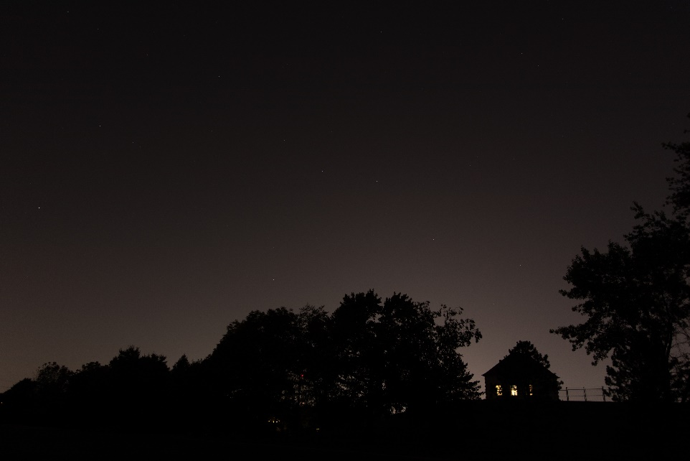
Determine Park Feasibility
- Determine site, review guidelines
- Reach out to stakeholders; park management, local government
- Conduct lightning inventory and scope of any necessary retrofit
- Host dark sky events
IDA-Missouri is here to help with this process!

Slide 28
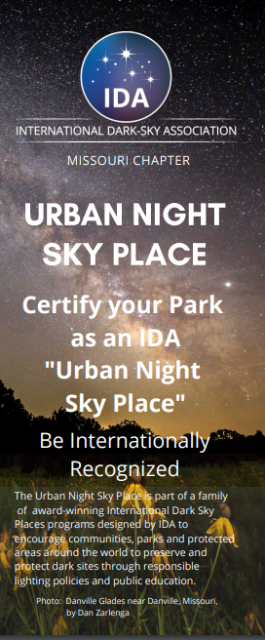
Take the First Step! https://www.darkskymissouri.org/idsp/inquiry
- Applications to the IDS Places programs can be intimidating and confusing.
- Complete the "Initial Inquiry" application on IDA Missouri's website at no cost or obligation to you.
- IDA Missouri's dedicated team will work with you to successfully apply and keep working with you throughout the process to help you achieve your goals!
Notes:
Phase 2: Putting together application materials. I have another powerpoint that goes into detail of initial steps of how to begin efforts for a Park certification, but to summarize there are some essential components to any certification:

Slide 29
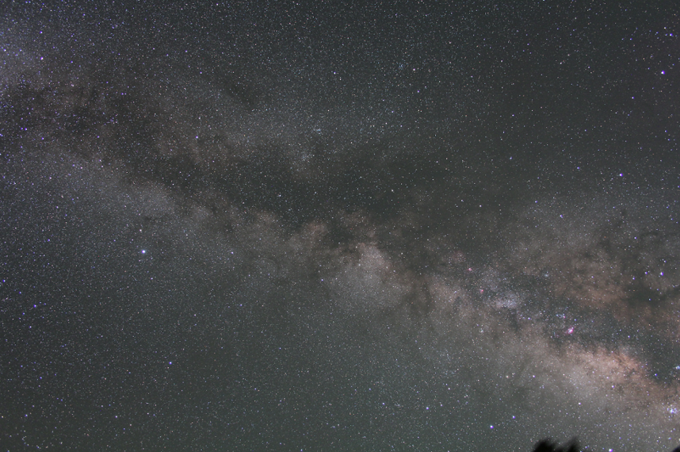
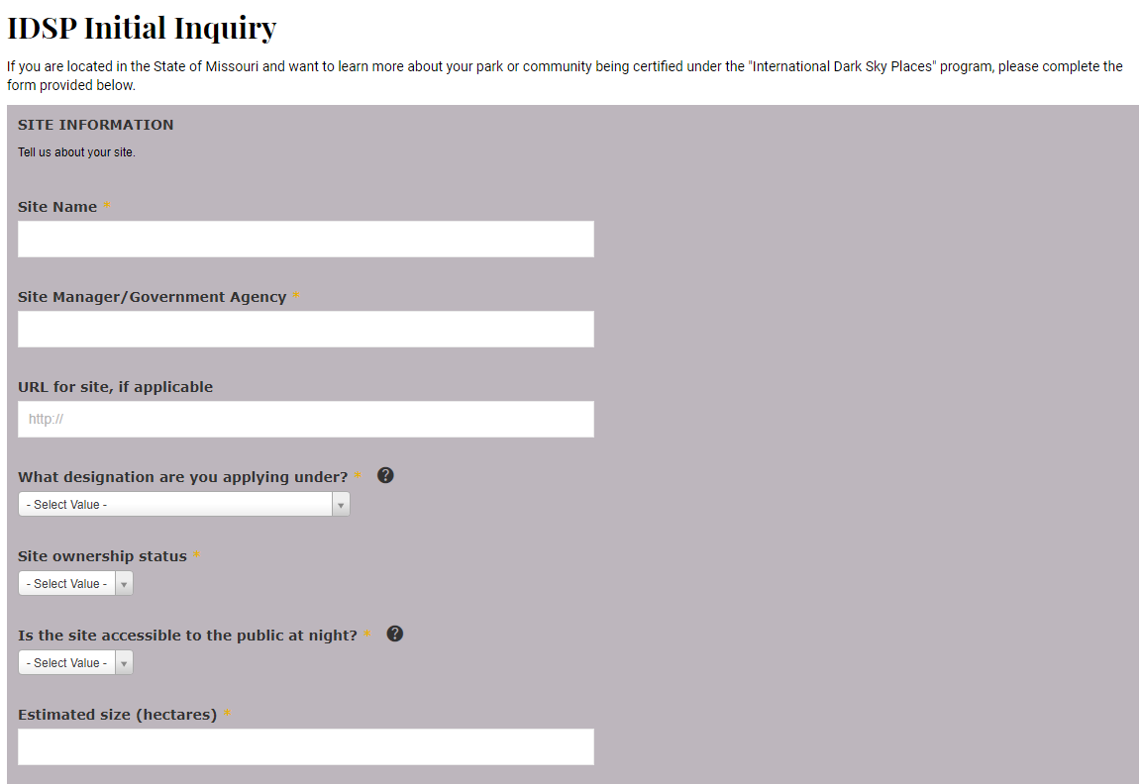
Take the First Step! https://www.darkskymissouri.org/idsp/inquiry
Fill-out the initial inquiry form, and we will get in touch with you!
Notes:
Phase 2: Putting together application materials. I have another powerpoint that goes into detail of initial steps of how to begin efforts for a Park certification, but to summarize there are some essential components to any certification:

Slide 30
Initial Inquiry Process
IDA-MO will review the application requirements and with applicant
Applicant determines if and when to pursue certification
IDA-MO supports applicant with application development and final submittal, including community outreach
Notes:
Phase 2: Putting together application materials. I have another powerpoint that goes into detail of initial steps of how to begin efforts for a Park certification, but to summarize there are some essential components to any certification:

Slide 31
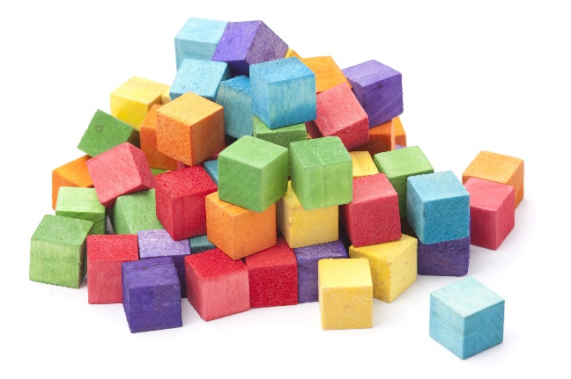
Main Components of an Application
- Letter of Nomination from an IDA Member, Agency Management, and letters of support from the community
- Create a lighting inventory
- Lighting compliance
- Write and adopt a Lighting Management Plan
- Community Outreach for the last year
- Night Sky Measurement Program
IDA-Missouri is here to help with this process!
This Photo by Unknown Author is licensed under CC BY
Notes:
1) Obtain a letter of nomination from a qualified IDA member nominator, as well as a supporting letter from the Park leadership, such as a superintendent or administrator.
2) Create a lighting inventory of all existing outdoor lighting within the park.
3) Create a quality comprehensive Lighting Management Plan (LMP) that describes how all outdoor lighting should be managed within the park. There are guidelines within the document and on our website that mention the aspects that need to be included in the plan.
4) Lighting compliance. By the time you submit the application, 2/3 (67%) of the existing lighting in your park needs to abide by the regulations listed in your LMP. You will also need to make sure that 90% of your lighting needs to be compliant within five years and 100% of your lighting needs to be compliant within ten years after receiving the designation.
5) Leadership example. This component is meant to show that your park is also committed to good uses of effective outdoor lighting, which can be accomplished in a few different ways:
A) Producing at least one “night sky friendly” lighting project that is publicly visible and interpreted.
B) Involving at least two external partners in dark sky restoration efforts.
C) Cooperation with at least two nearby municipalities that results in the adoption of lighting policies that improve sky conditions in the Park.
[Does not apply to Sanctuaries due to remote location]
6) Outreach. Your park should also have dedicated programming at least four times a year that educates visitors and the general public about dark skies and includes a reference to IDA.
[Sanctuaries - The importance of dark skies/natural darkness and the benefits of quality lighting
are paramount in Sanctuary external communications. If the Sanctuary typically provides interpretive programs, then dark skies must be one of the central themes communicated through on-site interpretation]
7) A measurement program must be maintained either by the Park, private landowner(s), or by another public or private organization (university, research center, IDA chapter, astronomy club, etc.) to follow the evolution of light pollution in the IDSP and assure that the night sky quality does not degrade.

Slide 32
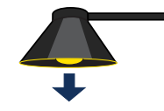
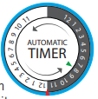
Lighting Basics
Light only what you need
Light should be only as bright as needed
Shield lights and direct them down
Only use light when you need it
Use warm color bulbs

Slide 33
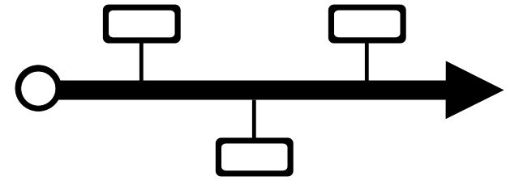
Approximate Timeline:
Most IDSP Designations: 1-3 Years
IDA-Missouri’s mission is to provide guidance and expertise so you can achieve your goals more efficiently!

Slide 34
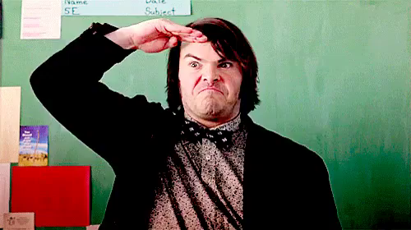
Links
International Dark Sky Places https://www.darksky.org/our-work/conservation/idsp/
Urban Night Sky Place Program Guidelines https://www.darksky.org/wp-content/uploads/bsk-pdf-manager/2021/05/UNSP-Final-May-2021.pdf
Use dark sky friendly lighting at your home and business https://www.darksky.org/our-work/lighting/lighting-for-industry/fsa/fsa-products/
Advocate for a lighting ordinance in your town https://www.darksky.org/our-work/lighting/public-policy/lighting-ordinances/

