Slide 1
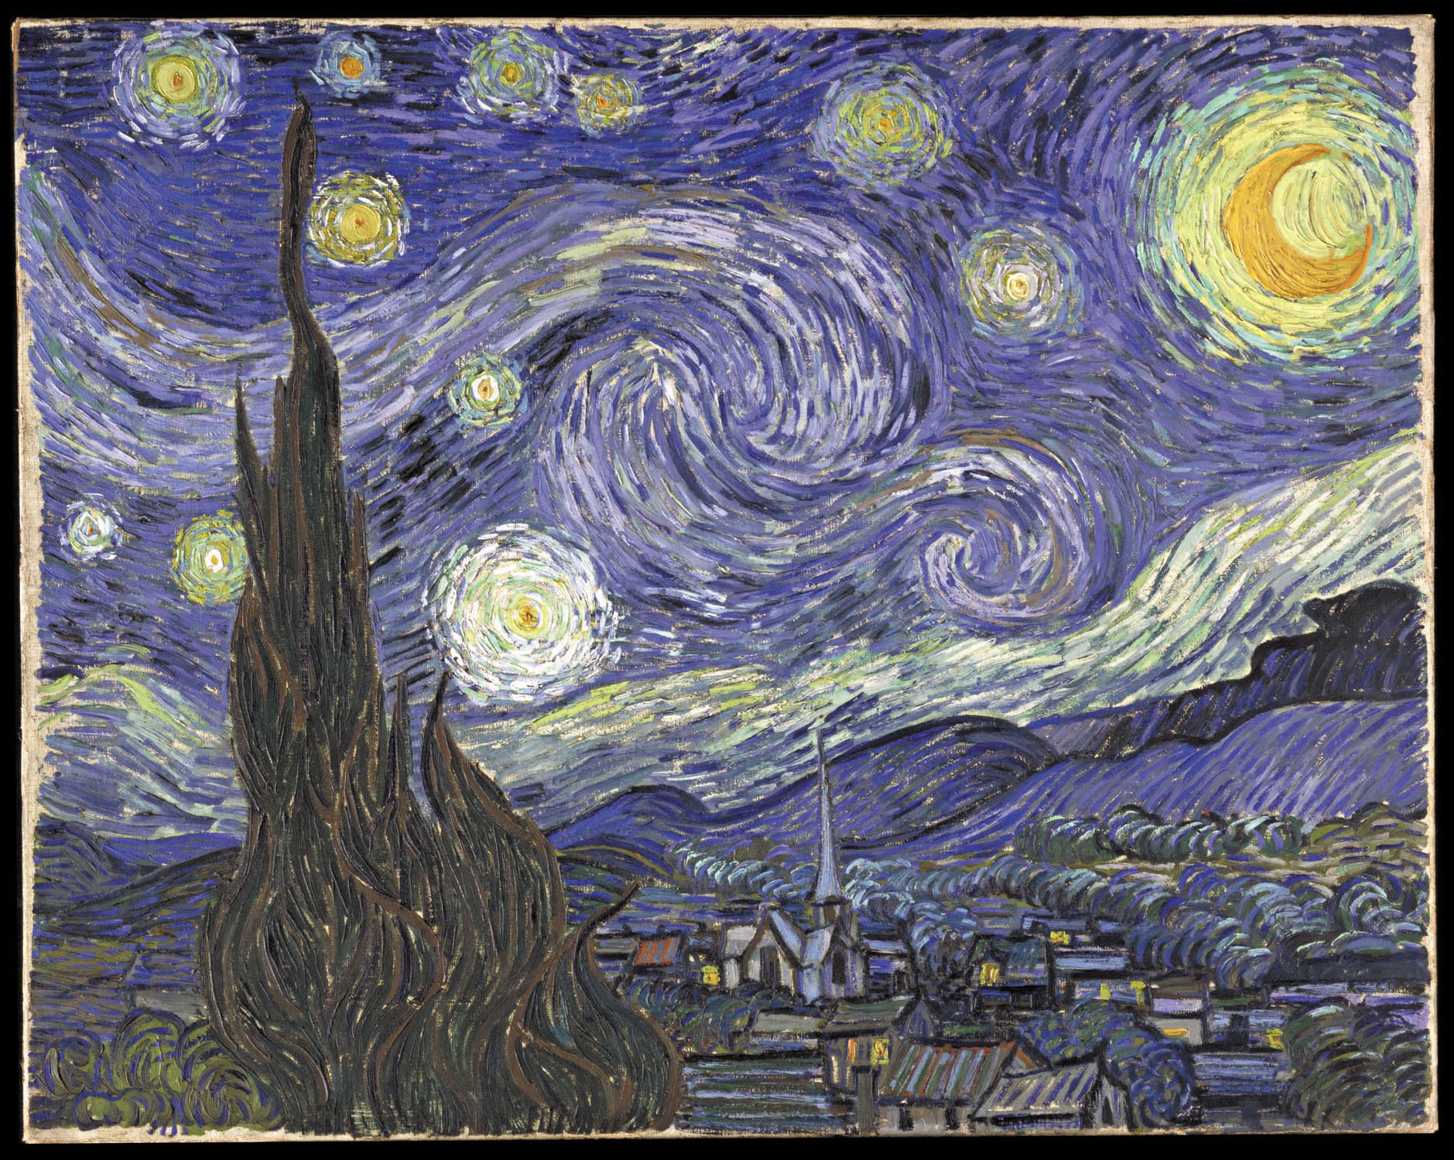
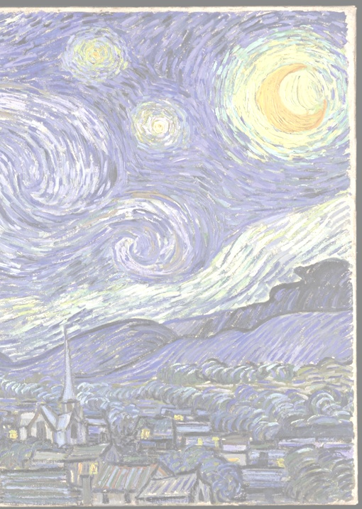
The Science & Growth of Light Pollution
Vayujeet Gokhale @Vayujeet, @darkskyTSU
Truman State University

Slide 2
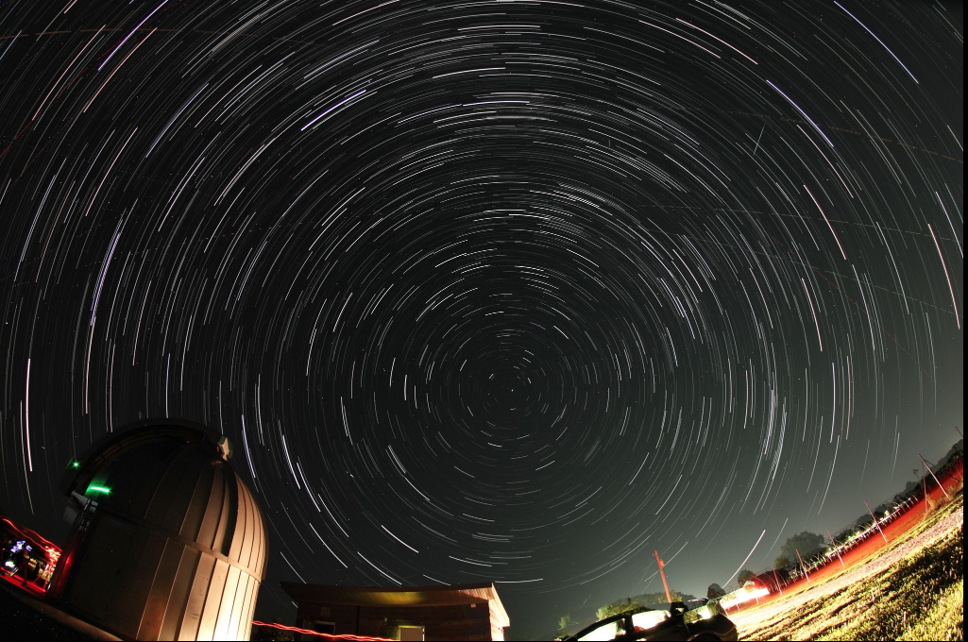
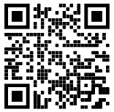
Outline of Talk
Background and Perspective
Quantifying Light Pollution
An Astronomer’s perspective on value of dark sky

Slide 3
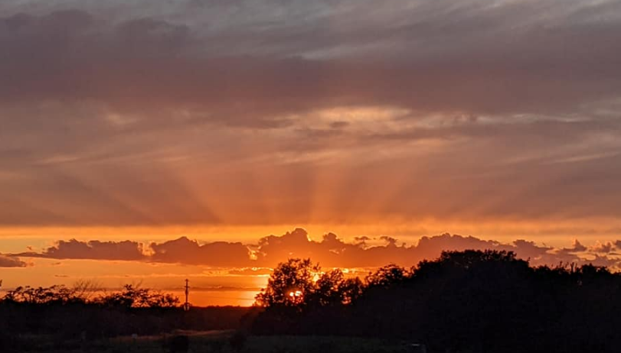
What I’d like you to do: I
Take friends, family, and random strangers to experience twilight

Slide 4
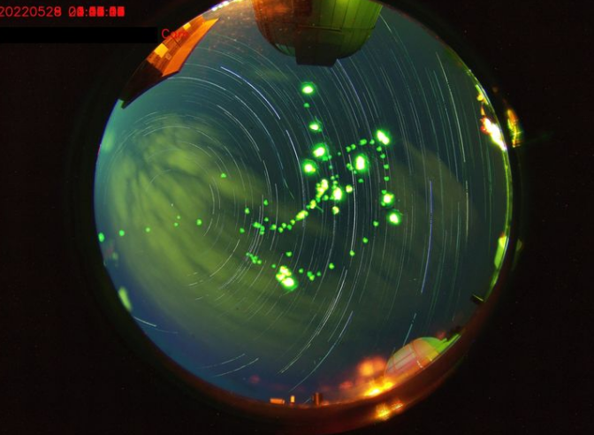
What I’d like you to do: II
Fireflies photobomb the all -sky-camera at the Truman State Observatory
“Half the park is after dark”:
Visit and camp outdoors, work towards reducing the fear of “darkness”
Sights and sounds of the night (not just stargazing!)

Slide 5
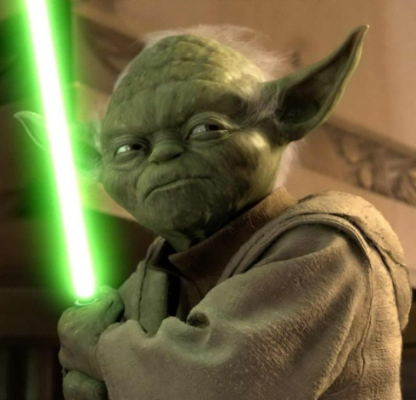
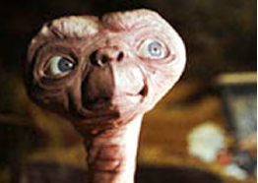
What I’d like you to do: III
Install a sense of wonder in younglings:
Why is a clear, cloudless daytime sky blue!?
Why is the night sky (supposed to be) dark? [Olbers’ Paradox]
Where is Everyone!? or Are we alone!? [Fermi’s paradox]

Slide 6
“Illuminate Freshman Seminar” Class Objectives
Basic definitions, terminology, and categories of light pollution,
Quantifying light pollution,
Science behind “good” and “bad” lighting,
Harmful effects of light pollution,
Current efforts to mitigate and reverse light pollution,
Engage with local administrators and decision makers by making the case for curbing light pollution and proposing solutions.
“Science”
“Activism Outreach”

Slide 7
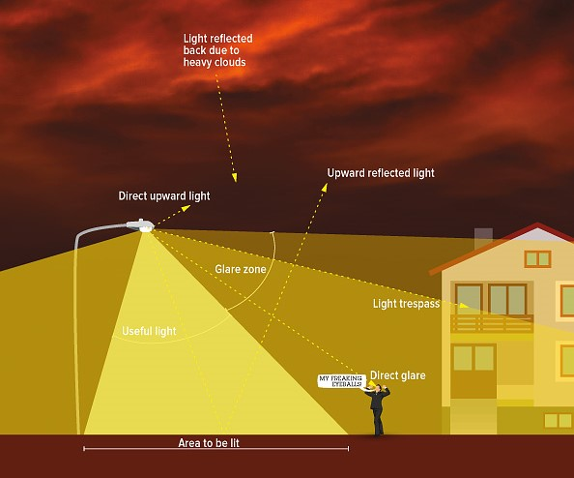
Perspective: What is Light Pollution?
Photo Credit: IDA

Slide 8
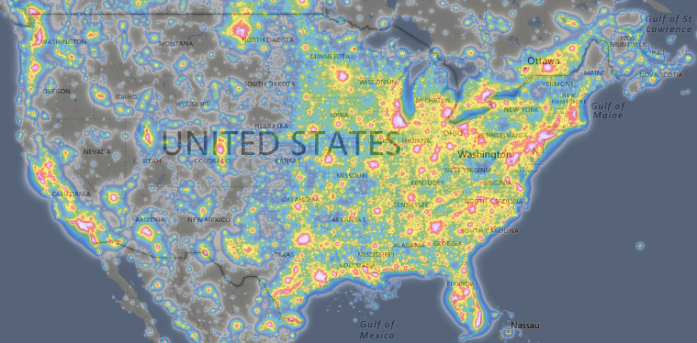
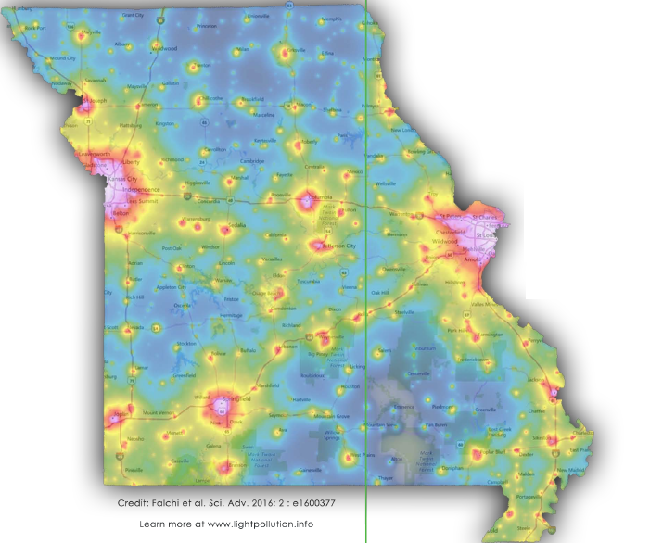
Perspective: The Challenge
https://lightpollutionmap.info/
“The loss of the night sky is placed in the broader context of society’s difficulty in fully articulating non-consumptive values such as natural beauty.”
Terrell Gallaway (Missouri State University; IDA-Mo Board Member)
How to bridge this gap!?

Slide 9
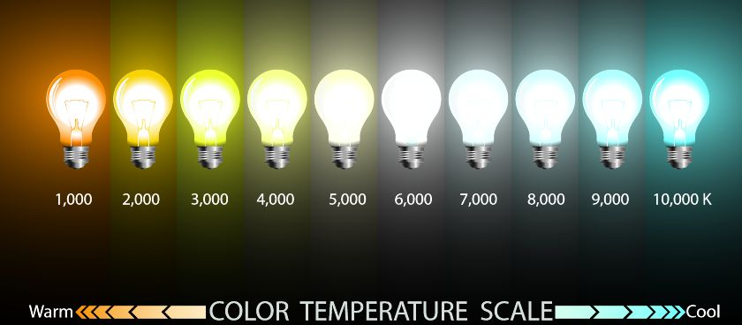
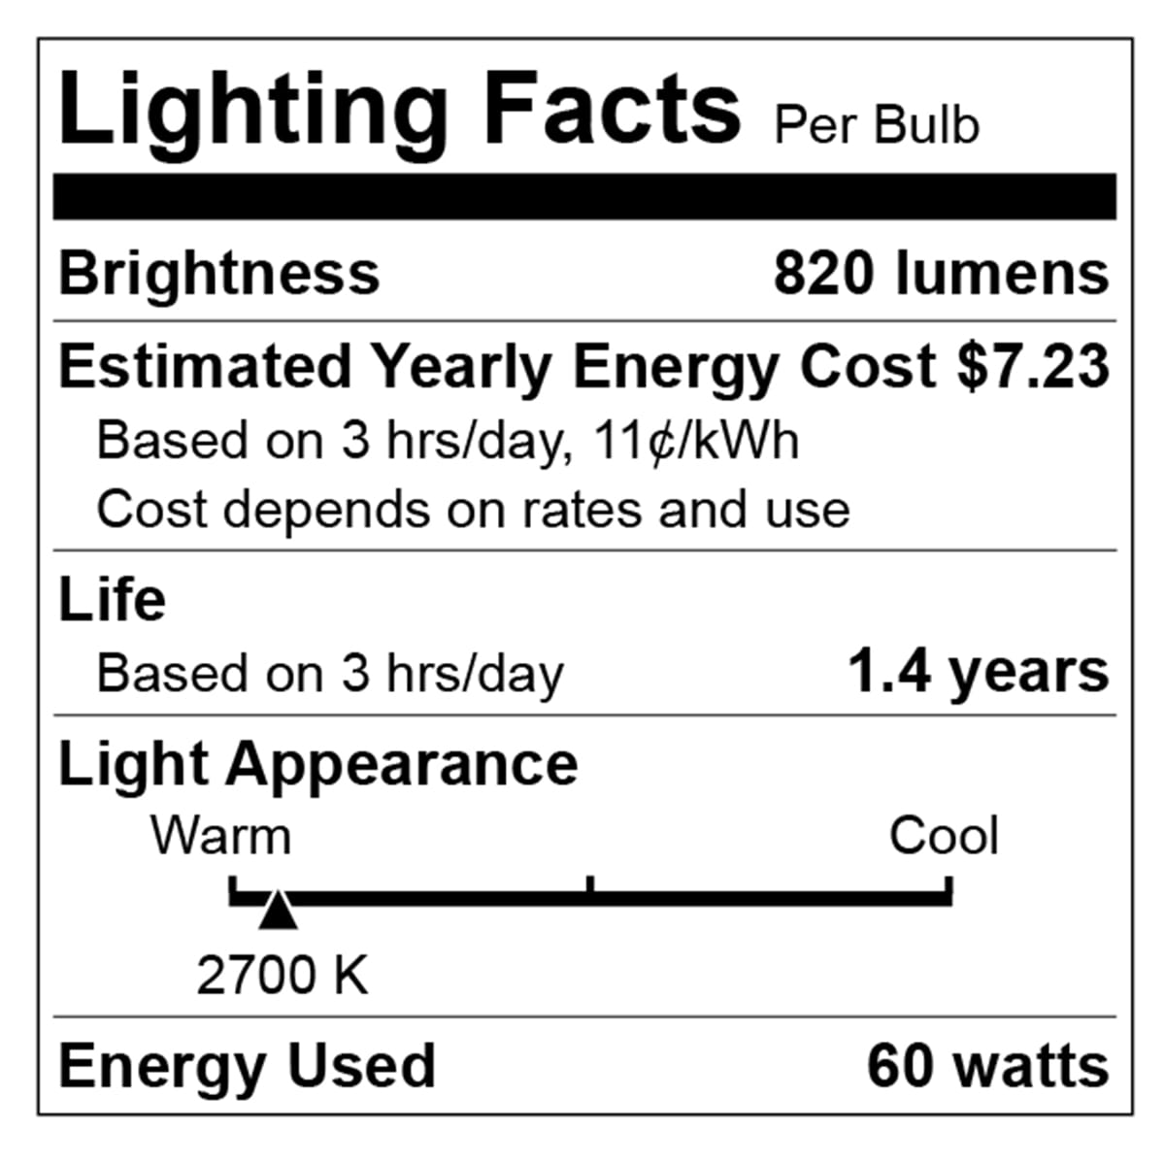
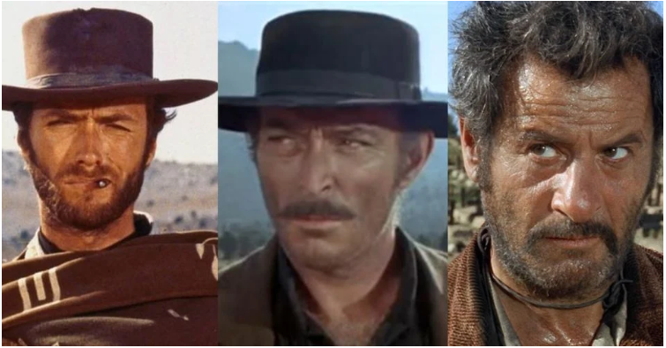
Perspective: Light Intensity and Color are both important
For outdoor lighting, aim for 3000 K and below, preferably about 2000 K.
Orange/Red good, yellow bad, blue light ugly

Slide 10
Perspective: The Challenge

Slide 11
Perspective: Astronomy & Light Pollution
Light Pollution is an increasing problem – urban sprawl and the increasing use of “cheap” LED lights is expected to make the problem worse.
Stargazers and Astronomers have a unique connection to the dark skies since traditionally, astronomers are the among the first to have noticed the problem.
Astronomers have found ways to quantify light pollution in terms of the “sky brightness”.

Slide 12
Quantifying Light Pollution Quantifying Symptoms of the Problem

Slide 13
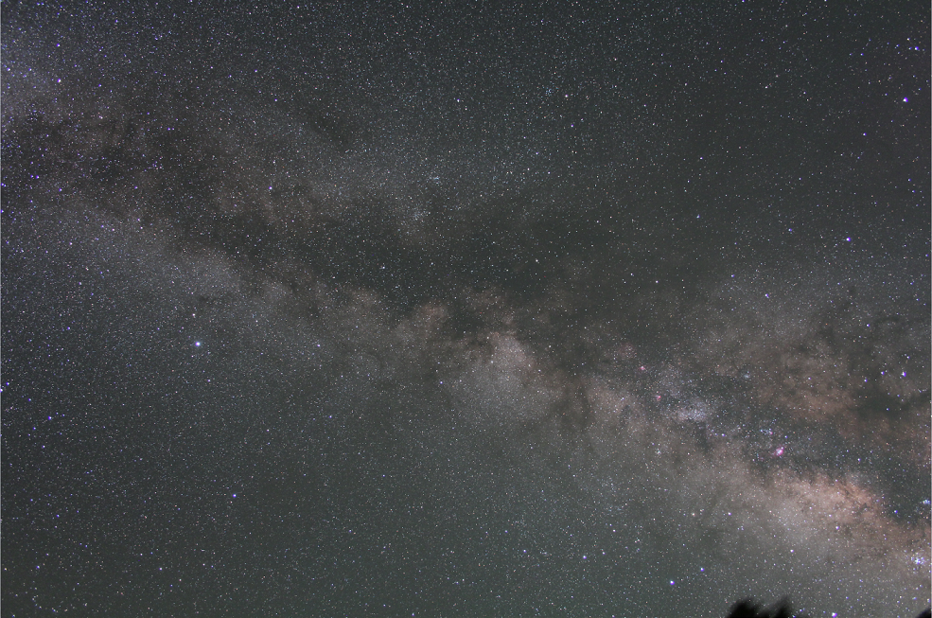
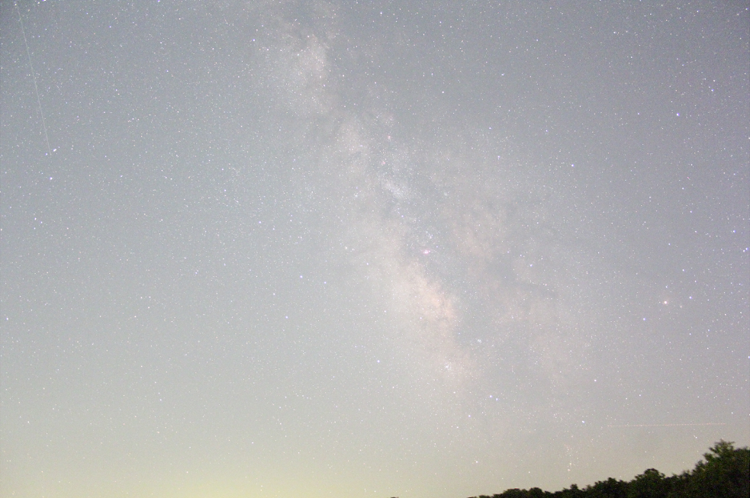
Symptoms of LP: Sky Glow
Flagstaff, Az 5 minute exposure, tracking ‘on’
Kirksville, Mo 1 minute exposure, tracking ‘on’

Slide 14
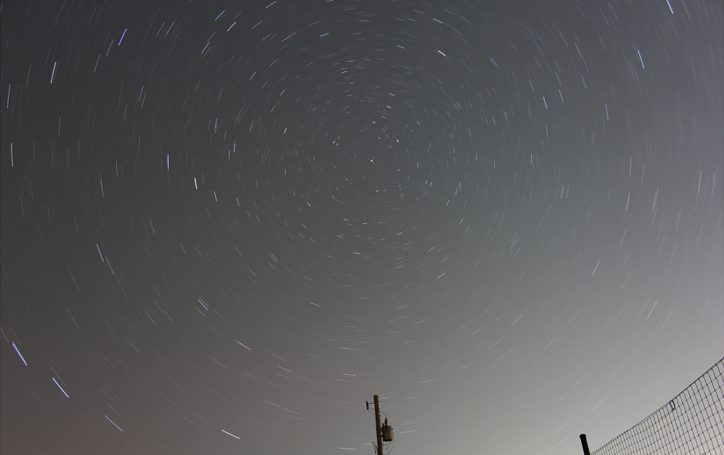
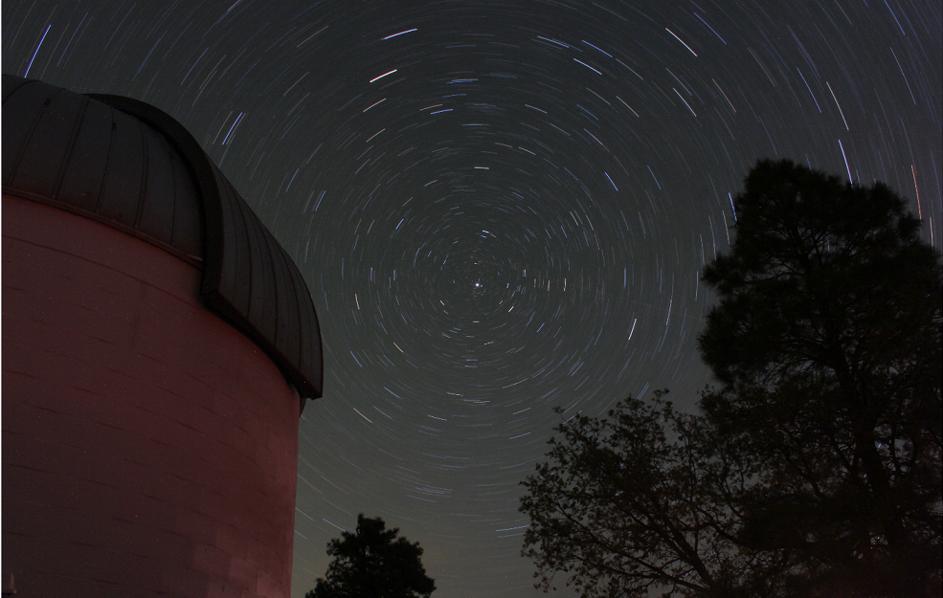
Symptoms of LP: Sky Glow
Flagstaff, Az 30 minute exposure, tracking ‘off’
Kirksville, Mo 15 minute exposure, tracking ‘off’

Slide 15
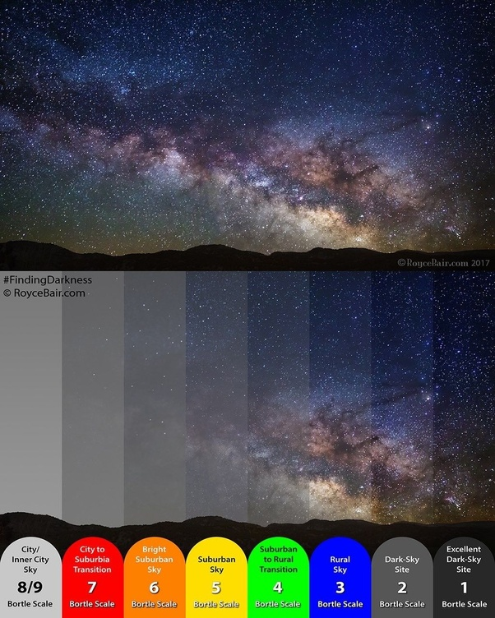
The Bortle Scale https://www.youtube.com/watch?v=0DEbUK6Qyb4
Photo Credit: Royce Blair

Slide 16
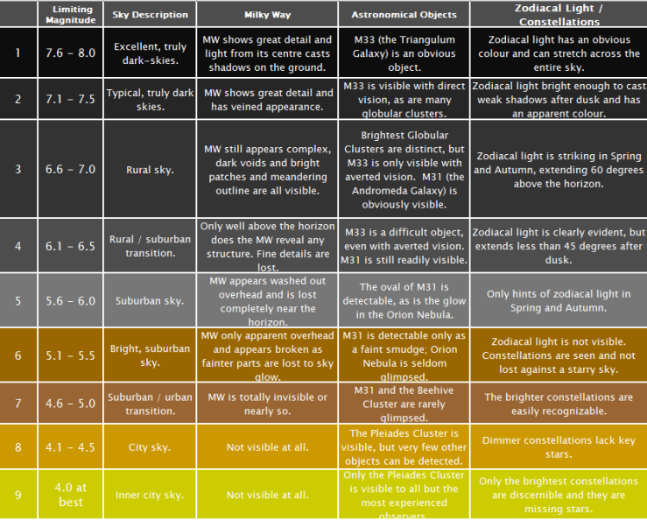
The Bortle Scale
Bortle 2001

Slide 17
Measuring Sky Brightness in terms of the Limiting Magnitude (i.e. faintest star you can see unaided)
The Globe and Night Network
https://www.globeatnight.org/

Slide 18
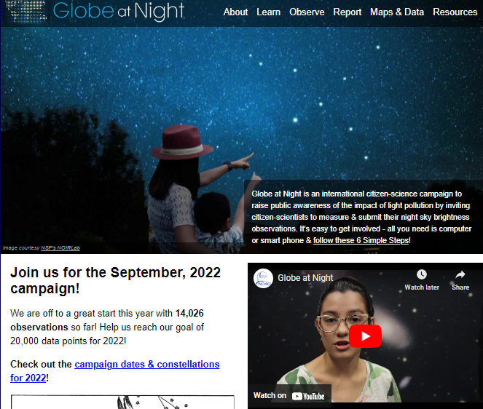
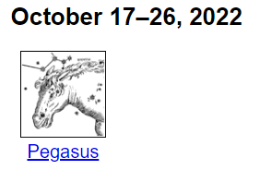
Globe at Night
Click here
https://www.globeatnight.org/

Slide 19
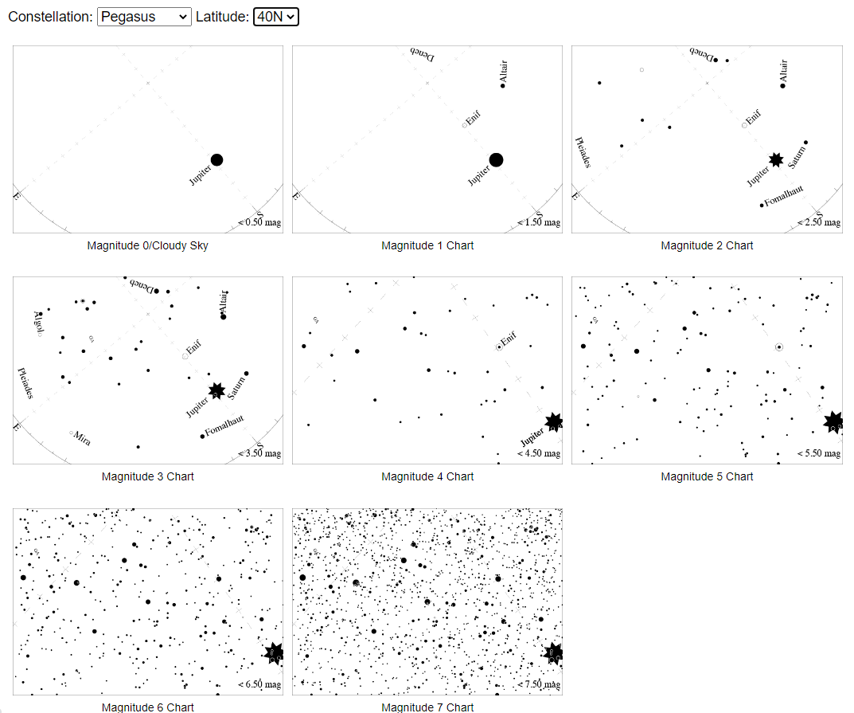
GaN: What does your sky look like?
Choose appropriate latitude (40-degrees is good for most of Mo)

Slide 20
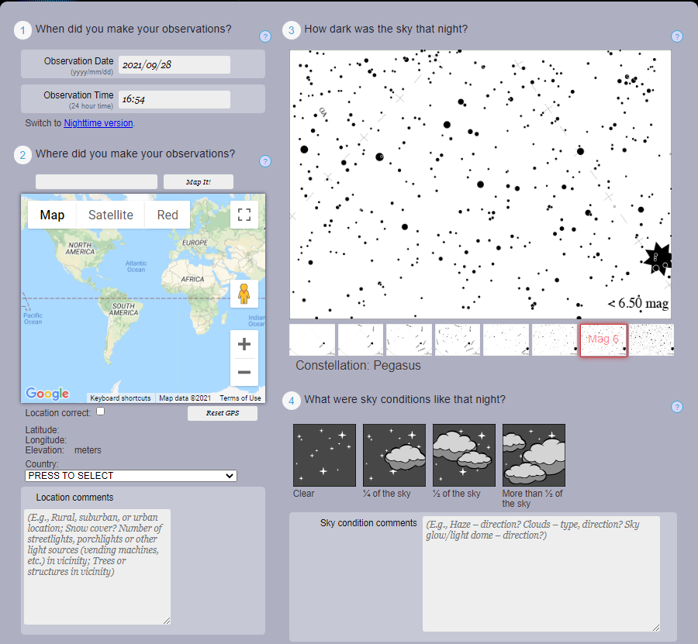
GaN: Report

Slide 21
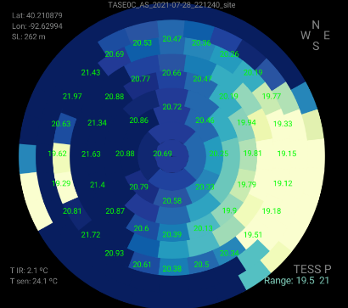
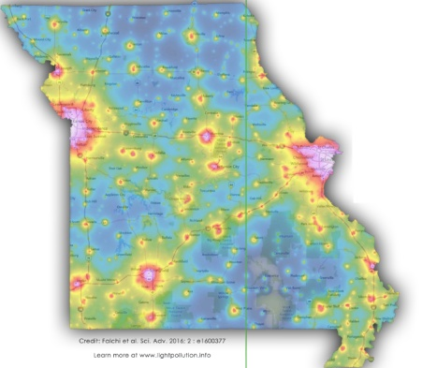
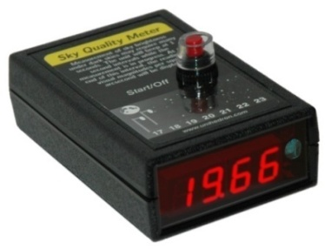
Measuring Light Pollution: Techniques
Remote Sensing (Looking down)
Ground-based Sensors (Looking up)
Single Channel (SQMs)
All Sky Imagery (DSLR+Fish-eye)
Satellites
Drone Imaging
Cover Large Areas
Good for ecological surveys
High Resolution possible
Expensive
No standardized calibration (yet)
Cover one location at a time
Good for studying temporal evolution
Poor resolution (SQMs, for example)
Cheaper and portable
Some standardization (SQMs), but DSLR calibration not yet standardized

Slide 22
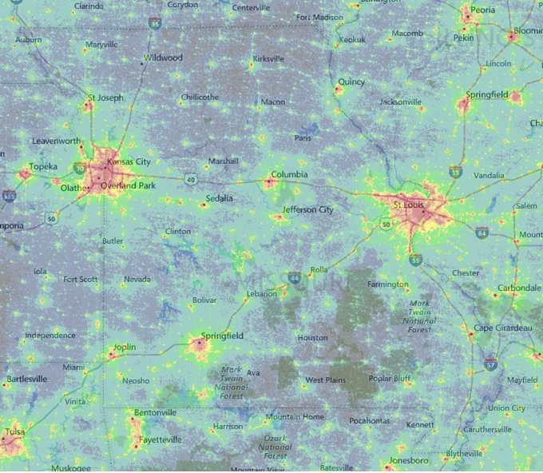
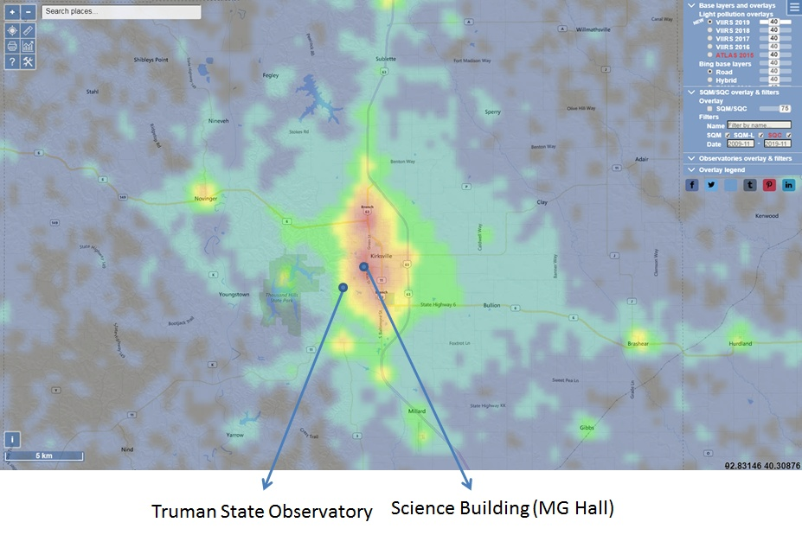
Satellite Maps
Light Pollution map of the World: https://www.lightpollutionmap.info/

Slide 23
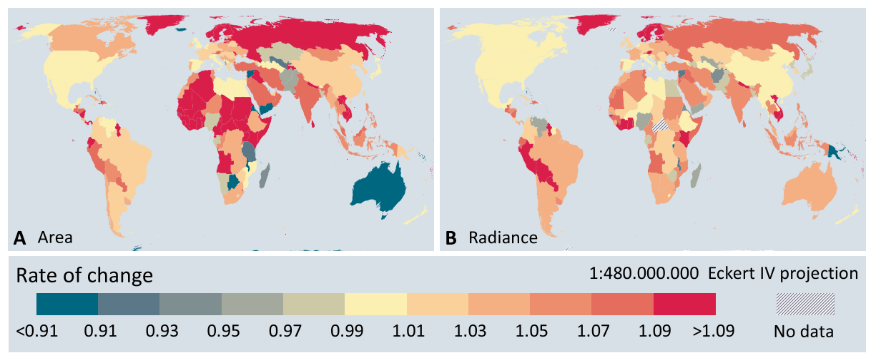
Satellite Data
Kyba, 2017
Both the amount of artificial light seen on Earth at night and the land area that light covers grow by about two percent each year on average.

Slide 24
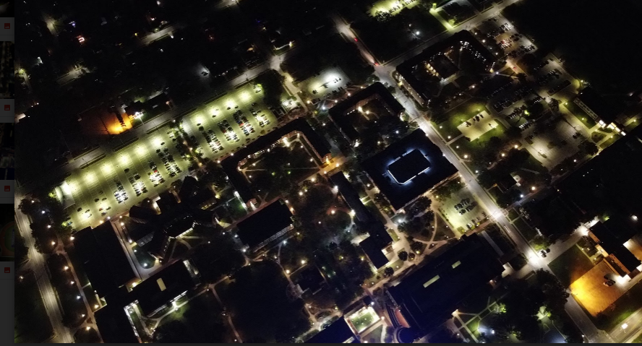
Drone Imaging: Examples

Slide 25
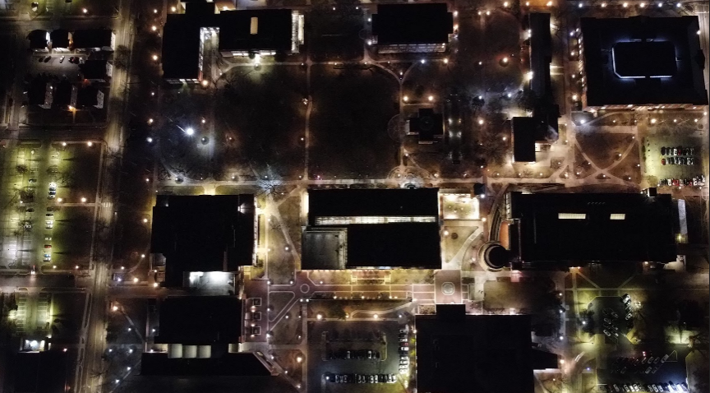
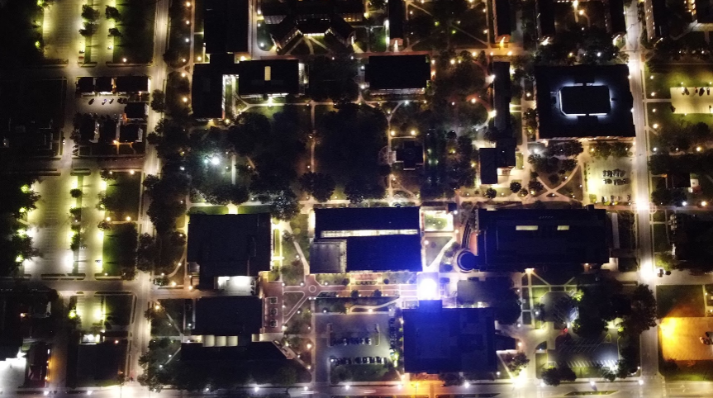
Drone Imaging: Examples

Slide 26
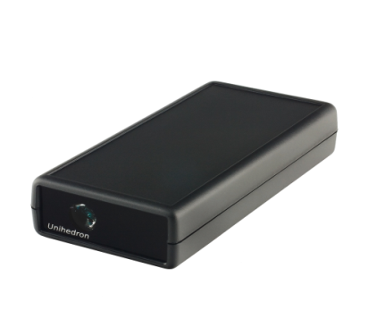
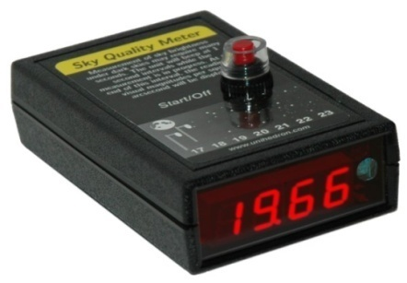
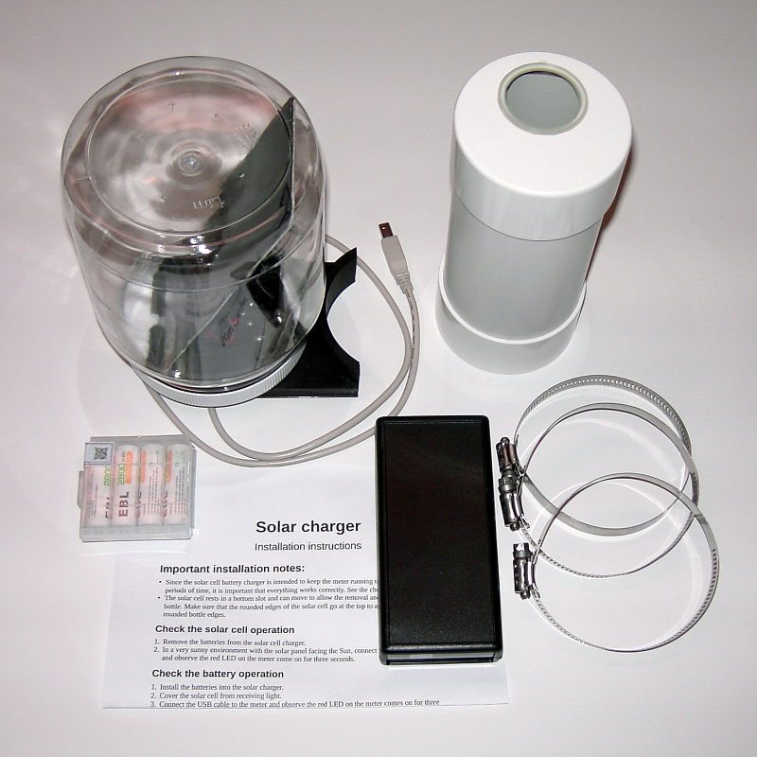
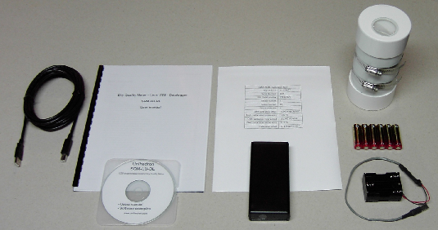
The Unihedron SQM
SQM – L (handheld): $ 100
SQM-LU-DL: $250
SQM-LU-DL + Housing: $290
SQM-LU-DL + Housing + Solar powered batteries: $370

Slide 27
The Missouri SQM Program https://www.darkskymissouri.org/programs/sqm-program
Citizen science,
Work with officials to reduce light pollution
Energy savings and benefits to tourism
Data collected from various locations in the program will help TSU researchers study the relationship between weather and Sky Brightness, and
Measure the changes in light pollution over time.

Slide 28
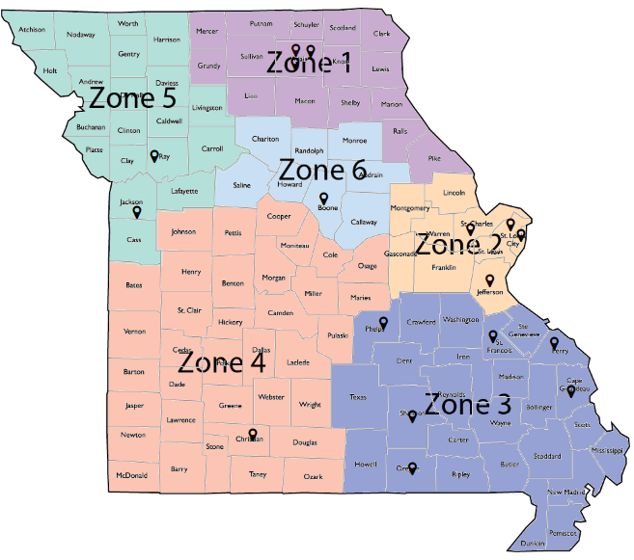
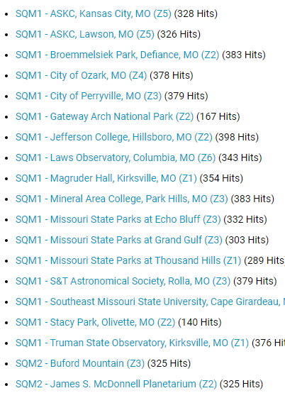
The Missouri SQM Program
More sites needed in Zone 4 and Zone 6

Slide 29
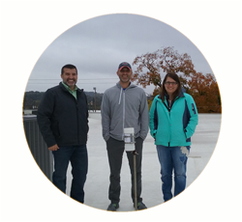
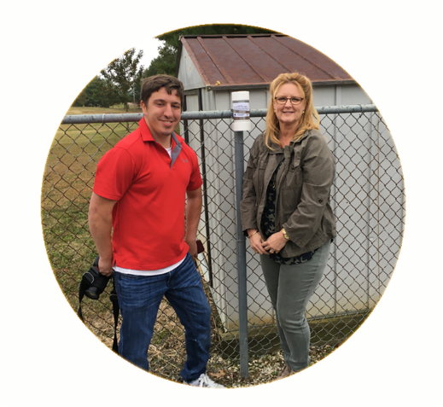
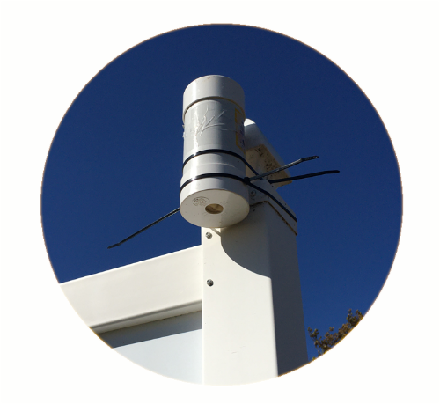
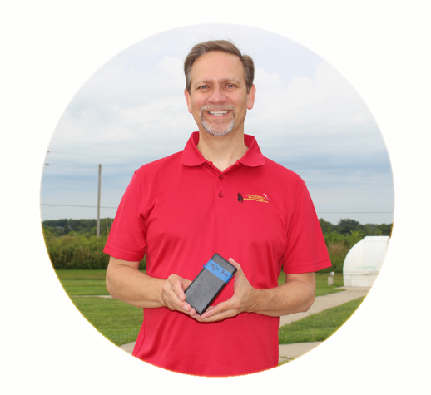
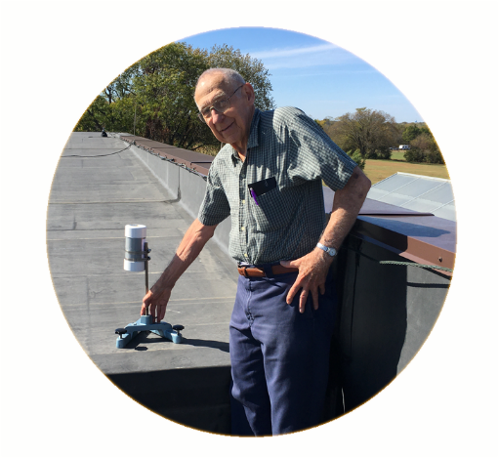
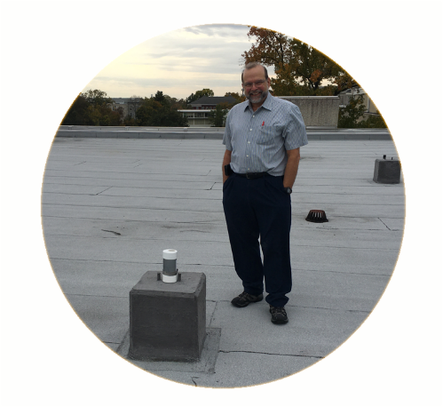
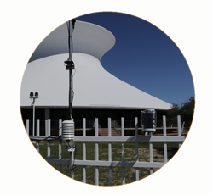
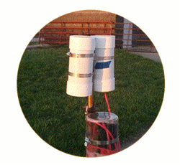
The Missouri SQM Program
Ozark
Perryville
Jefferson College
B-park
Mineral Area College
SEMO
STL Science Center
TSO

Slide 30
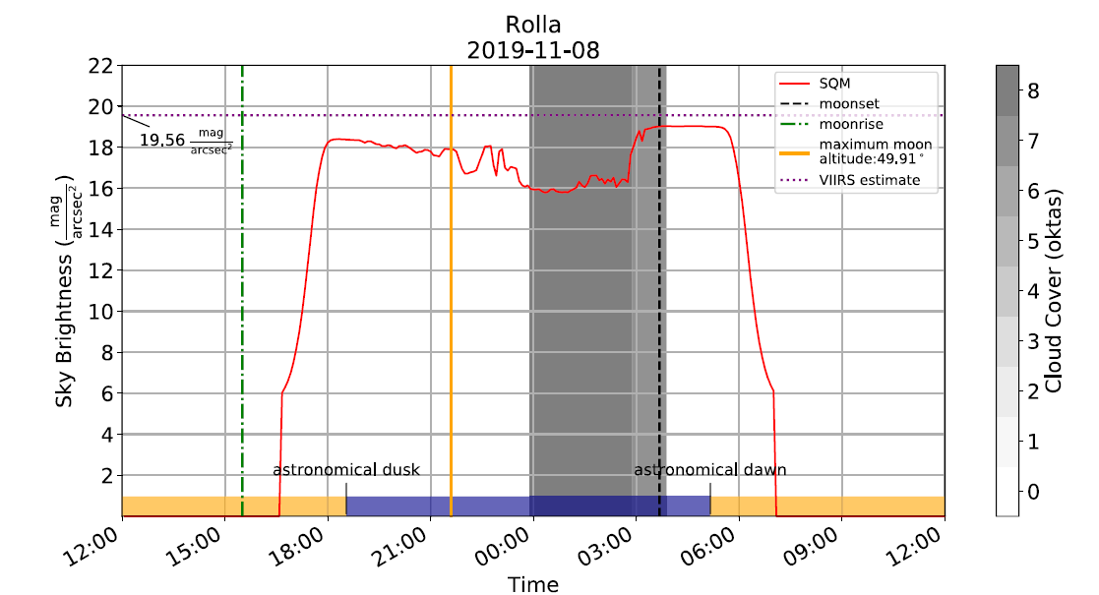
Results: Example
How do local weather conditions affect the sky brightness measurements at a given location?
Brighter
Darker

Slide 31
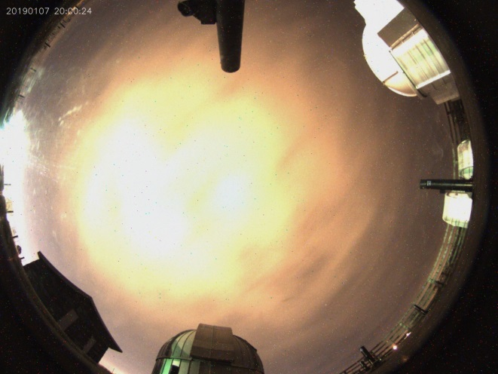
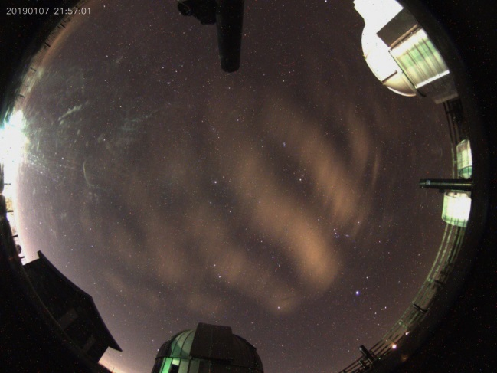
SQM and All-Sky-Cam: Kirksville
10:00 PM
3:00 AM
8:00 PM
Darker
Brighter

Slide 32
Results: Summary
Brighter
Darker
Whilst these analyses are useful, it would be great to have directional information and pictures to see where the clouds are, where the glare is and so on. That is, we need an: All-Sky-Camera Network!

Slide 33
The Adler Planetarium’s “Go-Net” All-Sky-Camera & TESS Photometer
$200, self-constructed
$500, “black box”
Goals:
Generate a sky-brightness map of the entire sky
Complement the SQM network to get directional info

Slide 34
Summary
Most obvious and measurable symptom of LP is skyglow: Skyglow affects close to 80% of all people on the planet, and about 99% of US/European peoples.
You can help quantify light pollution via the GaN program and/or the Missouri SQM program.
Most of the quantifying methods we have seen measure skyglow: how much light is finding its way into the night sky?

Slide 35
Summary
Glare affects most of us, most commonly in the context of vehicle head-lights and/or bright LEDs mounted sideways on walls and/or Electronic Billboards
LED lights, due to greater directionality, cause greater glare.
Harder to quantify the effects of glare in terms of color, and its effects on “recovery time” of eyes.
Severity of glare is related largely to the dosage (how bright?).

Slide 36
Summary
Light Pollution is an increasing problem – urban sprawl and the increasing use of “inexpensive” LED lights is expected to make the problem worse.
“inexpensive” is doing a lot of heavy-lifting here
The inability to see stars is a symptom of the problem.
The real problem is the harm done to the ecological health, and the negative impact of LP on birds, pollinators, insects, and humans.

Slide 37
QUIZ! Identify Features in the Night Sky

Slide 38
The Astronomer wonders…
What is the purpose of outdoor lighting?
Why is the cloudless daytime sky blue?
Why is the night sky (supposed to be) dark? [Olbers’ Paradox]
Where is Everyone? [The Fermi Paradox]

Slide 39
Discussion Forum
Pushback against LED lights: -- What is the true cost of LED lighting?
We need different (better?) ways of measuring and talking about light pollution?
Current methods are essentially: “Oh, we cannot see the stars as clearly anymore!”, i.e. Light Pollution is “only” about astronomy
Communicating science to administrators
Communicating science to general public

Slide 40
Observatory.truman.edu
Background and Perspective
Quantifying Light Pollution
An Astronomer’s perspective on value of dark sky
gokhale@truman.edu

Slide 41
Additional Slides

Slide 42
Purpose of Outdoor Lighting
Enhance safety for people,
Improve security for property,
Aesthetic value,
Economic development.
Common Applications
Roadway and street lights,
Parking lots,
Sports fields,
Housing complexes,
Residential,
Downtown areas,
Malls and shops,
Gas stations & car dealerships,
Parks,
Electronic Billboards, etc.

Slide 43
Campus Inventory
Compiled from student maps from Fall 2020, Fall 2021, and Summer 2021
265 total “globe lights” (there are at least a few more, for example, around Barnett etc.
Almost half are now CCT ~3000 K
About half have “dark sky reflectors”
Moving forward, the “Dark Sky Group” will work on double-checking and updating map
https://www.google.com/maps/d/edit?mid=1JFndVU4Acxbr5F1OCiXkvsTO5qVJ1S1J&usp=sharing

Slide 44
Research Question
How do local weather conditions affect the sky brightness measurements at a given location?
Weather conditions: Cloud Cover, Humidity, Aerosol content, Wind/Dust etc.
Sky Brightness: A measure of light pollution, measured by SQMs and All-Sky-Cameras.
Location: Collect data and do analyses at several locations to minimize bias due to peculiarities at a specific location

Slide 45
Typical Sky Brightness Values
“Sky Brightness”: Measured in mag/arcsec², mcd/m² or lux

Slide 46
SQM and All-Sky-Cam: Kirksville
10:00 PM
3:00 AM
8:00 PM
Darker
Brighter

Slide 47
10:00 PM
12:30 AM
3:00 AM
Darker
Brighter

Slide 48
Results: Example
How do local weather conditions affect the sky brightness measurements at a given location?
Brighter
Darker

Slide 49
IDA-Missouri SQM Program: Comparison
Comparing sky brightness measurements at five different locations on the same night (26th December 2019). Note that at each location the sky brightness is the lowest (higher readings on y-axis) at the beginning of night, and has a rapid decline at different times during the night. The rapid decline corresponds to clouds spreading across Missouri on that particular night.

Slide 50
Research Question
How do local weather conditions affect the sky brightness measurements at a given location?
Weather conditions: Cloud Cover, Humidity, Aerosol content, Wind/Dust etc.
Sky Brightness: A measure of light pollution, measured by SQMs and All-Sky-Cameras.
Location: Collect data and do analyses at several locations to minimize bias due to peculiarities at a specific location

Slide 51
IDA-Missouri SQM Program: Comparison
Comparing sky brightness measurements at five different locations on the same night (26th December 2019). Note that at each location the sky brightness is the lowest (higher readings on y-axis) at the beginning of night, and has a rapid decline at different times during the night. The rapid decline corresponds to clouds spreading across Missouri on that particular night.

Slide 52
Results: Variations in Sky Brightness
Plot illustrating the spread of the Sky Brightness on the overcast vs. clear nights for each location from November 1st 2019 - November 30th 2020.
The solid lines show the middle 68 % of the data, while the dotted lines show the middle 95%.

Slide 53
Results: Seasonal Variations

Slide 54
“Satellight” Pollution
"But that homie's already dead,
he just doesn't know it yet"

Slide 55
“Satellight” Pollution is an existential threat to recreational and professional astronomy

Slide 56
Artificial Satellites: Outlook

Slide 57
Artificial Satellites: Outlook
Current and planned satellite launches are approaching 100,000.
Table on right shows number of stars visible from Earth as a function of magnitude.
Most people live in light polluted areas, where limiting magnitude is about 3 or lower.
In less than 5 years, most people will be able to see more artificial satellites in the sky than stars!

Slide 58
Artificial Satellites: Outlook

Slide 59
Artificial Satellites: History
Simulated instantaneous distribution of Starlink satellites. The constellation is dense up to about 53° latitude with a smaller number of satellites at higher latitudes (McDowell ApJ 892:L36).

Slide 60
Starlink Satellite Simulations: ~ 12,000 satellites

Slide 61
Estimates for ~ 42,000 satellites

